Slide 1
Occultation phenomena Current standards and latest news 2018/2019
XXIX SOPiZ PTMA Conference (40-th Anniversary) April 27-28th, 2019 - Warsaw
Wojciech Burzyński, M. Eng.

Slide 2
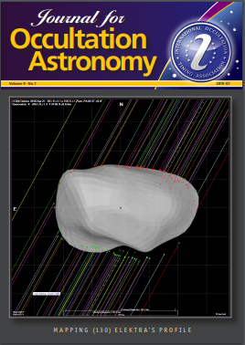
Journal of Occultation Astronomy (JOA)
On February 18, 2019, IOTA, IOTA / ES and RASNZ made a joint decision that all JOA numbers should be available as PDF files for every interested person at no cost.
Until now, only observers associated in IOTA, IOTA/ES or RASZN, paying the annual membership fee in these organizations, had full access to several of the latest JOA numbers through the website login system.
All JOA numbers are now available as PDF files on the IOTA/ES website:
http://iota-es.de/joafree.html
Archival issues of the Occultation Newsletter (ON) from 1974-2009, which were later transformed into the JOA, still are present on the main page of IOTA:
http://occultations.org/pub/newsletters/

Slide 3
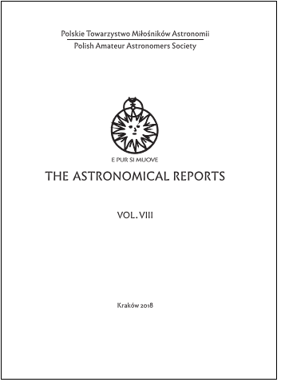
The Astronomical Reports
From 2018, occultation observations results made by SOPiZ members are also published in English in the scientific bulletin of PTMA - "The Astronomical Reports”
This bulletin was issued in years 1974 - 1981 (6 issues) and reactivated in 2015 by Tomasz Ściężor, EngD.
SOPiZ observation results for 2017 - The Astronomical Reports vol. VIII
Results for 2018 in print now.

Slide 4
Presence at occultation conferences
Solar Eclipse Conference , SEC 2018
2-5 VIII Genk (Gandawa), Belgia M. Zawilski - „The catalog of the historical observations of solar eclipses for Europe and the Near East
SEC 2018 main website: http://www.rvonline.be/sec2018/index.php
M. Zawilski’s lecture:
http://www.rvonline.be/sec2018/assets/downloads/Sunday/09_MarekZawilski.pdf﻿
Participants lectures on You Tube:
https://www.youtube.com/channel/UCR5BMAN7NHiccUc_P1iM_YA

Slide 5
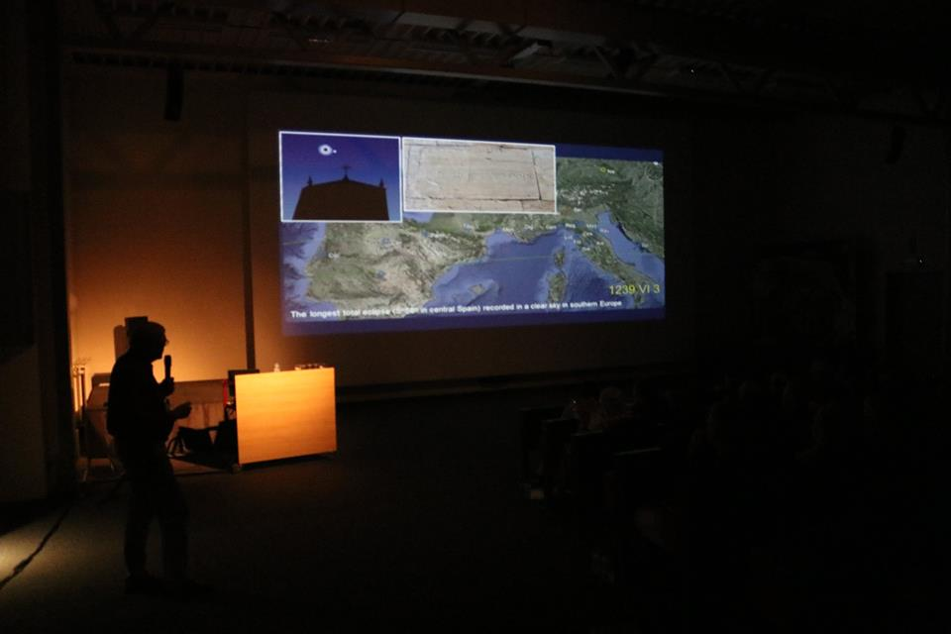
Solar Eclipse Conference , SEC 2018
M. Zawilski - „The catalog of the historical observations of solar eclipses for Europe and the Near East

Slide 6
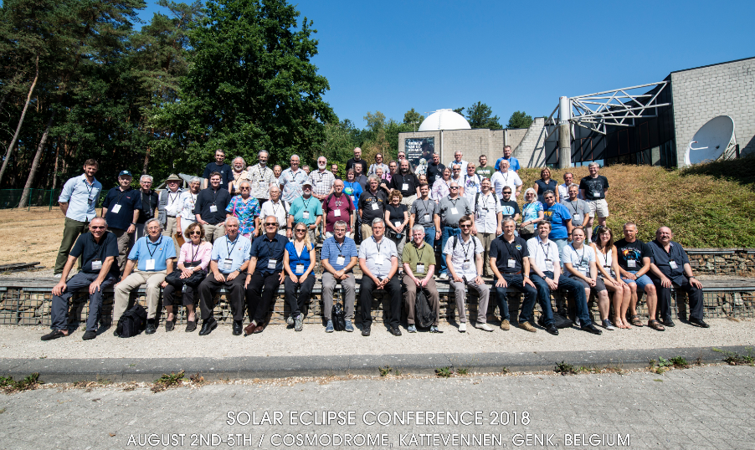
Solar Eclipse Conference 2018, 2-5 VIII 2018

Slide 7
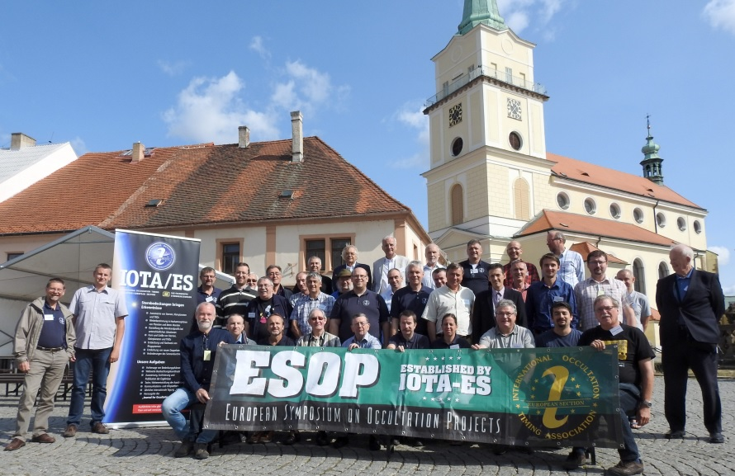
37-th European Symposium on Occultation Projects (ESOP) 24-29 VIII 2018 – Rokycany near Pilsen, Czech Republic

Slide 8
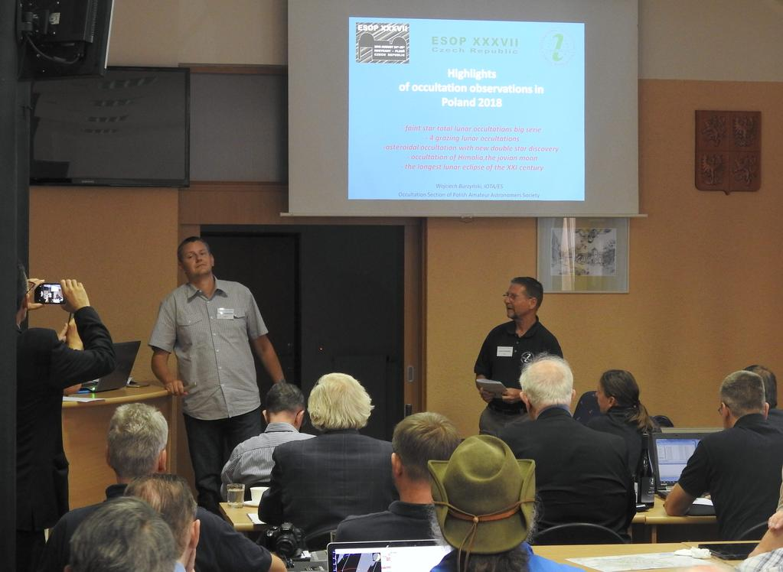
37-th European Symposium on Occultation Projects (ESOP) W. Burzyński - „Highlights of occultation observations in Poland 2018”

Slide 9
European Planetary Science Congress 2018 16-21 IX 2018 – Technische Universität Berlin, Germany G. Murawski - „ Use of CMOS cameras in exoplanet transit photometry”

Slide 10
On-line occultation conferences participation THIRTEENTH TRANS-TASMAN SYMPOSIUM ON OCCULTATIONS New Plymouth, New Zealand 2019 May 20 & 21
The entire TTSO13 meeting will be webcast using MeetCheap. The webcast will commence 10 minutes prior to the start of each day's programme as detailed below. Free to join or depart at any time.
Login to MeetCheap: http://login.myownmeeting.com/conference,60602806
IOTA 37th Annual Meeting - September 21, 2019
Camp Oakes, near Big Bear, California, USA.
The meeting will be during the Riverside Telescope Makers' Conference, which is now called the RTMC Astronomy Expo, at that site. NO WEBCAST THIS YEAR ☹

Slide 11
GPS system rollover
When the system was designed in the 1970s, it was decided to store weeks number in a 10-bit format, which allows storing 1024 values ​​(from 0 to 1023) - this is a time interval of 19.7 years. On the night of 6/7 April 2019, there was a "rollover" counter, which may cause some older receivers to operate.
The error related to the GPS rollover may come out even many years after April 6, 2019. After the first such episode (1999), the bugs associated with it were recorded even in 2017!
It is worth adding that the new and modernized GPS signals will no longer be affected by this problem. Ultimately, the weeks will be counted in a 13-bit system, which in practice will solve the GPS rollover problem.
The materials published on the GPS.gov website show that even if our receiver is not ready for GPS rollover, it should not affect the positioning. At least not directly. However, errors may appear in a related timestamp.

Slide 12
GPS system rollover
However, there were problems with some older analogue VTI’s.
KIWI-OSD (prototype X 2002, produced in 2005-2009) which was connected to the Garmin 18x LVC receiver. The problem was not present with the Garmin 18 LVC connected. The KIWI-OSD Inserter displayed the date of 26-08-2099 and accelerated time by 4 seconds
GPSBOXSPRITE2 (BlackBoxCamera) - correct time but wrong date (shifted -1024 weeks)
TIM 10 - inserter displayed the date of 26-08-2099
STV Astro - UNABLE to VIDEO OUTPUT!
IOTA VTI v.3.2 with the GlobalTop PA6H GPS module - no problem
IOTA VTI v.2 with US GlobalSAT EM406a GPS module - no problem
GPSBOXSPRITE3-U (BlackBoxCamera) with U-blox GPS module - no problem
Tomasz Tech SMART OSD INSERTER - no problem
Telescopes equipped with older GPS modules have also been tested by observers:
Meade LX 2000, younger than 2011 - no problem

Slide 13
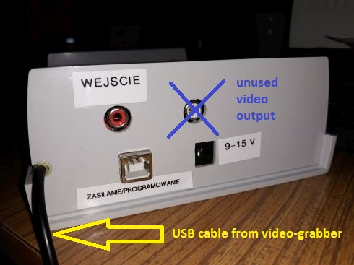
Another copy of „smopi VTI”
Modification: built-in video-grabber Made by: Witold Piskorz, Cracow (unofficially presented at SOPiZ Conference in 2018)

Slide 14
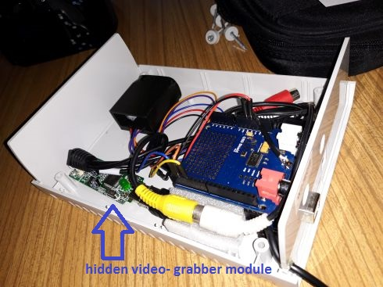
Another copy of „smopi VTI”
Original „smopiVTI” project: http://smopi.news.nstrefa.pl
Witold Piskorz Cracow, 2018

Slide 15
Digital Video Time Inserter
The idea was unofficially presented in the so-called backstage in August 2018 during the XXXVII ESOP conference in Rokycany by Stefan Meisner from Switzerland.
The main constructor of the device is Andreas Schweizer.
Project assumptions:
- precise time signal taken from the integrated GPS receiver
- very sensitive monochrome CCD matrix
- price of the DVTI as low as possible (up to 500 CHF with 100 pieces ???)
- start fundraising in the Kickstarter platform even in 2019
/Kickstarter - an English-language crowdfunding website where fundraisers are carried out to finance various projects/
On XXXVII ESOP the 1st step (proof-of-concept) of the project was unoficially presented. It was a modification of the popular unexpensive CMOS camera - ASI120MM by adding a designed electronics board with a build-in GPS receiver.
Thanks to this, it is possible to insert precise time taken from the GPS into a digital image.

Slide 16
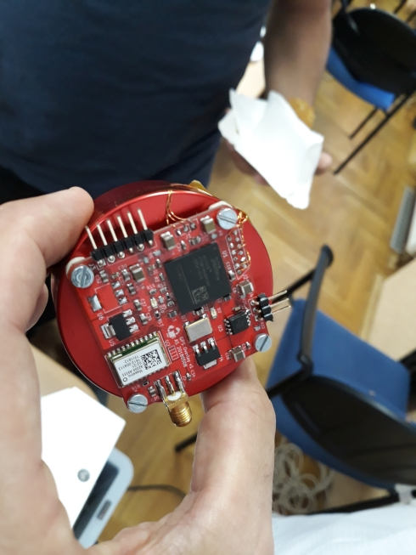
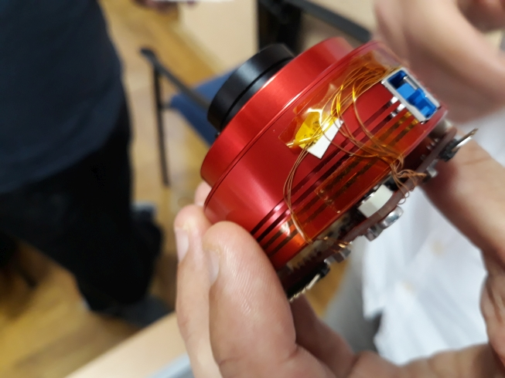
Digital Video Time Inserter
Proof-of-concept modified ASI120MM

Slide 17
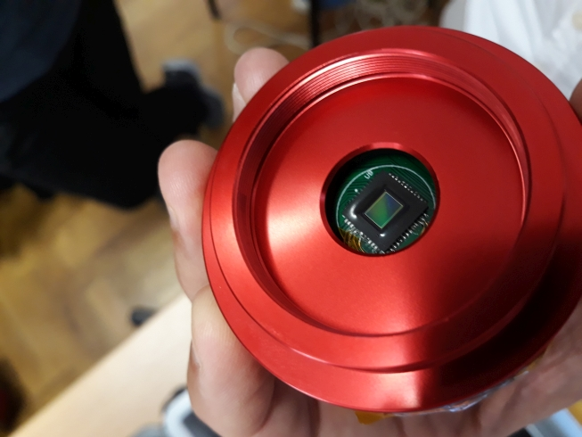
Digital Video Time Inserter

Slide 18
Digital Video Time Inserter
Website of project - https://groups.io/g/d-vti-cam
Prototype Version 1 (standalone camera, Semi AR0130CSSM sensor) - completed
Firmware development and testing for prototype version 1 - ongoing
provide an ASCOM video driver for the camera on the host side
save SER and ADV files, the latter with GPS timestamps in the metadata.
the control tool should be extended to support 16-bit ADV recording, histogram, dark frame subtraction
Prototyp Version 2 (standalone camera, based on experience with ver. 1) - onging
Prototype V2 will be implemented in 2 phases because it contains a large number of new components (USB-C, microSD, new GPS module, RAM, new FPGA, RF switch…) Phase 1 - bigger PCB with all components in place for easier debugging. Phase 2 - the design will be adjusted and condensed. Firmware development and testing for prototype version 2 - not started
Release candidate - not started
Kickstarter campain - not started

Slide 19
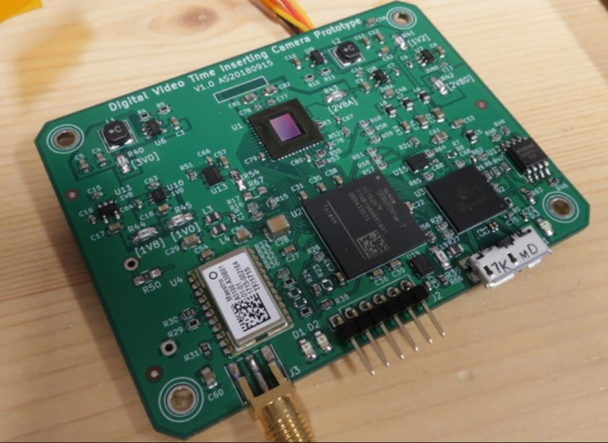
Digital Video Time Inserter
The prototype V1, PCB board – photo by Stefan Meister

Slide 20
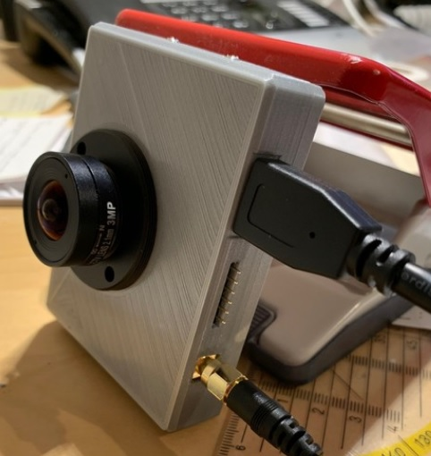
Digital Video Time Inserter
The prototype V1, housing - photo by Stefan Meister

Slide 21
Digital Video Time Inserter – 2nd prototype
The 2nd prototype will have the following attributes:
cylindrical form factor, 2 inch diameter, length about 90mm, M42x0.75 connection
separate PCB for the sensor
test bigger sensors (IMX178, IMX174, IMX428)
use GPS module with integrated antenna
generic input, 1PPS output, 1PPS+UART input
precise crystal, e.g. LFTVXO070168
calibrate the crystal with the GPS signal, save the calibration in the PROM
USB C connector
microSD card for in-camera recording
onboard RAM for frame buffer, dark subtract, picture-in-picture
TIME STAMP : Date / Start time of the frame in UTC with millisecond accurancy / End time of the frame / frame number/ position accuracy in meters, GPS coordinates and satellite no.
with SNR level of the received signal (shown in a small filled bar).

Slide 22
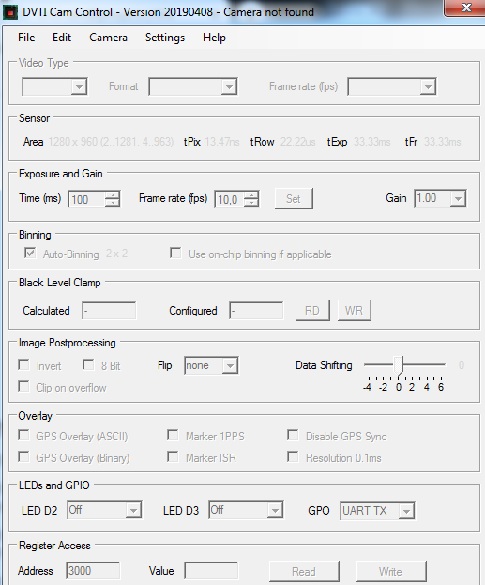
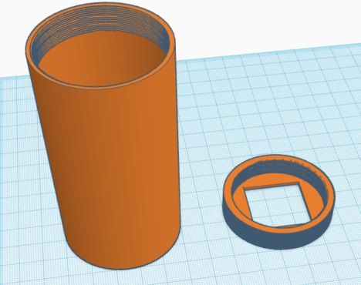
Digital Video Time Inserter – firmware
Design of the 2-nd prototype
Camera control software

Slide 23
Astrometric catalogs – the Gaia DR2 for Guide 9 and Cartes du Ciel planetarium type software
From June 2018, Jost Jahn from Germany creates a catalog of stars with Gaia DR2 data, which will be read by Guide 9. Current sets have been prepared for the moment:
simple SPL - accuracy 1 ", number of stars: 1.026.562.268, size 16.4 GB
STD standard - accuracy 0.04 ", number of stars: 1,692,901.510, size 76 GB, proper motions with an accuracy of 0.001 ", brightness with an accuracy of 0.01 mag
The target catalog have a precision of 0.0001 "(the average uncertainty of position measurement in the Gaia DR2 catalog). Catalog can be downloaded from the website: http://www.gaia2.de/catalog.html
On the same webpage there is a description (Michael Koch) what should be done to Guide 9 for only display the stars from the Gaia DR2 catalog. It is avoided in this way display of stars by data from the UCAC3, default Guide star catalog.
________________________________________________________________________
From June 11, 2018, the Gaia DR2 catalog can be used online or offline in the Cartes du Ciel (Skychart) software: https://www.ap-i.net/skychart/en/news/gaia_dr2

Slide 24
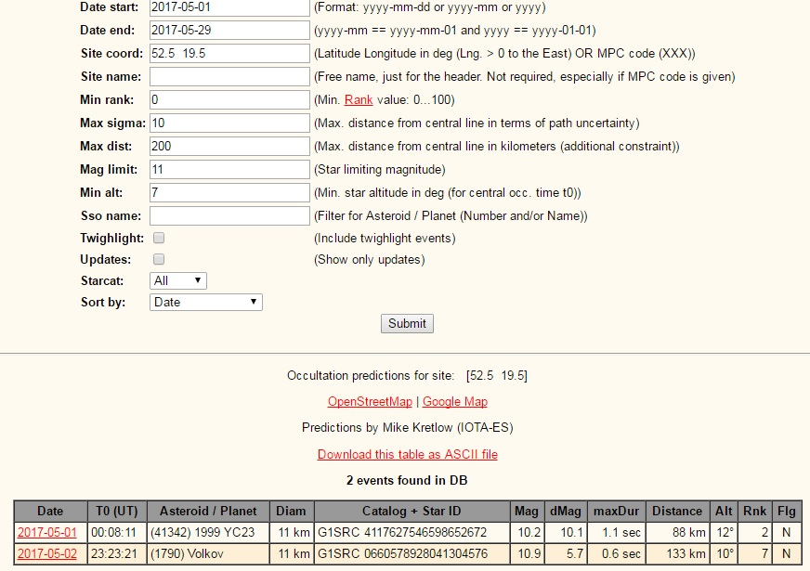
Mike Kretlow’s asteroidal occultations predictions
From February, 2019, Mike Kretlow ceased publication of asteroidal occultations predictions based on his own set of astrometric catalogs (GR1, HSOY, UCAC5) on his website. He recommended using a comprehensive observation planner - the Occult Watcher software.

Slide 25
EURASTER – new rules for the publication of asteroidal occultations results
On April 3, Eric Frappa announced new rules for publishing the results of asteroidal occultations observations due to rapidly growing number of reports.
Only the events with at least one POSITIVE observation will be published on Euraster website
Eric will still continue to archive „all” the full reports received.
Please continue to send all your NEGATIVE reports.
They could be important if a positive report appears for the same event.
The EURASTER webpage is far more readable now - we don't have to move through lots of negatives to check the successful events.

Slide 26
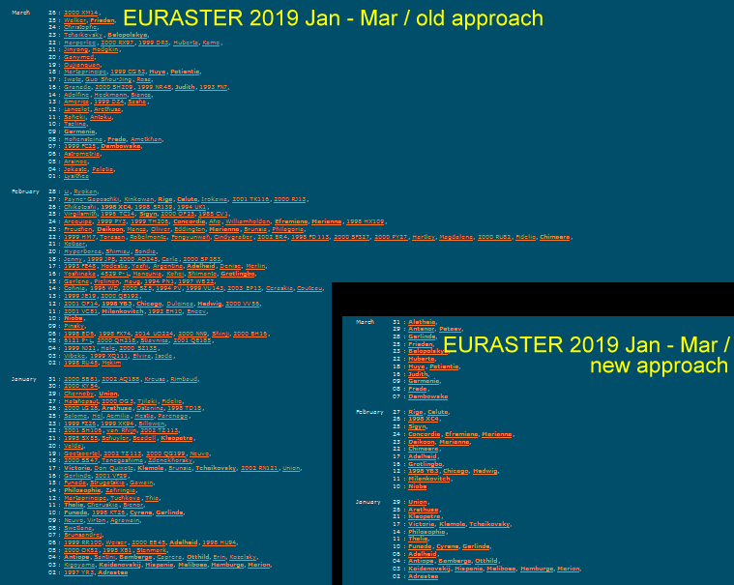
The EURASTER database – new appearance

Slide 27
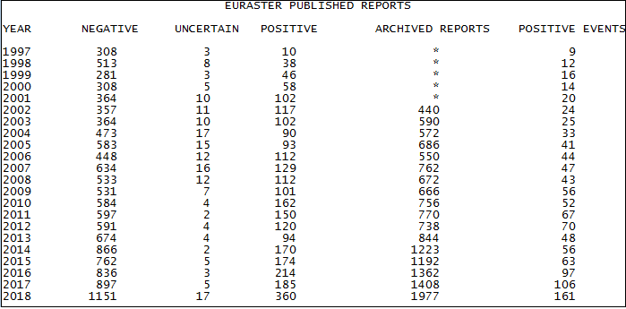
EURASTER database statistic: 1997-2018
Up to 2018, all clear positive and negative reports are published on the EURASTER except negative alone events with predicted max duration < 1s.
Check your name in Occult software (asteroid observations -> observations by an observer) to see the number of your observations that are really used (positive or negative).

Slide 28
„Occult” software – news and improvements
May 29, 2018 (ver. 4.5.7.2) - increasing positional accuracy of stars used to calculate asteroidal occultations predictions up to 0.00001 s in RA and 0.0001 "in DEC
May , 31 2018 (ver. 4.5.8.0) - asteroidal occultations predictions uses stars positions from the Gaia DR2 catalog by default
"GaiaDR2_14" - catalog of 30.1 mln stars to the brightness of 14.0 mag used in Occult
July 6,2018 (ver. 4.5.10.0) - end of software support for the reduction of moon's profile according to Watts' photographical atlas
November 1, 2018 (ver. 4.5.12.1) - asteroidal occultations light curves with a minimum duration of 0.8 seconds (previously 1 s) can be processed now by Occult
March 4, 2019 (ver. 4.6.5.0) - adding predictions for Jupiter's irregular moons, due to their occultation serie in 2019-2020 period

Slide 29
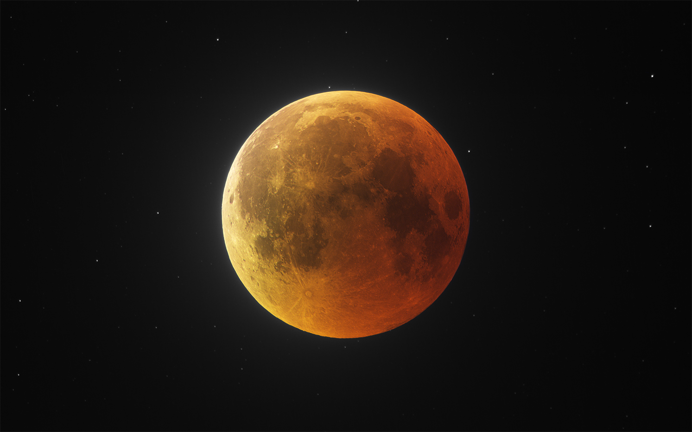
Total lunar eclipse – 27 VII 2018
The longest totality phase of lunar eclipse in the next 100 years – 1 h 43 m
Gabriel Murawski – Canon 4/300 mm telelens, ASI 178 MM-c CMOS camera, EQ5 mount

Slide 30
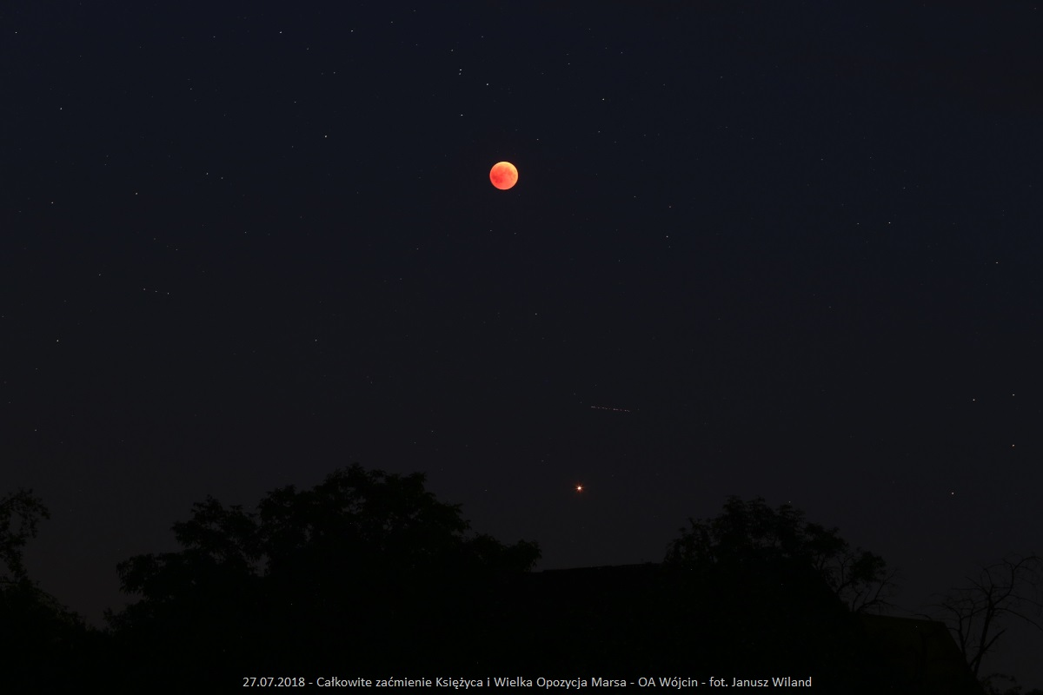
Total lunar eclipse – 27 VII 2018
… and Mars Opposition 2018 taken by Janusz Wiland

Slide 31
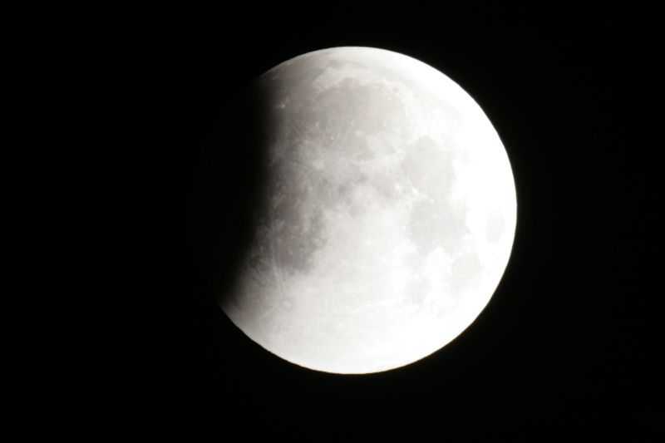
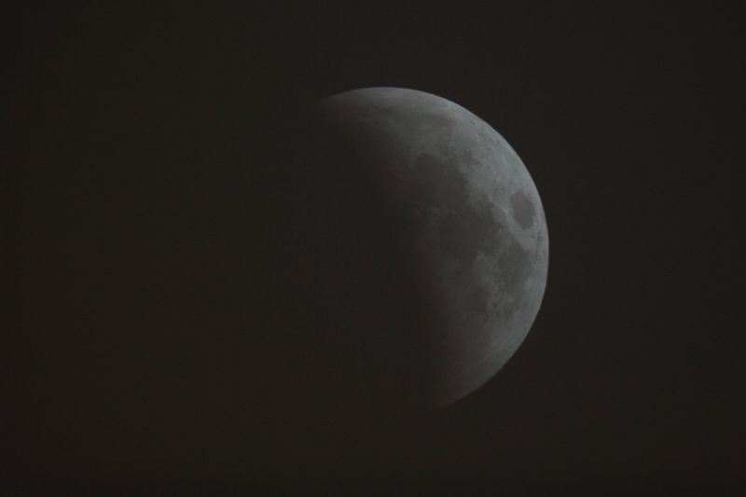
Total lunar eclipse – 21 I 2019
taken by Witold Piskorz
taken by Marcin Filipek

Slide 32
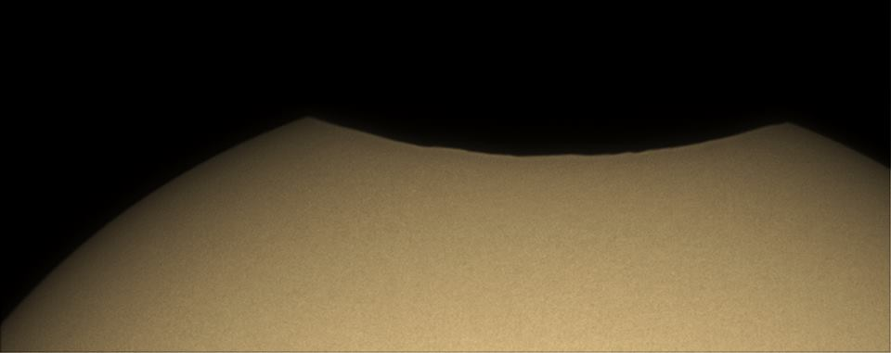
Partial solar eclipse – 11 VIII 2018 1.45 %, several mins. before maximum phase
Taken by Adam Nowak in Tallin, Estonia – ASI 178 MM-c CMOS monochrome camera with 400 mm f/6 telelens

Slide 33
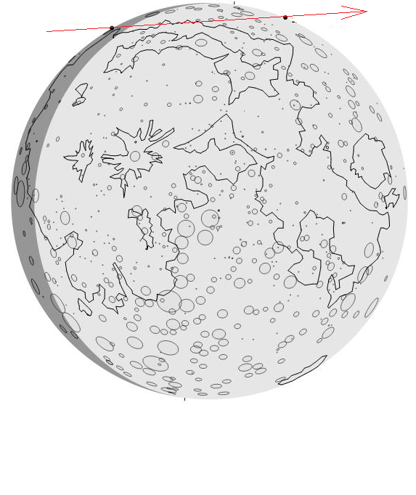
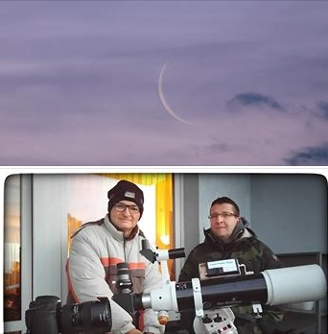
Saturn occultation by the Moon – 2 II 2019
Moon phase : - 6 %
Elongation: 28°
Moon altitude: 8 ° ... 12 °
Sun altitude: -3 ° ... +3 °
Observed visually by Janusz Wiland
and Tomasz Wężyk from
Piotrków Trybunalski – photo J. Wiland

Slide 34
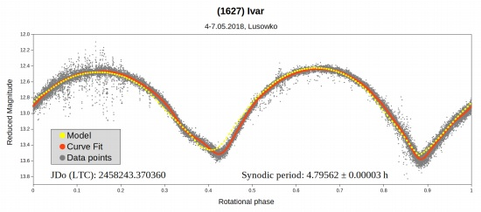
Asteroid astrometry and photometry
Tomasz Kluwak’s observations
Lusowko Platanus Observatory (near Poznan) – IAU code: K80
Poster on the European Planetary Science Congress 2018:
„Photometric observations of asteroids - in support of Gaia Mission”
http://www.astrosurf.com/delcroix/doc/EPSC2018/posters/4-Poster5.pdf

Slide 35
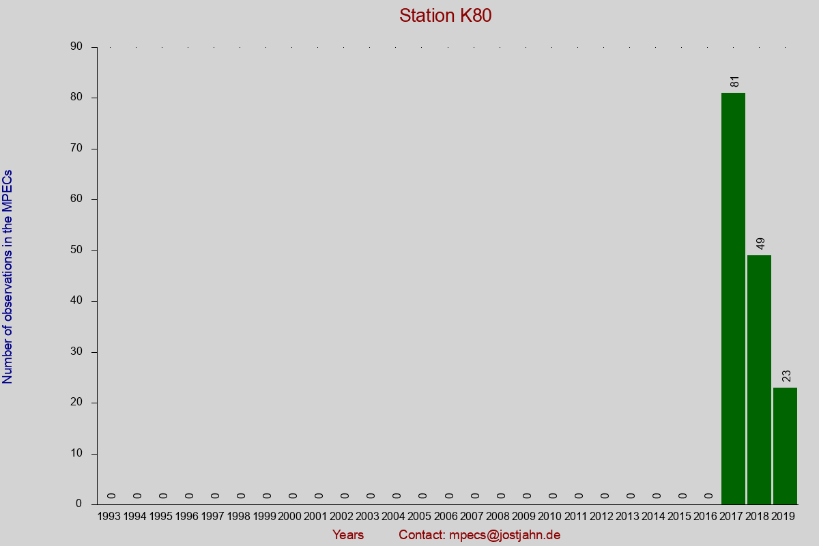
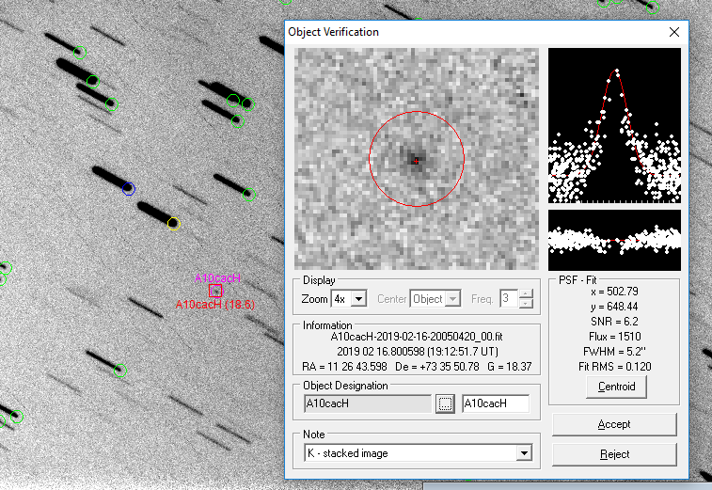
Asteroid astrometry and photometry
K80 OBSERVATORY STATISTIC: http://mpec.jostjahn.de/K80-stat.html

Slide 36
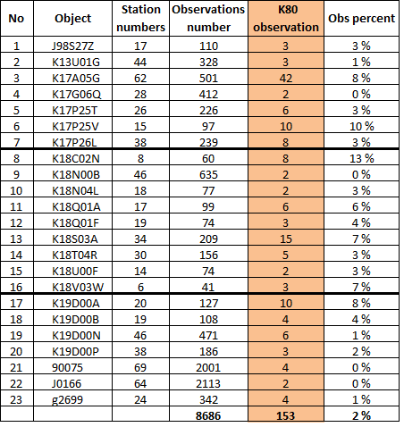
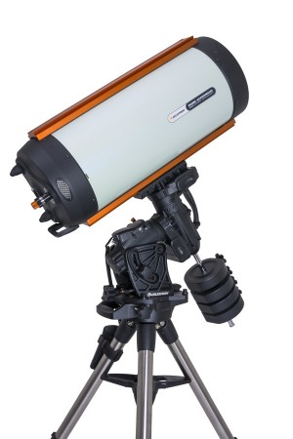
Asteroid astrometry and photometry
Tomasz Kluwak’s observations in 2017-2019 period

Slide 37
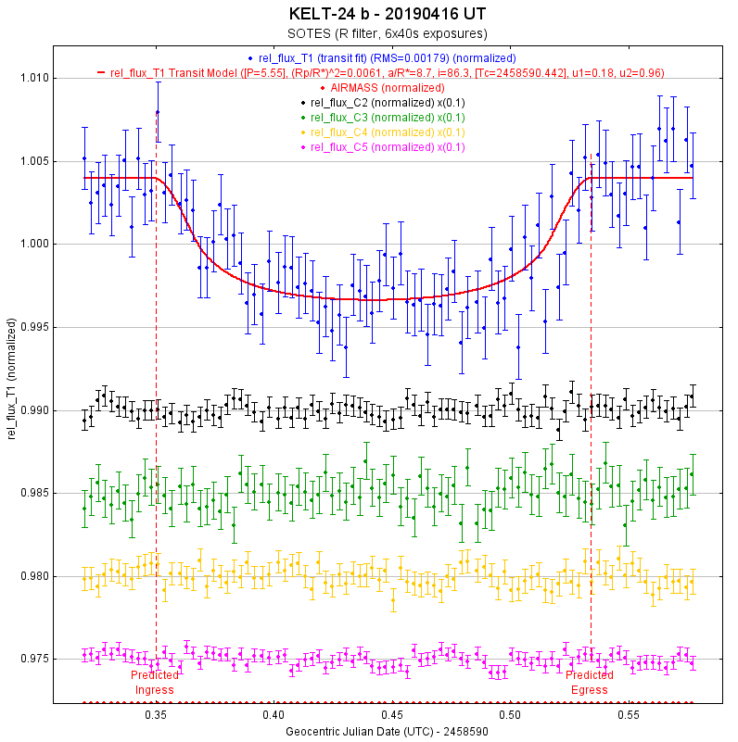
Exoplanets co-discoveries
KELT-24 b This is the third
co-discovered exoplanet by
Gabriel Murawski
magnitude drop: 0.007
Please follow at:
https://www.facebook.com/ObserwatoriumSOTES/

Slide 38
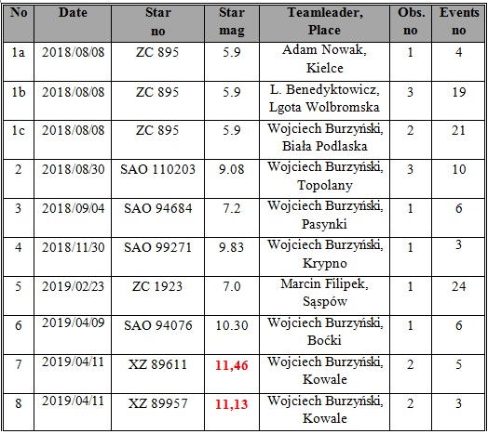
Lunar graze occultation observations 2018/19
POSITIVES

Slide 39
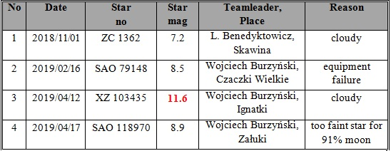
Lunar graze occultation observations 2018/19
NEGATIVES
In 2018, 7 out of 31 raported grazing lunar occultations were observed in Poland
In 2019 till today, all reported (4) grazing lunar occultations come from Poland !

Slide 40
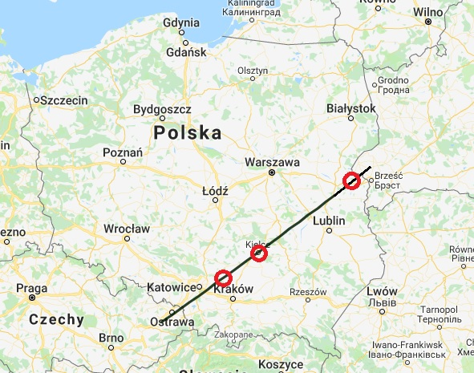
Lunar graze occultation results – ZC 895 (5.9 mag)
3 observation sites have been set – Biała Podlaska, Kielce, Wolbrom near Kraków

Slide 41
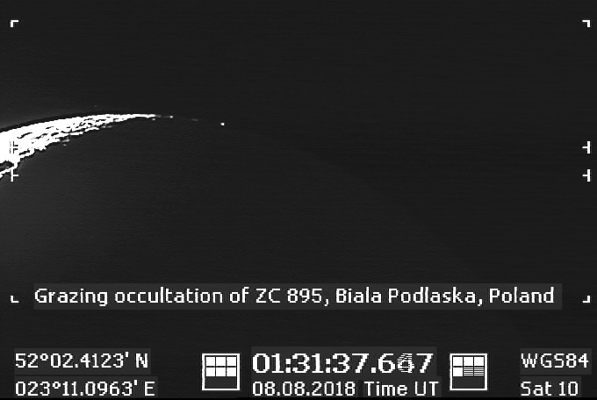
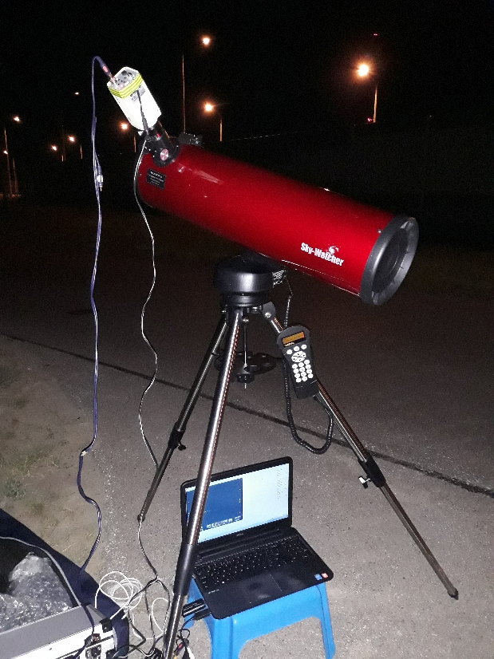
Lunar graze occultation results – ZC 895 (5.9 mag)
W. Burzyński’s observation site (Biała Podlaska) – 1 sec. before the event

Slide 42
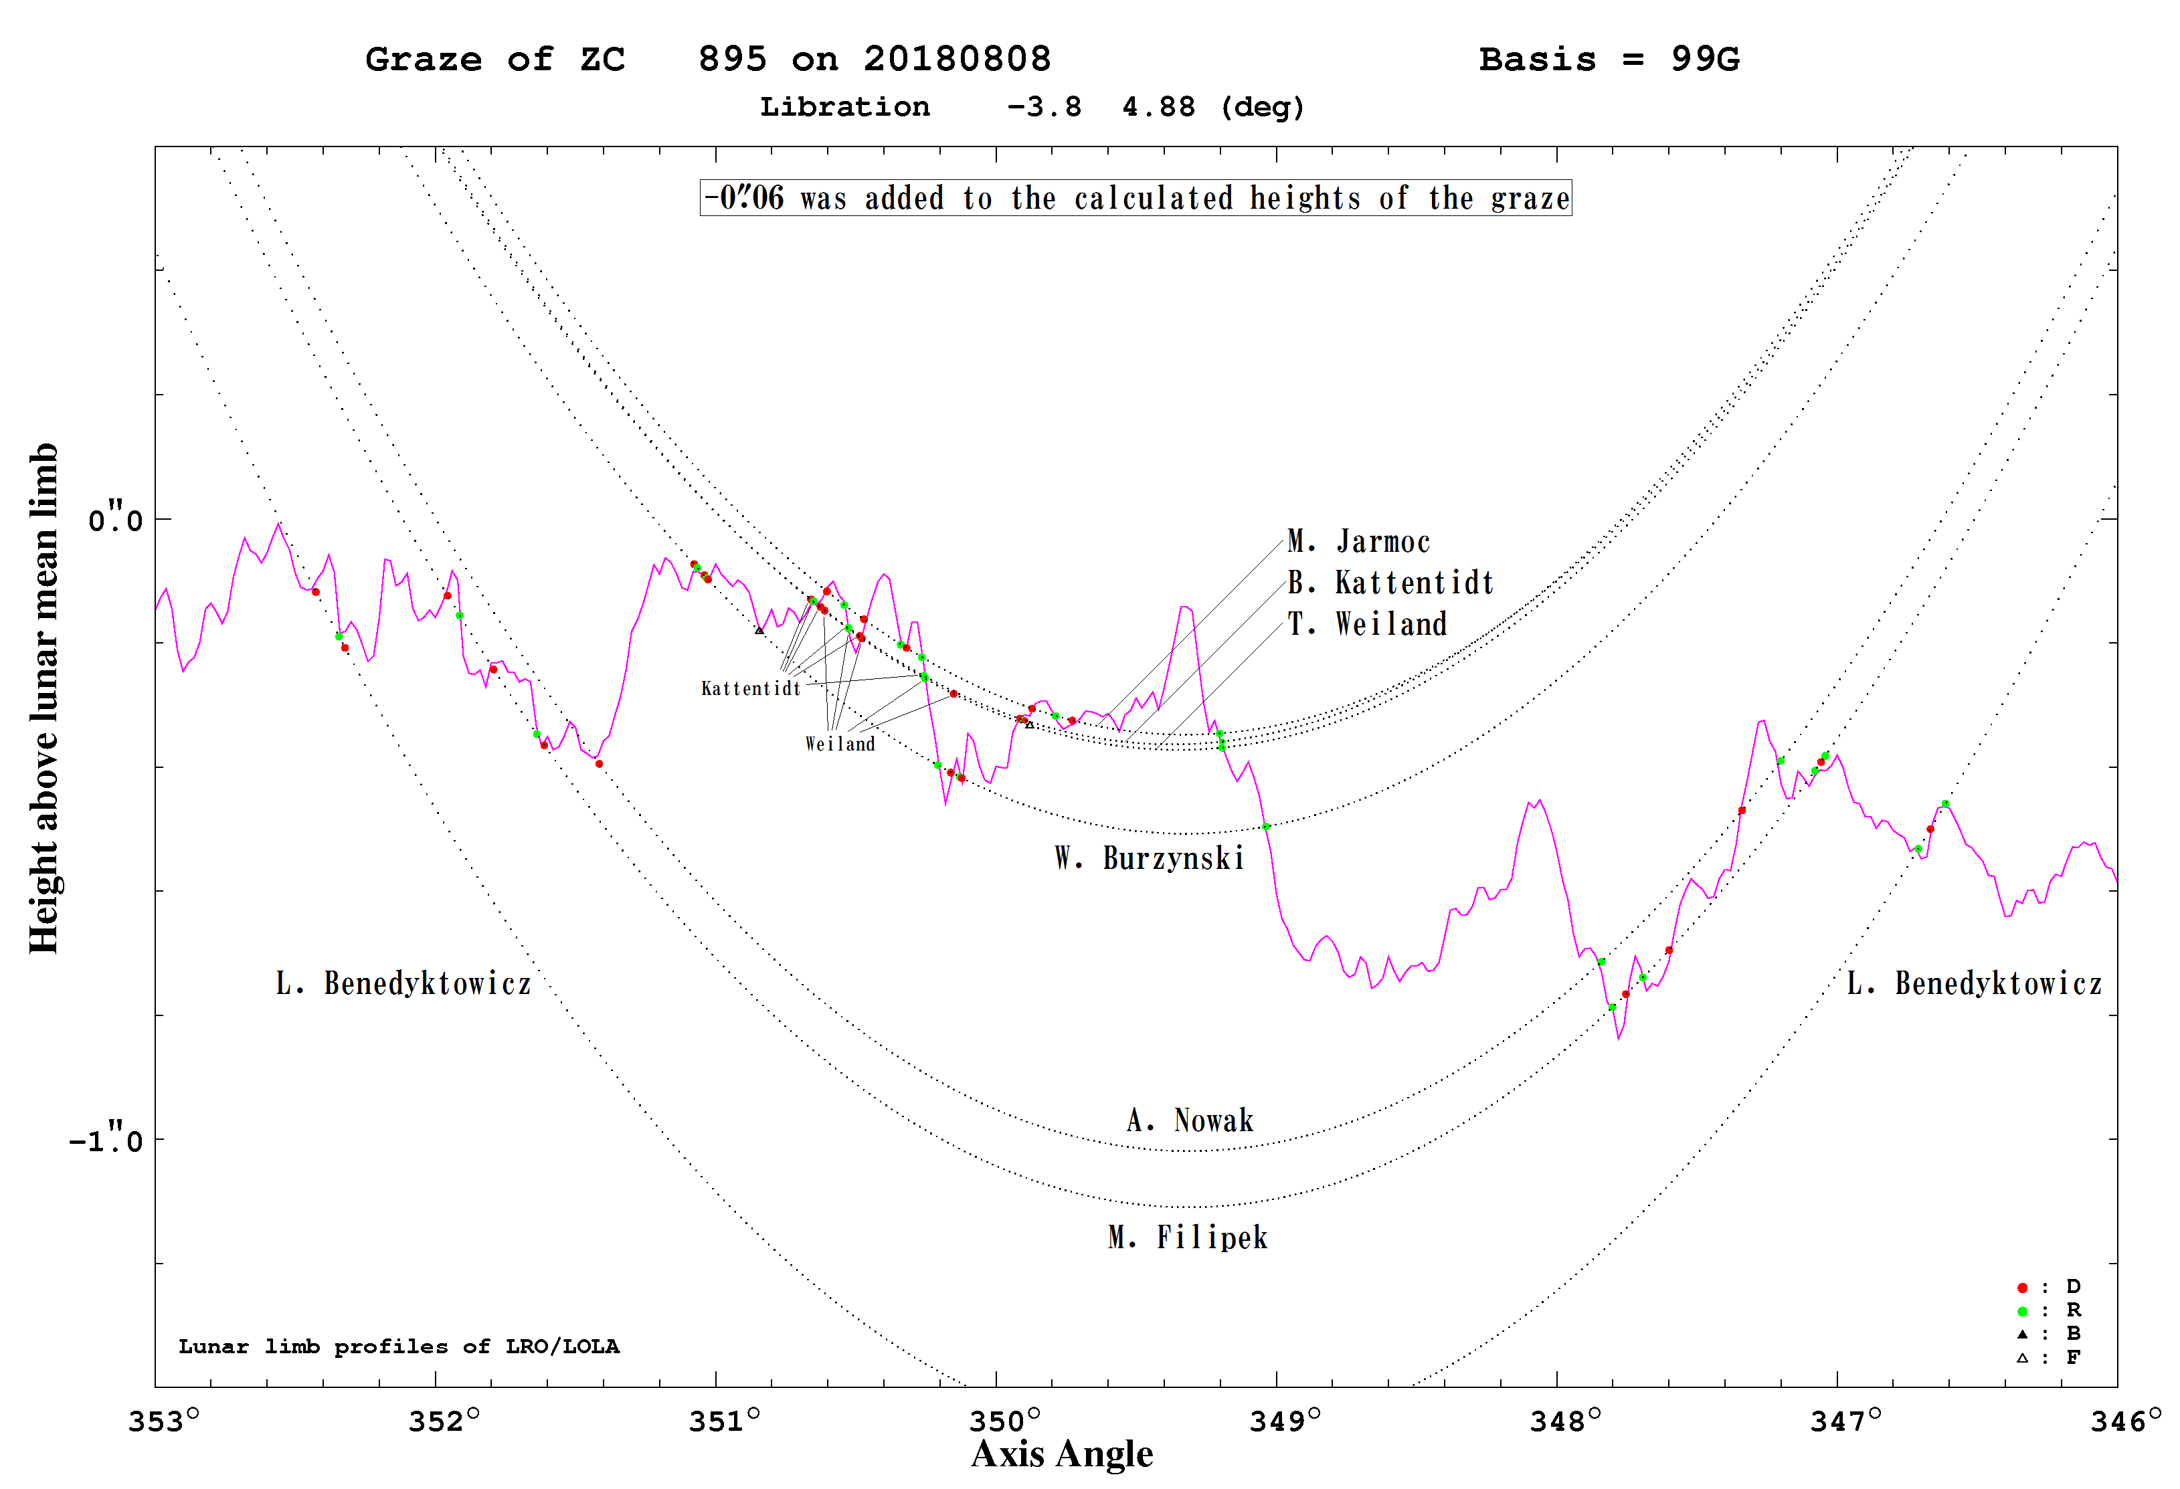
Lunar graze occultation results – ZC 895

Slide 43
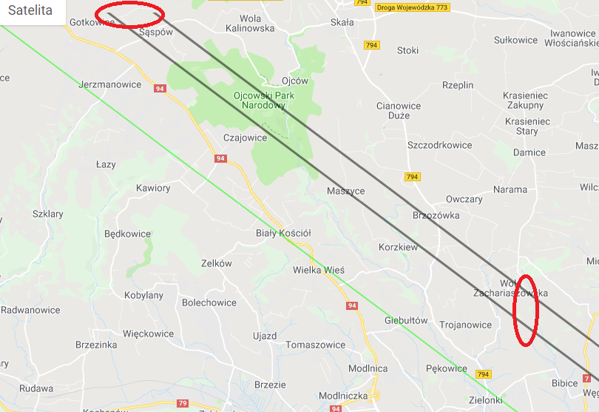
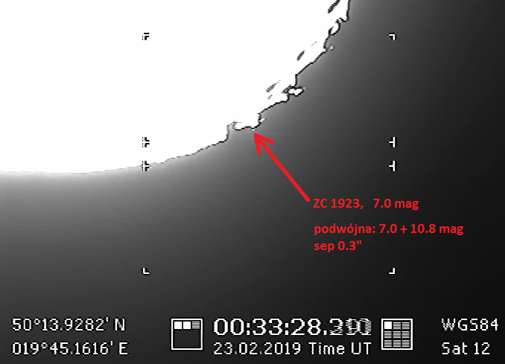
Lunar graze occultation results – ZC 1923
CA: 11.4 deg S

Slide 44
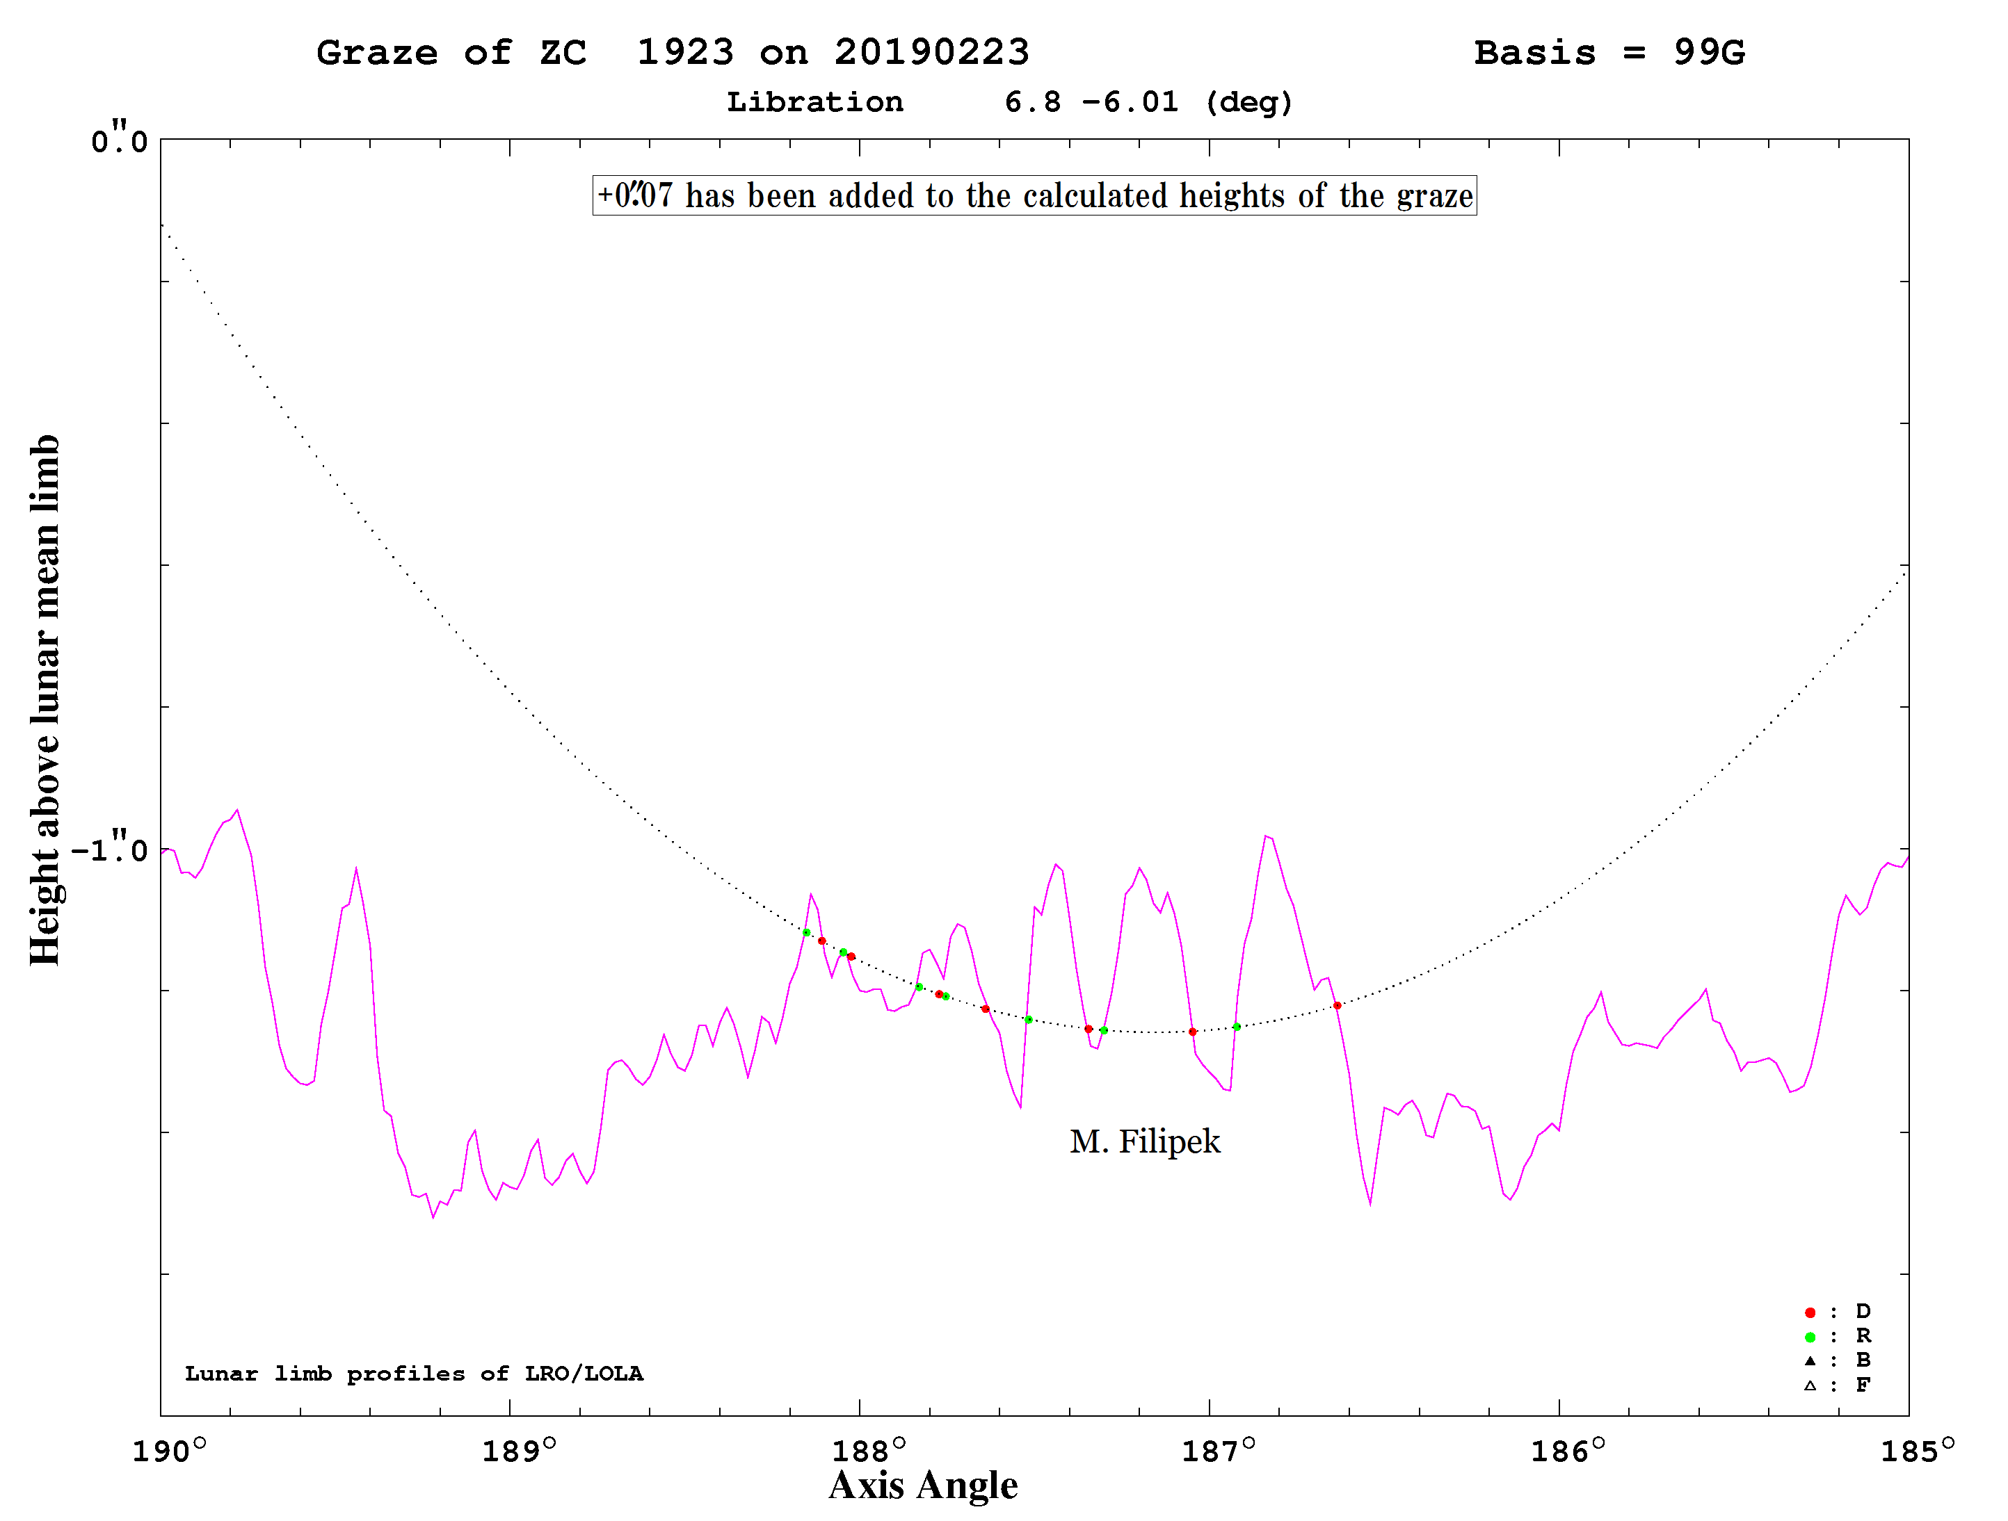
Lunar graze occultation results – ZC 1923

Slide 45
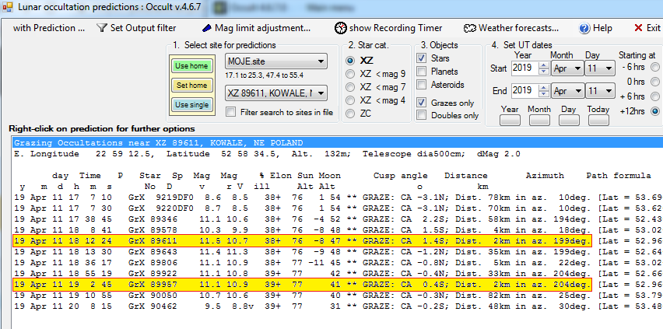
Graze of XZ 89611 – the faintest world graze ?
Occult’s settings :
set maximal allowed telescope diameter (500 cm)
set dMag correction factor as „+2”
set chosen searchin radius, e.g. 50 km

Slide 46
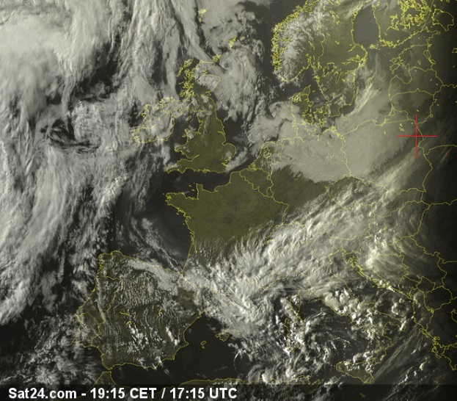
Graze of XZ 89611 – the faintest world graze ?

Slide 47
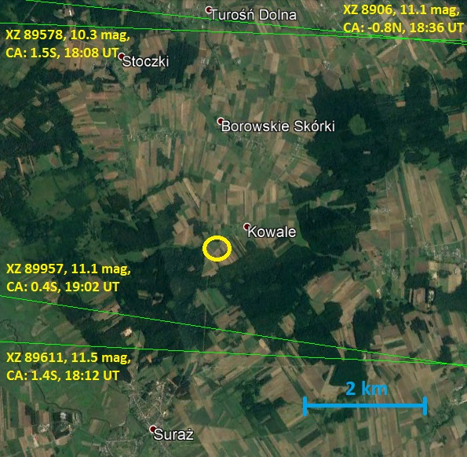
Graze of XZ 89611 – the faintest world graze ?

Slide 48
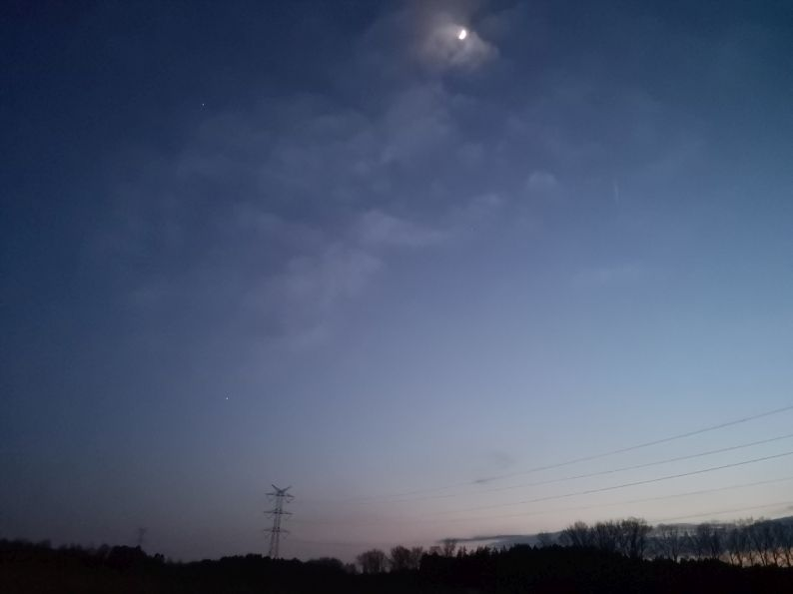
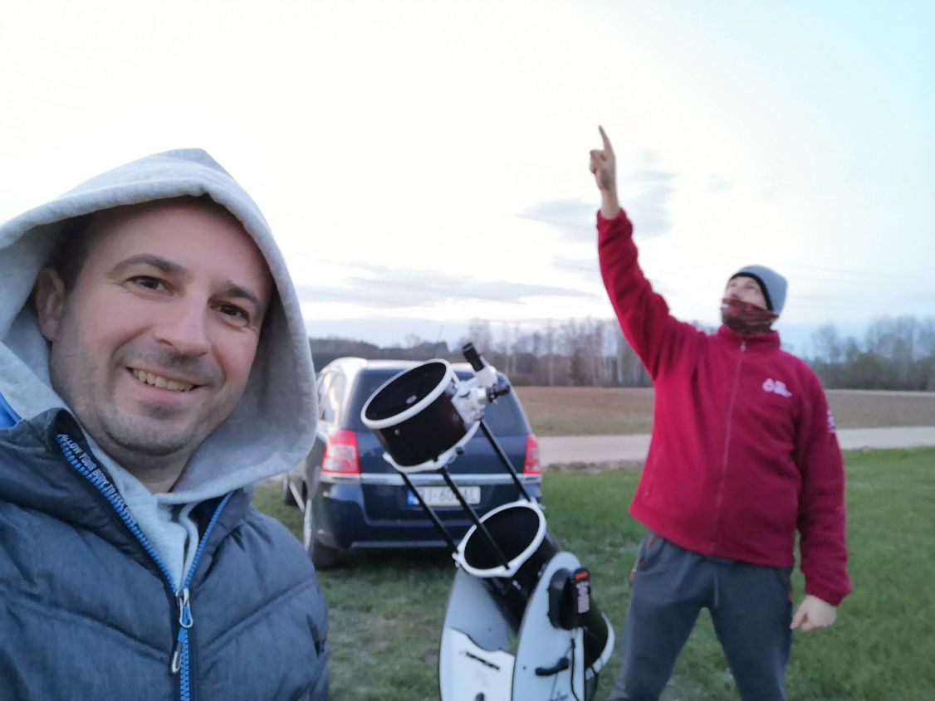
Graze of XZ 89611 – the faintest world graze ?

Slide 49
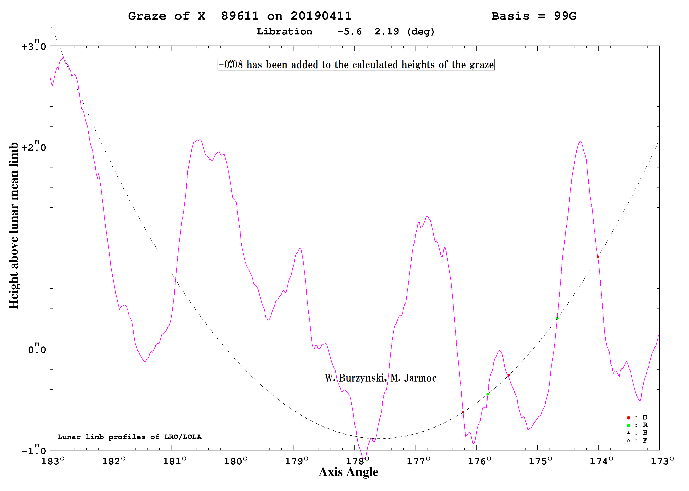
Graze of XZ 89611 – the faintest world graze ?

Slide 50
Grazes of XZ 89611 & XZ 89957 results

Slide 51
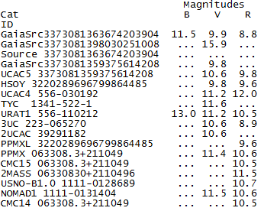
Graze of XZ 89611 – the faintest world graze ?
According to knowledge I have, both events can be treat unoficially as new "world record" of the faintest lunar grazing occultation. PREVIOUSLY: XZ 75176 (10.81 mag) on 16 VIII 2009 by Jan Manek
Was it a WORLD RECORD or not ?
Full description:
http://www.sopiz.ptma.pl/rekordowe-zakrycia-brzegowe-11-kwietnia-2019/

Slide 52
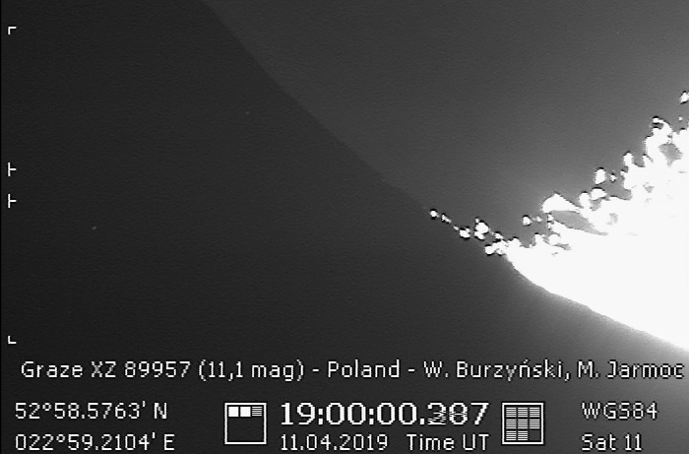
Grazing occultation of XZ 89957 – 11.1 mag

Slide 53
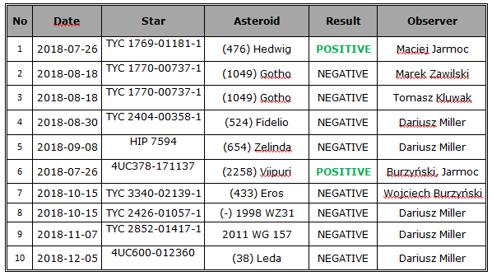
Asteroidal occultation observations 2018
… since last SOPiZ Conference on May 27-26, 2018.

Slide 54
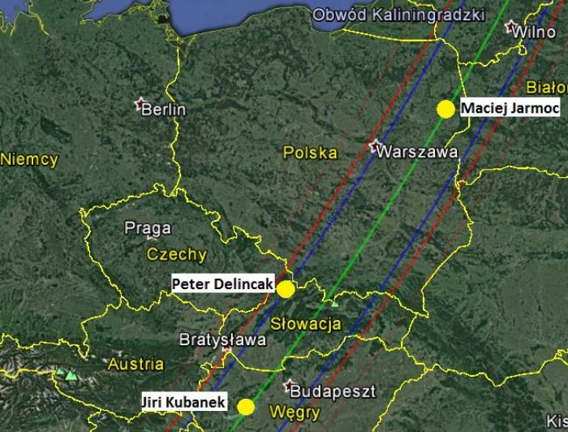
(476) Hedwig occultation results
(476) Hedwig occults TYC 1769-01181-1: new double star detection
The occultation of TYC 1769-01181-1, 11.9 mag star, by the (476) Hedwig is the first case of discovery of the double star by the Polish observer, Maciej Jarmoc, by using an occultation-method.
At the same time, observers from - Slovak Republic (Peter Delincak - only one component occulted) - Czechia (Jiŕi Kubanek - both components occulted)
made co-discoveries about the fact
that the star was new close double with the components separation of 0.040"
The occultation path of (476) Hedwig asteroidal occultation on Jul, 26th 2018 with positive observation sites marked.

Slide 55
(476) Hedwig occultation results
The light curve recorded by Maciej Jarmoc during (476) Hedwig asteroidal occultation on Jul 26, 2018. The stepped LC means double star occultation by the asteroid.

Slide 56
(476) Hedwig occultation results
The double star solution made from (476) Hedwig asteroidal occultation on Jul, 26th 2018.

Slide 57
(2258) Viipuri occultation results
(2258) Viipuri occultation: possible asteroid's satellite detection
In the case of the occultation of 4UC 378-171137 star by the asteroid (2258) Viipuri we are dealing with a possibility of re-discovery its small satellite, with a diameter of 3-5 km. The event duration was only 0.70s.
The event of a similar type, associated with (2258) Viipuri, was observed in the USA on August 3, 2013 by Jerry Bardecker.
It is not entirely possible to treat observation made by Wojciech Burzyński and Maciej Jarmoc as a confirmation of the existence of the asteroid's moon.
It is equally likely that asteroid (2258) Viipuri has occulted a close double star with companions separation of 0.088” ?
The investigation of this event's nature is in progress.

Slide 58
(2258) Viipuri occultation results
The LC recorded during (2258) Viipuri asteroidal occultation on Sep 19, 2018. Possible asteroid's satellite or a new double star detection.

Slide 59
(2258) Viipuri occultation results

Slide 60
(2258) Viipuri occultation 2013 - USA
(unfortunately) only single integrated frame event

Slide 61
Asteroidal occultation observations 2019

Slide 62
(663) Gerlinde occultation results
In this case, as well as (50) Virginia occultation on April 1, 2019 , an unexpected shift of the shadow path towards south has occured (~50 km)

Slide 63
(663) Gerlinde occultation results

Slide 64
(259) Aletheia occultation results
STATION inside the shadow path - 4 km S from the central line
The light curve of (259) Aletheia event obtained with Tangra software.
Measured magnitude drop was 1.30 mag

Slide 65
(259) Aletheia occultation results
Lossless recording observation file in AVI format has been read by the Tangra program. As a result, a CSV file ('comma separated value') was obtained, which then was imported into AOTA, the Occult’s component. The AOTA will provide the final timings of event with uncertainties due to used camera and its integration mode.

Slide 66
(259) Aletheia occultation results
All 5 observations come only from Poland.

Slide 67
Future lunar grazes occultation up to 7.4 mag
Jun 7 - 6.9 mag, Bydgoszcz
Sep 23 – 7.3 mag, Poznań
Oct 19 – 7.0 mag, Częstochowa
Oct 20 – 7.4 mag, Częstochowa
Oct 21 – 7.0 mag, Warszawa, Poznań
Nov 7, 6.9 mag, Łódź
Nov 16 – 6.0 mag, Poznań, Bydgoszcz
Nov 19 – 7.1 mag, Bydgoszcz, Łódź
Dec 21 – 5.7 mag, Suwałki

Slide 68
Future asteroidal occultation up to 11.0 mag

Slide 69
Future asteroidal occultation up to 11.0 mag

Slide 70
Future asteroidal occultation up to 11.0 mag

Slide 71
Future asteroidal occultation up to 11.0 mag

Slide 72
Future asteroidal occultation up to 11.0 mag

Slide 73
Future asteroidal occultation up to 11.0 mag

Slide 74
Future asteroidal occultation up to 11.0 mag

Slide 75
Future asteroidal occultation up to 11.0 mag

Slide 76
Future asteroidal occultation up to 11.0 mag

Slide 77
Future asteroidal occultation up to 11.0 mag

Slide 78
ESOP XXXIX in Poland – Bialystok 28 VIII – 2 IX 2020
Campus of the University of Bialystok– Physics Faculty

Slide 79
Thank you for your attention ☺ Any questions ?
Maya (7yo) during attempt to beat the faintest grazing occultation „world record” on April 12th, 2019

