Slide 1
SOPIZ PTMA in 1979-2019 Statistic data
XXIX SOPiZ PTMA Conference (40-th Anniversary) April 27-28th, 2019 - Warsaw
Wojciech Burzyński, M. Eng.

Slide 2
The Occultation Section of the Polish Amateur Astronomers Society
The Occultation Section of the Polish Amateur Astronomers Society (pol. SOPiZ PTMA) was founded in 29th April 1979.
IOTA was born in May 1975, IOTA/ES in June 1976.
„Golden Ages” between 1991 and 2001 when over 40 members were been able to observe over 600 total lunar occultations per year – it was 6-9 % of global observations. Grazing expeditions in 90’s have had over dozen people.
„Dark Ages” from 2005 to 2015 – internal discussions on the further form of the Section and the ILOC announcement to stop collecting total lunar occultation observations since March 2009 caused strong weakening of observers activity.
Unfortunately between 2012 and 2015 our most active and charismatic members have passed away. The biggest problem now is the lack of new members and the aging of those present.
Since 2015…. - revival ?

Slide 3
The Occultation Section of the PAAS - developmental milestones
1980 – The Electronic Time Recorder (pol. „ERC”) made by R. Fangor
1982 – first use of electronic stopwatch for occultation work
1985 – first use of photomultiplier for occultation work
1986 – first occultation software for ZX Spectrum computers have been written by
M.Zawiski, R. Fangor, J. Wiland, et al.
1989 – „ERC READ DATA” – the software for reading audio casette tapes
has been written by J. Wiland
1990 – first use of sensitive CCD TV camera for occultation work
1990 – first use of the DCF module for occultation work – L. Benedyktowicz
1993 – use of blinking LED in the CCD’s field of view
1993 – The Microprocessor Time Recorder (pol. „MRC”) made by J. Wiland
1997 – first video time inserter based on the DCF signal made by J. Wiland
1997 – first use of the GPS handheld device (station coordinates meas.)
2013 – first video time inserter based on the GPS signal made by T. Wezyk
2015 – the VTI based on the Arduino board (open source project) by P. Smolarz

Slide 4
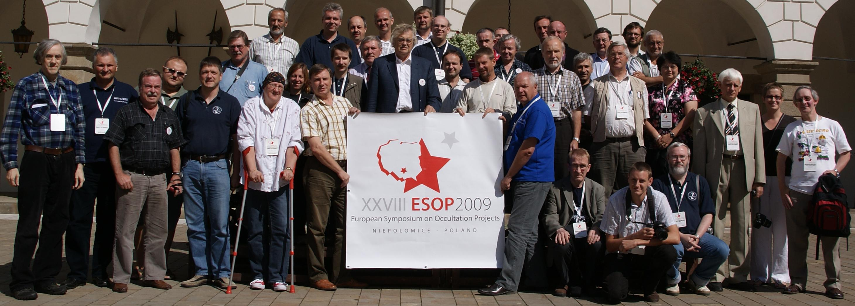
The Occultation Section of the PAAS
Since 1984 members of PAAS Occultation Section have participated in European Symposium on Occultation Projects (ESOP). Four ESOPs were organized in Poland:
1986: Warsaw / Lodz 1994: Krakow
2000: Lodz 2009: Niepolomice near Krakow (photo below)
next: 28.08 - 02.09. 2020, Bialystok

Slide 5
The Occultation Section of the PAAS
ASTEROIDAL OCCULTATION
In 1988 first positive asteroidal occultations have been recorded:
14 IV 1988 - SAO 120975 – the 7.3 mag star and (772) Tanete at Olsztyn Observatory,
N Poland, by Jan Tatyża (however without timing)
09 VIII 1988 - SAO 56117, 7.5 mag star and (626) Notburga
at Ksiaz Castle, SW Poland, by Jerzy Speil
(also missing near Lublin, E Poland, was
observed by Mieczysław Paradowski)
01 I 1994 - PPM 96118, 8.2 mag star and (144) Vibilia - the second successful
asteroidal occultation by Witold Piskorz at Niepolomice Observatory,
S Poland (1st positive on the world in 1994!)

Slide 6
The Occultation Section of the PAAS
COLLECTIVE ASTEROIDAL OCCULTATION WITH POSITIVE RESULTS :
15 V 1995 - (30) Urania - the first collective observation ever,
- 5 observers, 5 POSITIVE !
26 III 1998 - (578) Heppelia – 2 observers
17 IX 2002 - (345) Tercidina – 2 observers had travelled to Slovakia
26 VIII 2003 - (420) Bertholda – 5 observations POSITIVE
and 12 MISS (135 observers in total !!)
22 XII 2003 - (925) Alphonsina – 4 observers
07 VI 2011 - (173) Ino – 2 observers
30 IX 2017 - (217) Eudora – 1 of 2 POSITIVE
20 V 2018 - P5M06 Himalia – 3 of 4 POSITIVE
31 III 2019 – (259) Aletheia – 1 of 5 POSITIVE

Slide 7
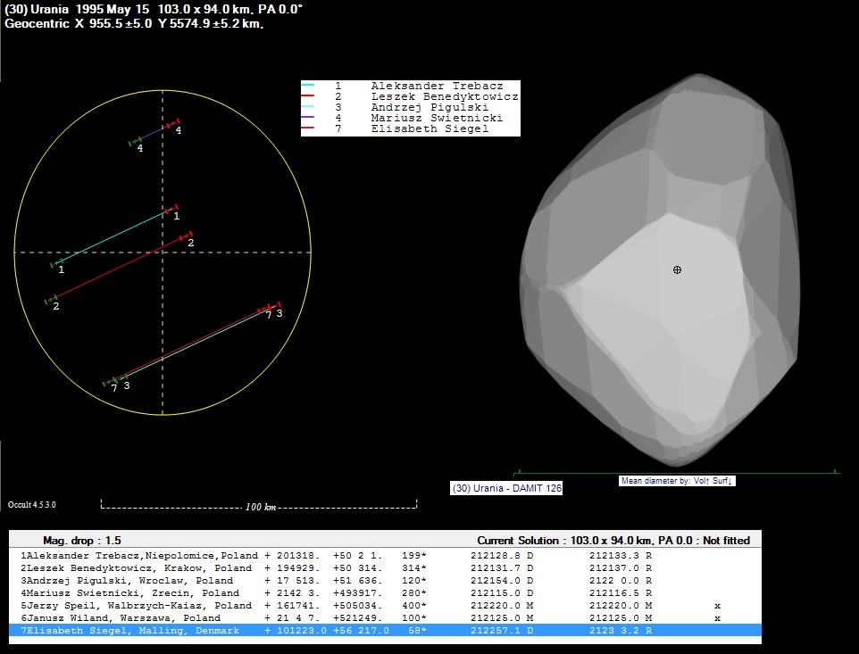
(30) Urania occultation – 5 positive obs.

Slide 8
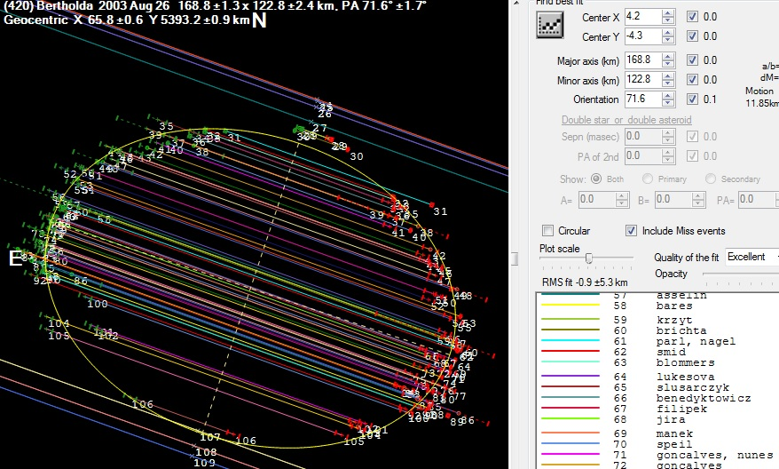
Bertholda occultation - 17 of 135 were from Poland The 3rd place in number of observers recording asteroidal occultation ever... ... and the winner is the occultation of (472) Roma in 2010 with 231 observers from Europe.

Slide 9
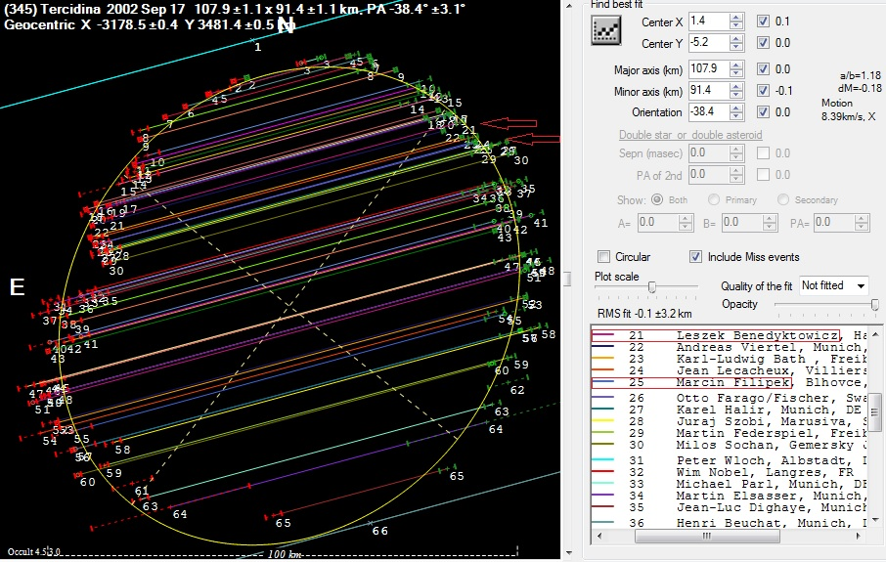
Tercidina occultation – expedition to Slovakia

Slide 10
Asteroidal occultation reports 1988 -1999
YEAR | TOTAL | NEGATIVE | POSITIVE | REMARKS
1988 |  |  | 1 | J. Speil
1989
1990
1991
1992
1993 |  |  | 1 | W. Piskorz
1994
1995 |  |  | 6 | (30) Urania event
1996
1997
1998 |  |  | 3
1999

Slide 11
Asteroidal occultation reports 2000 - 2009
YEAR | TOTAL | NEG | POS | REMARKS
2000 | 27 | 27 | -
2001 | 50 | 50 | 2 (IOTA) | 13 negatives in one event – (2525) O’Stean on May, 8
2002 | 23 | 22 | 1 (+2, IOTA) | Tethys event observed by W. Burzyński
2003 | 32 | 23 | 9 (8 - IOTA) | Bertholda = 5 positives + 13 negatives
2004 | 18 | 16 | 2 (3 - IOTA)
2005 | 31 | 30 | 1
2006 | 12 | 11 | 1
2007 | 11 | 10 | 1
2008 | 11 | 11 | -
2009 | 8 | 7 | 1

Slide 12
Asteroidal occultation reports 2010 - 2019
YEAR | TOTAL | NEG | POS | REMARKS
2010 | 1 | 1 | -
2011 | 9 | 7 | 2
2012 | 4 | 4 | - | all events observed by M. Filipek
2013 | 3 | 3 | - (2,IOTA) | all events observed by M. Filipek
2014 | 5 | 5 | - (2,IOTA)
2015 | 7 | 7 | - (4,IOTA)
2016 | 9 | 8 | 1 (Pluto) (+2, IOTA) | Pluto observed by G. Murawski
2017 | 13 | 10 | 3 (7,IOTA)
2018 | 16 | 7 | 9
2019 | 13 … | 12 … | 1 …
TOTAL | 362 | 326 | 36

Slide 13
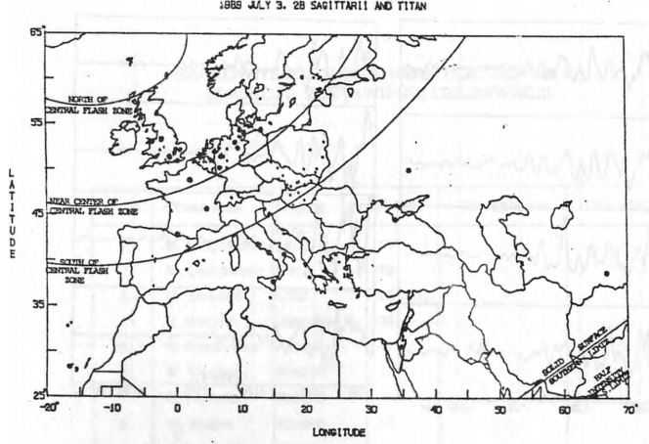
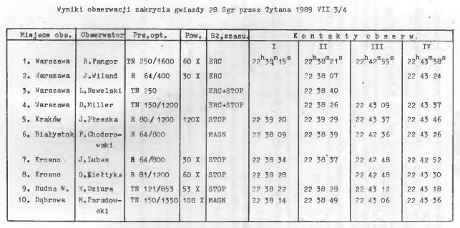
The Occultation Section of the PAAS
PLANETARY OCCULTATION:
On July 4, 1989 observations of the occultation of 28 Sgr by Titan were made in central and south-eastern Poland by 10 observers in total. Central flash was recorded in Warsaw.

Slide 14
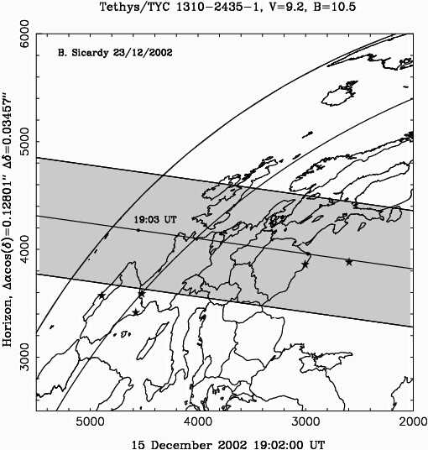
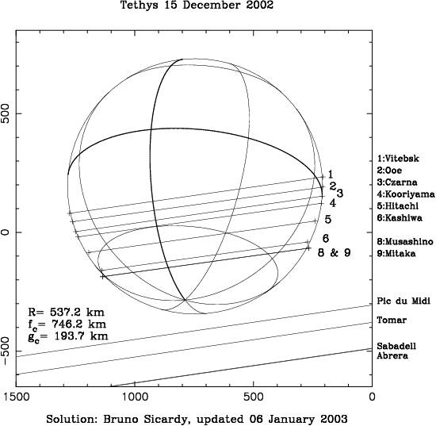
The Occultation Section of the PAAS
PLANETARY OCCULTATION:
OCCULTATION OF PPM 94676 BY TETHYS ON DEC 15th, 2002 by W. Burzynski (3)

Slide 15
The Occultation Section of the PAAS
GRAZING LUNAR OCCULTATION:
25 VIII1981 First grazing occultation result from single station observer (M. Szulc)
SAO 78221 (8.6 mag), CA = 7.7, MF: -23%
1 event (RD), OC = -1.76”
8-cm telescope, 7 km S from the graze limit line

Slide 16
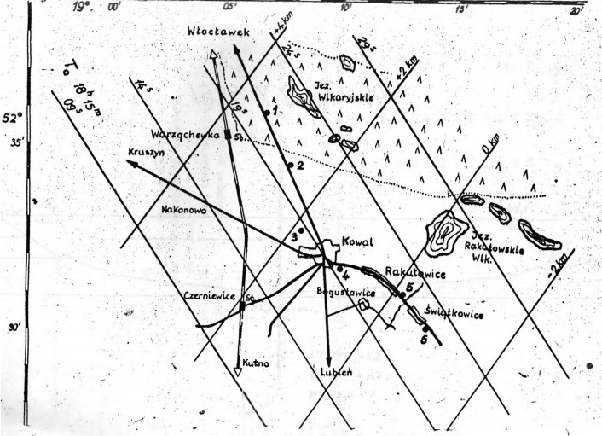
The Occultation Section of the PAAS
GRAZING LUNAR OCCULTATION:
06 X 1984 First collective grazing occultation expedition with positive results
ZC 3349 (tau Aqu), 4.0 mag
CA = 2.8 N, MF = +91% !
4 observers near Kowal,
central Poland
13 events recorded

Slide 17
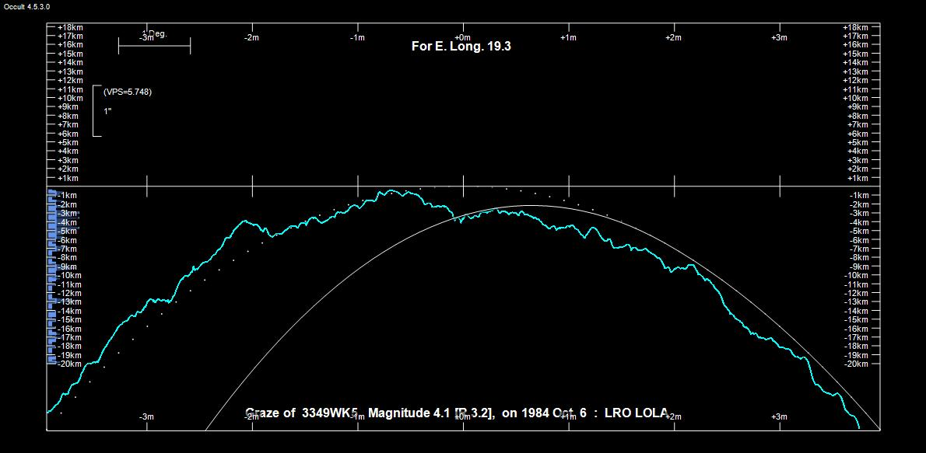
06 X 1984 First collective grazing occultation expedition with positive results

Slide 18
The Occultation Section of the PAAS
12 VIII 1990 Second collective grazing occultation expedition with positive results
- 10 stations near Gdansk-Jasien, N Poland
- 10 observers from Niepolomice Observatory had travelled by Antonov PLANE !!! over 560 km from Cracow-Balice airport ! - 42 events recorded in total

Slide 19
The Occultation Section of the PAAS
28.04.1998 The greatest grazing occultation expedition in Poland ever (Aldebaran)
- 29 stations near Lodz, central Poland - 42 observers (9 were from Czech Republic and Slovakia) - 140 events recorded ! - mean residual of events: - 0.019" ± 0.098"

Slide 20
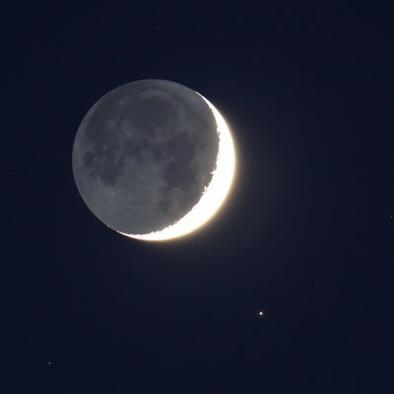
The latest collective activity – Aldebaran grazing occultation, 21 April 2015
Nowinka, NE Poland
8 observers
64 events
mean residual of events: - 0.006" ± 0.045"

Slide 21
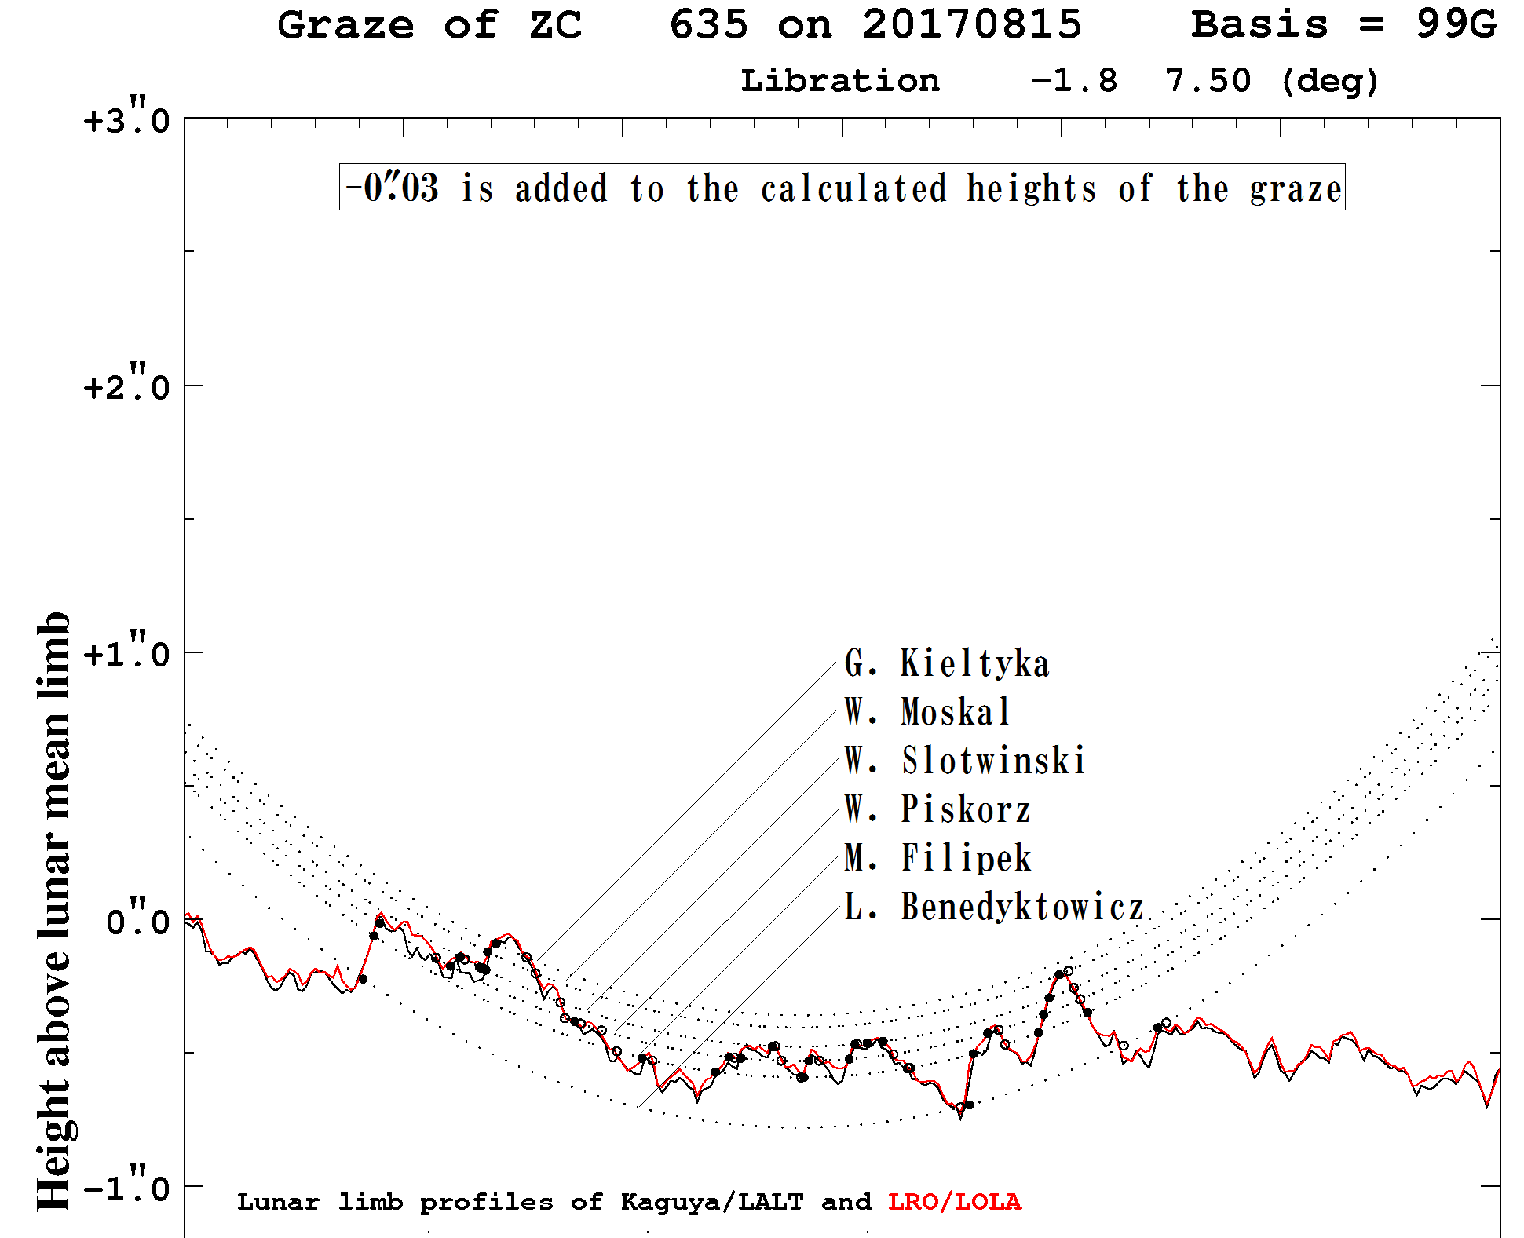
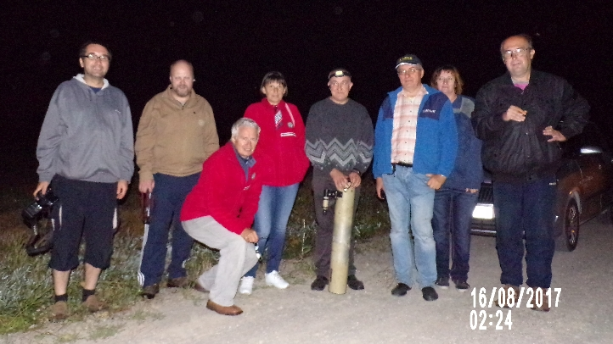
The latest collective activity – lunar grazing occultation on 15th Aug, 2017
In 2017, 3 of 18 reported global grazing occultation were observed in Poland
6 observers
58 events
mean residual
of events:
0.007" ± 0.039"

Slide 22
Grazing lunar occultations expeditions 1990 -1999
YEAR | TOTAL | NEGATIVE | POSITIVE | REMARKS
1990 | 2 | - | 2
1991 | 2 | - | 2
1992 | 5 | 2 | 3
1993 | 3 | - | 3
1994 | 1 | 1 | -
1995 | 4 | 1 | 3
1996 | 2 | 1 | 1
1997 | 3 | - | 3
1998 | 15 | 9 | 6 | Aldebaran „great” graze
1999 | 13 | 10 | 3

Slide 23
Grazing lunar occultations expeditions 2000 - 2009
YEAR | TOTAL | NEGATIVE | POSITIVE | REMARKS
2000 | 18 | 8 | 10 | best year ever !
2001 | 11 | 7 | 4
2002 | 13 | 5 | 8
2003 | 10 | 3 | 7
2004 | 1 | - | 1
2005 | 3 | - | 3
2006 | 4 | - | 4
2007 | 8 | 2 | 6
2008 | 2 | - | 2
2009 | - | - | -

Slide 24
Grazing lunar occultations expeditions 2010-2019
YEAR | TOTAL | NEGATIVE | POSITIVE | REMARKS
2010 | 3 | 1 | 2
2011 | - | - | 1
2012 | - | - | -
2013 | - | - | -
2014 | - | - | -
2015 | 2 | - | 2
2016 | 1 | 1 | -
2017 | 3 | - | 3
2018 | 8 | 1 | 7
2019 | 7 … | 3 … | 4 … | the faintest WORLD graze ? (11.46 mag ?)
TOTAL | 162 | 62 | 110

Slide 25
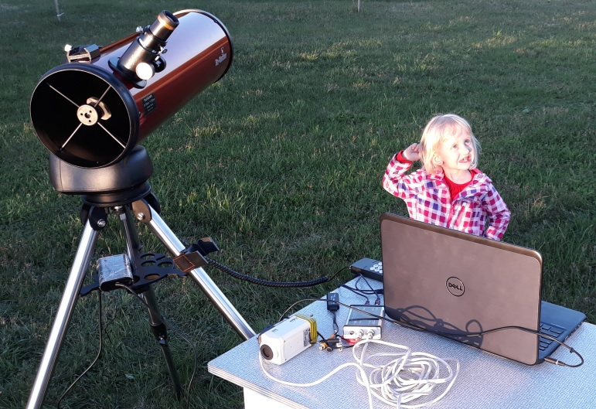
Thank you all ☺ Good job and keep going !
„Eye-and-Ear” methode by 4 yo volunteer

