Slide 1
Jan Śniadecki
The tireless Cracow astronomer
See the full paper in „Kwartalnik Historii Nauki”, June 2019, and possibly
in „Urania” this autumn.

Slide 2
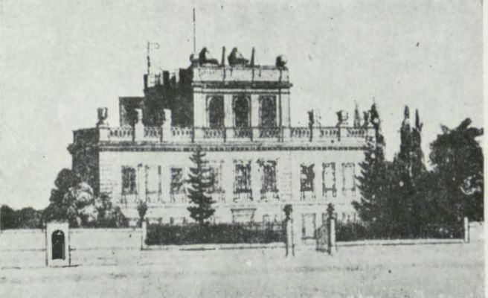
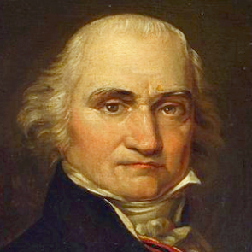
Jan Śniadecki (1756-1830)
The Cracow observatory open in 1792

Slide 3
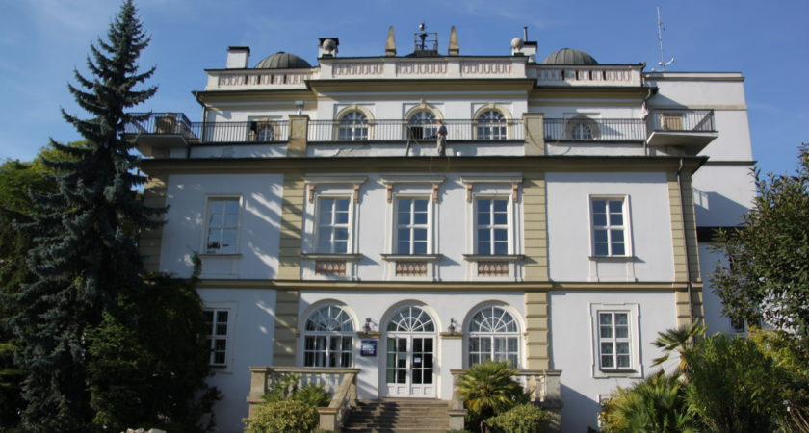
The observatory building in its present state

Slide 4
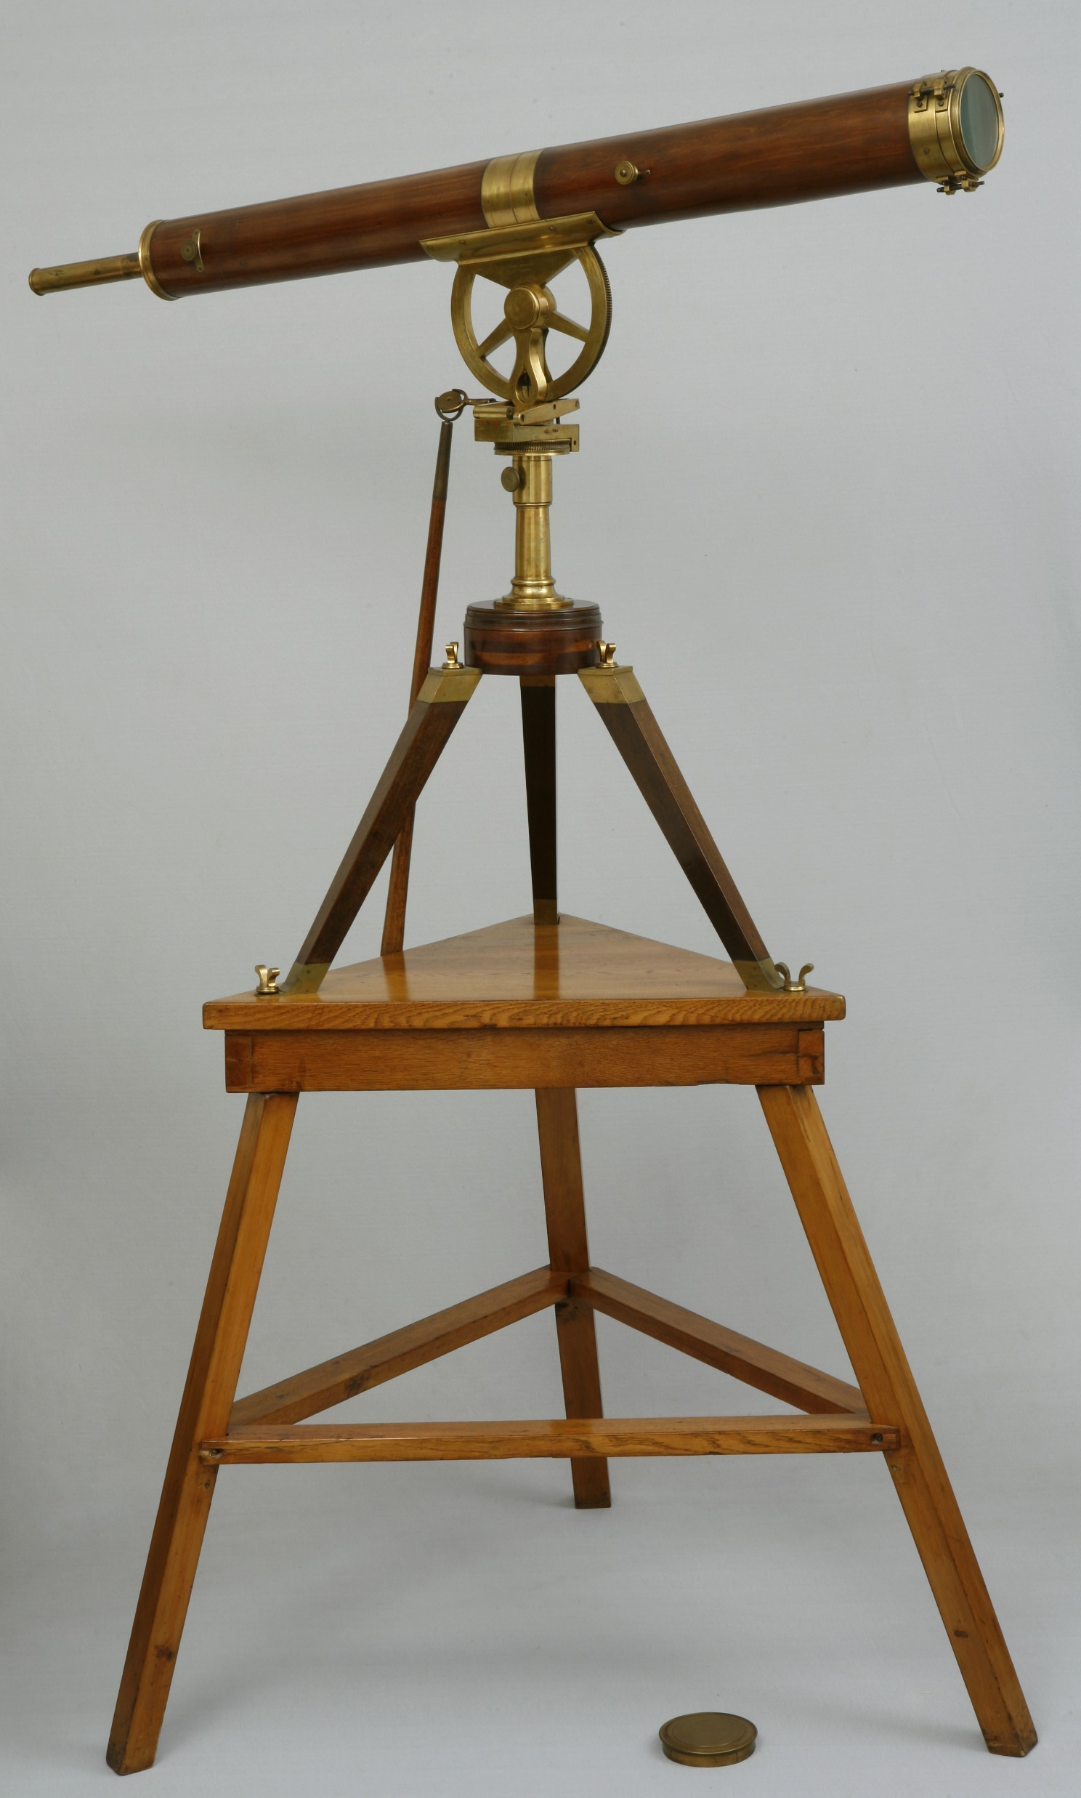
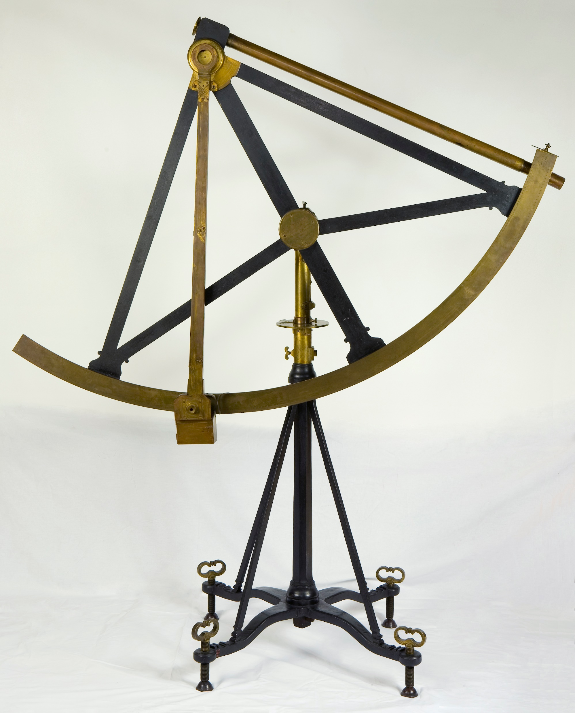
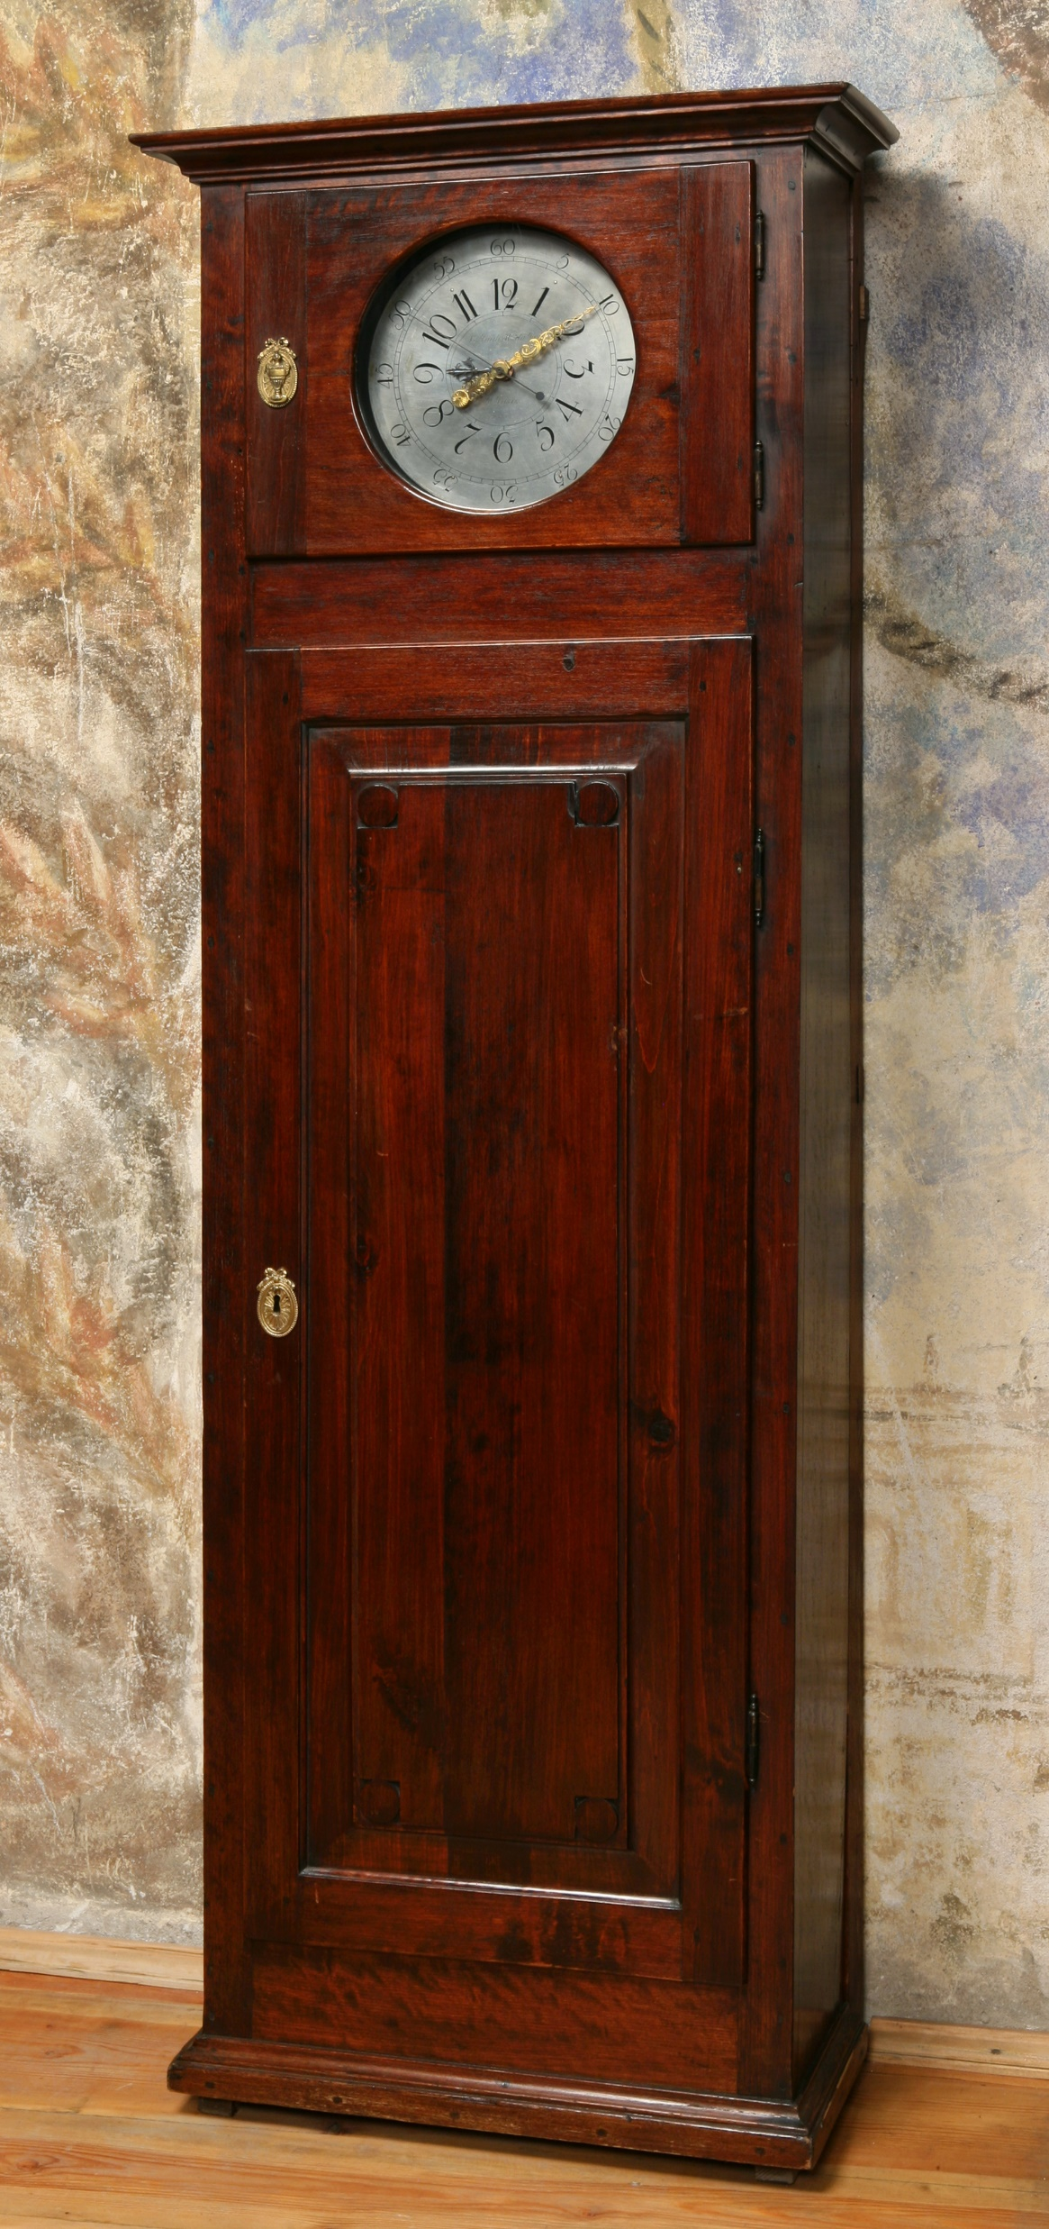
The Dollond refractor 93 mm
The quadrant made by Canivet
The pendulum clock made by Le Paute
The basic observational equipment (contained also a transit instrument which is lost)
Courtesy: The Jagiellonian University Museum; phot. Phot. Grzegorz Zygier
Imagine that you have only these instruments…

Slide 5
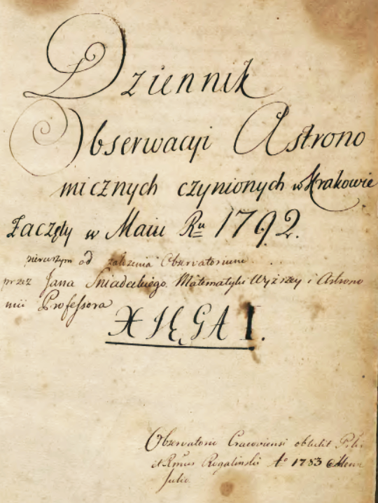
Title page of the Observation Journal

Slide 6
Co-operation and correspondence with
F-X.von Zach (Gotha),
F.d.P. Triesnecker (Vienna)
and M.Odlanicki-Poczobut (Vilnius).
Publications in:
Roczniki Towarzystwa Naukowego Warszawskiego,
Monatliche Correspondenz (ed.v.Zach),
Ephemerides Astronomicae ... ad Meridianum Vindobonensem (ed.F.Triesnecker).

Slide 7
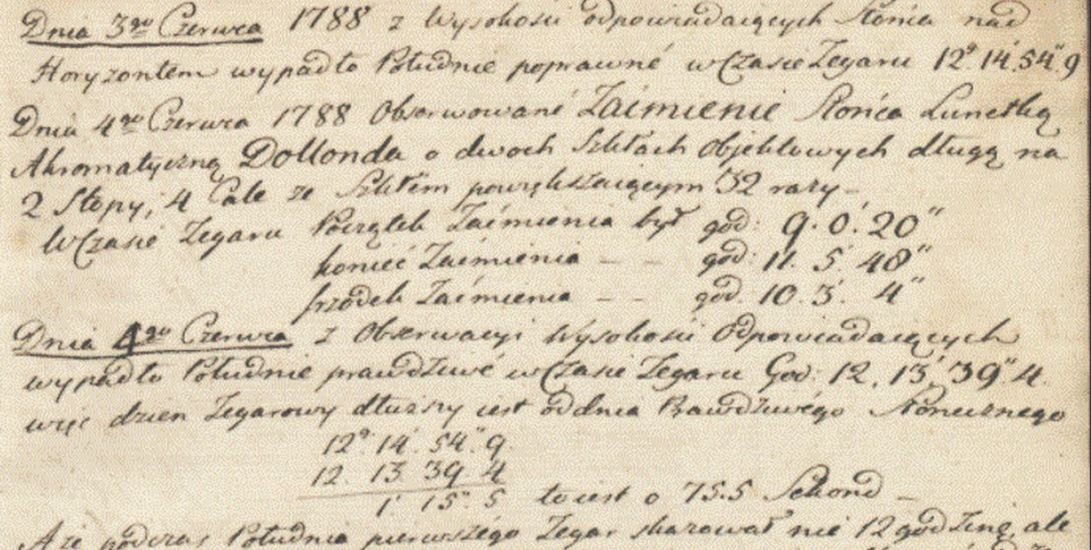
First scientific observation – partial solar eclipse on June 4, 1788,
still before opening of the observatory

Slide 8
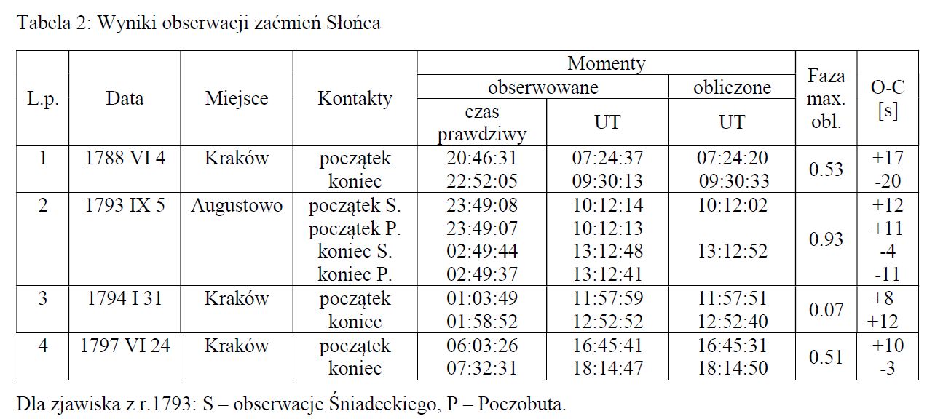
Occult
Results of solar eclipse observations

Slide 9
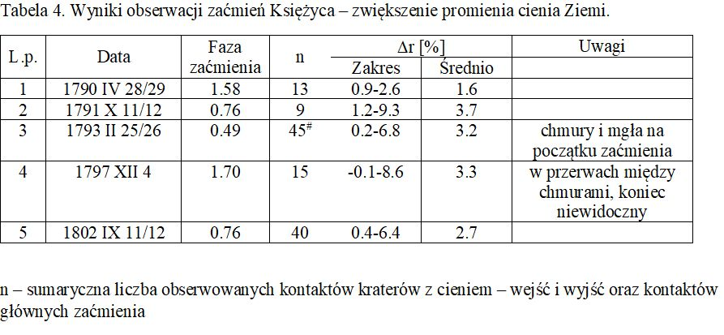
Results of observations of lunar eclipses

Slide 10
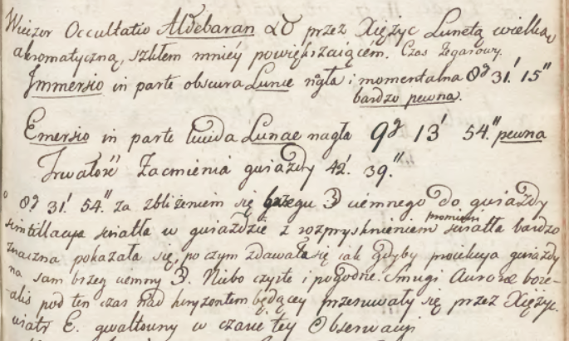
The Aldebaran occultation on Mar 7, 1794 recorded

Slide 11
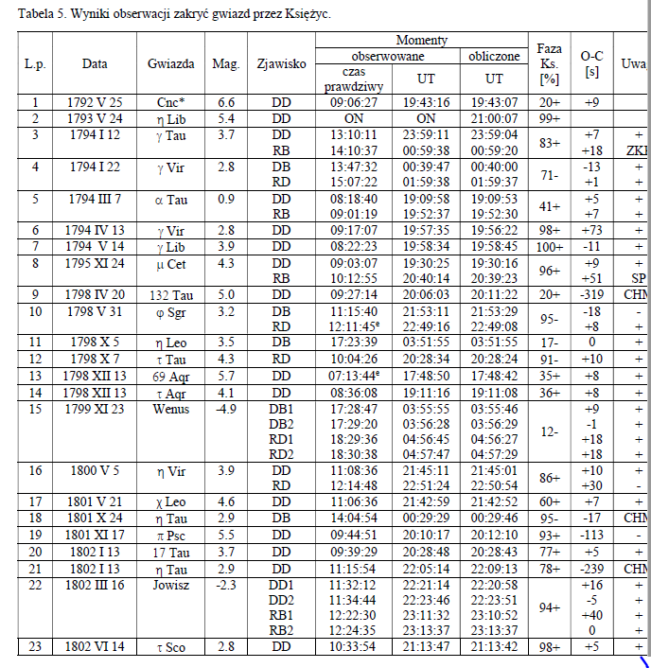
Results of lunar occultation observations

Slide 12
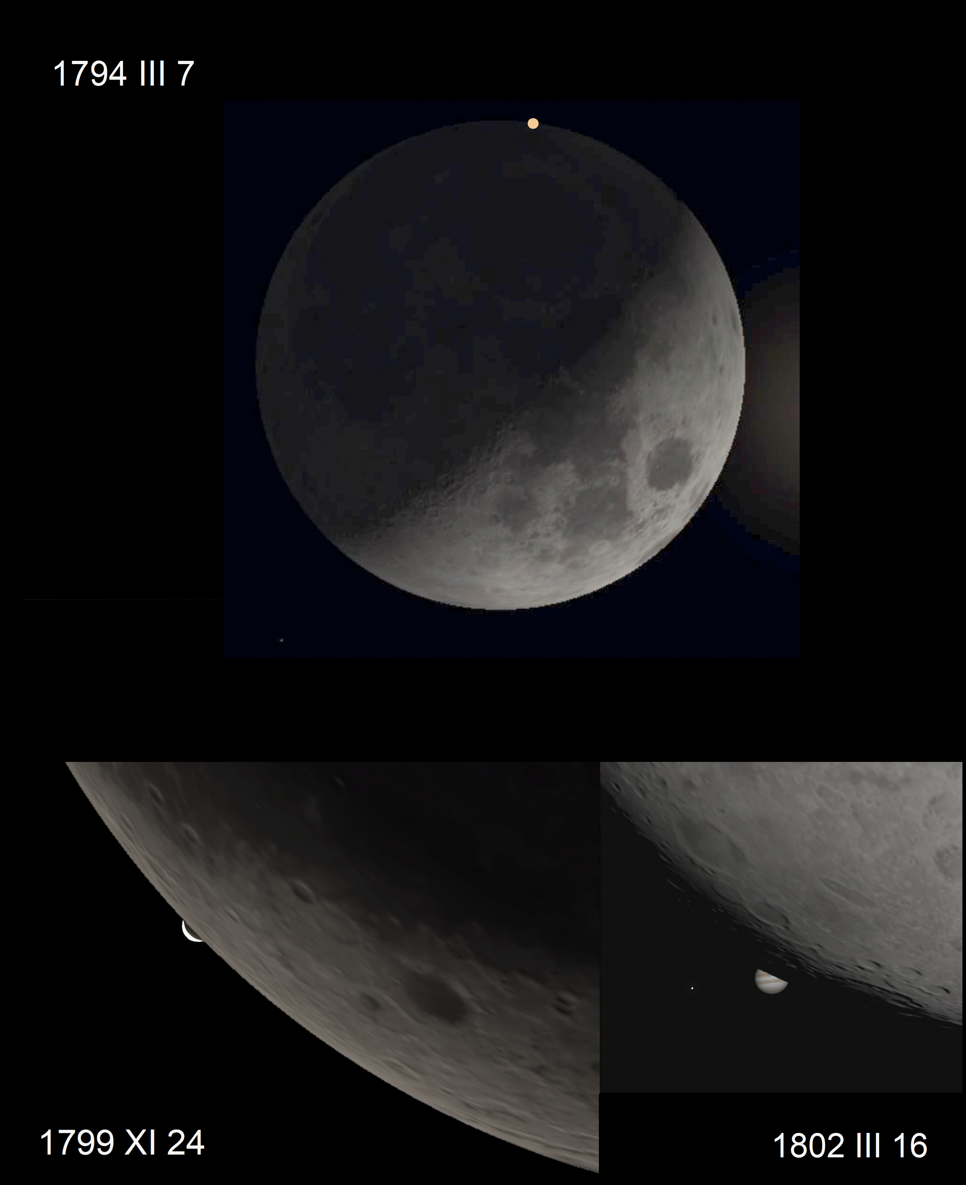
Aldebaran
Venus
Jupiter

Slide 13
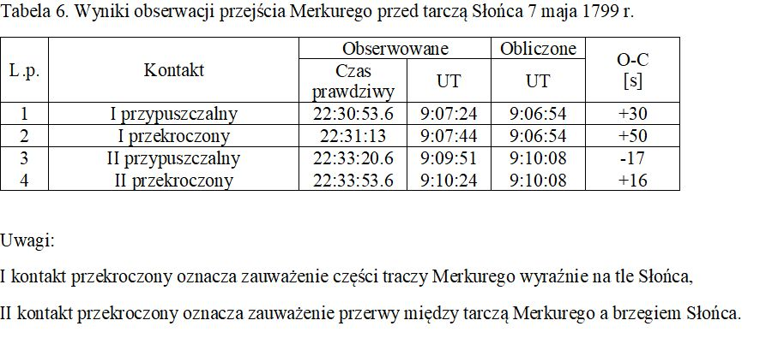
Observation results of the Mercury transit on May 7, 1799

Slide 14
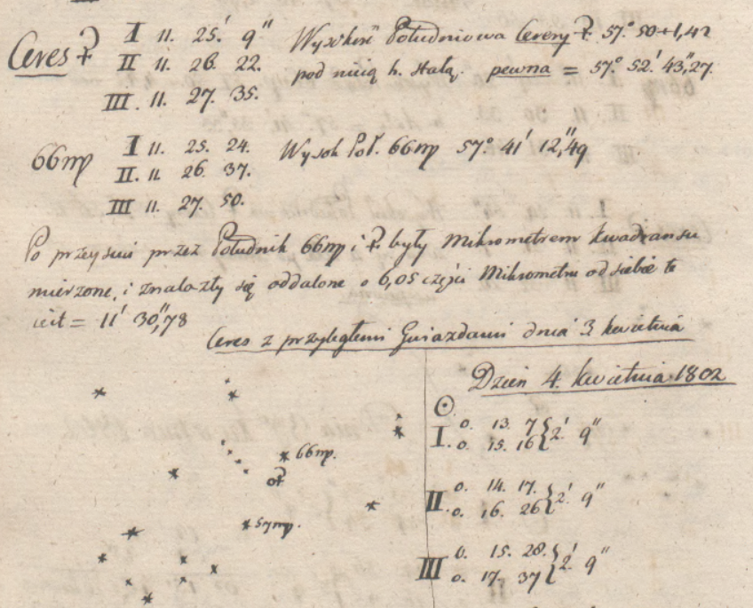
Positional observations
of Ceres
in 1802

Slide 15
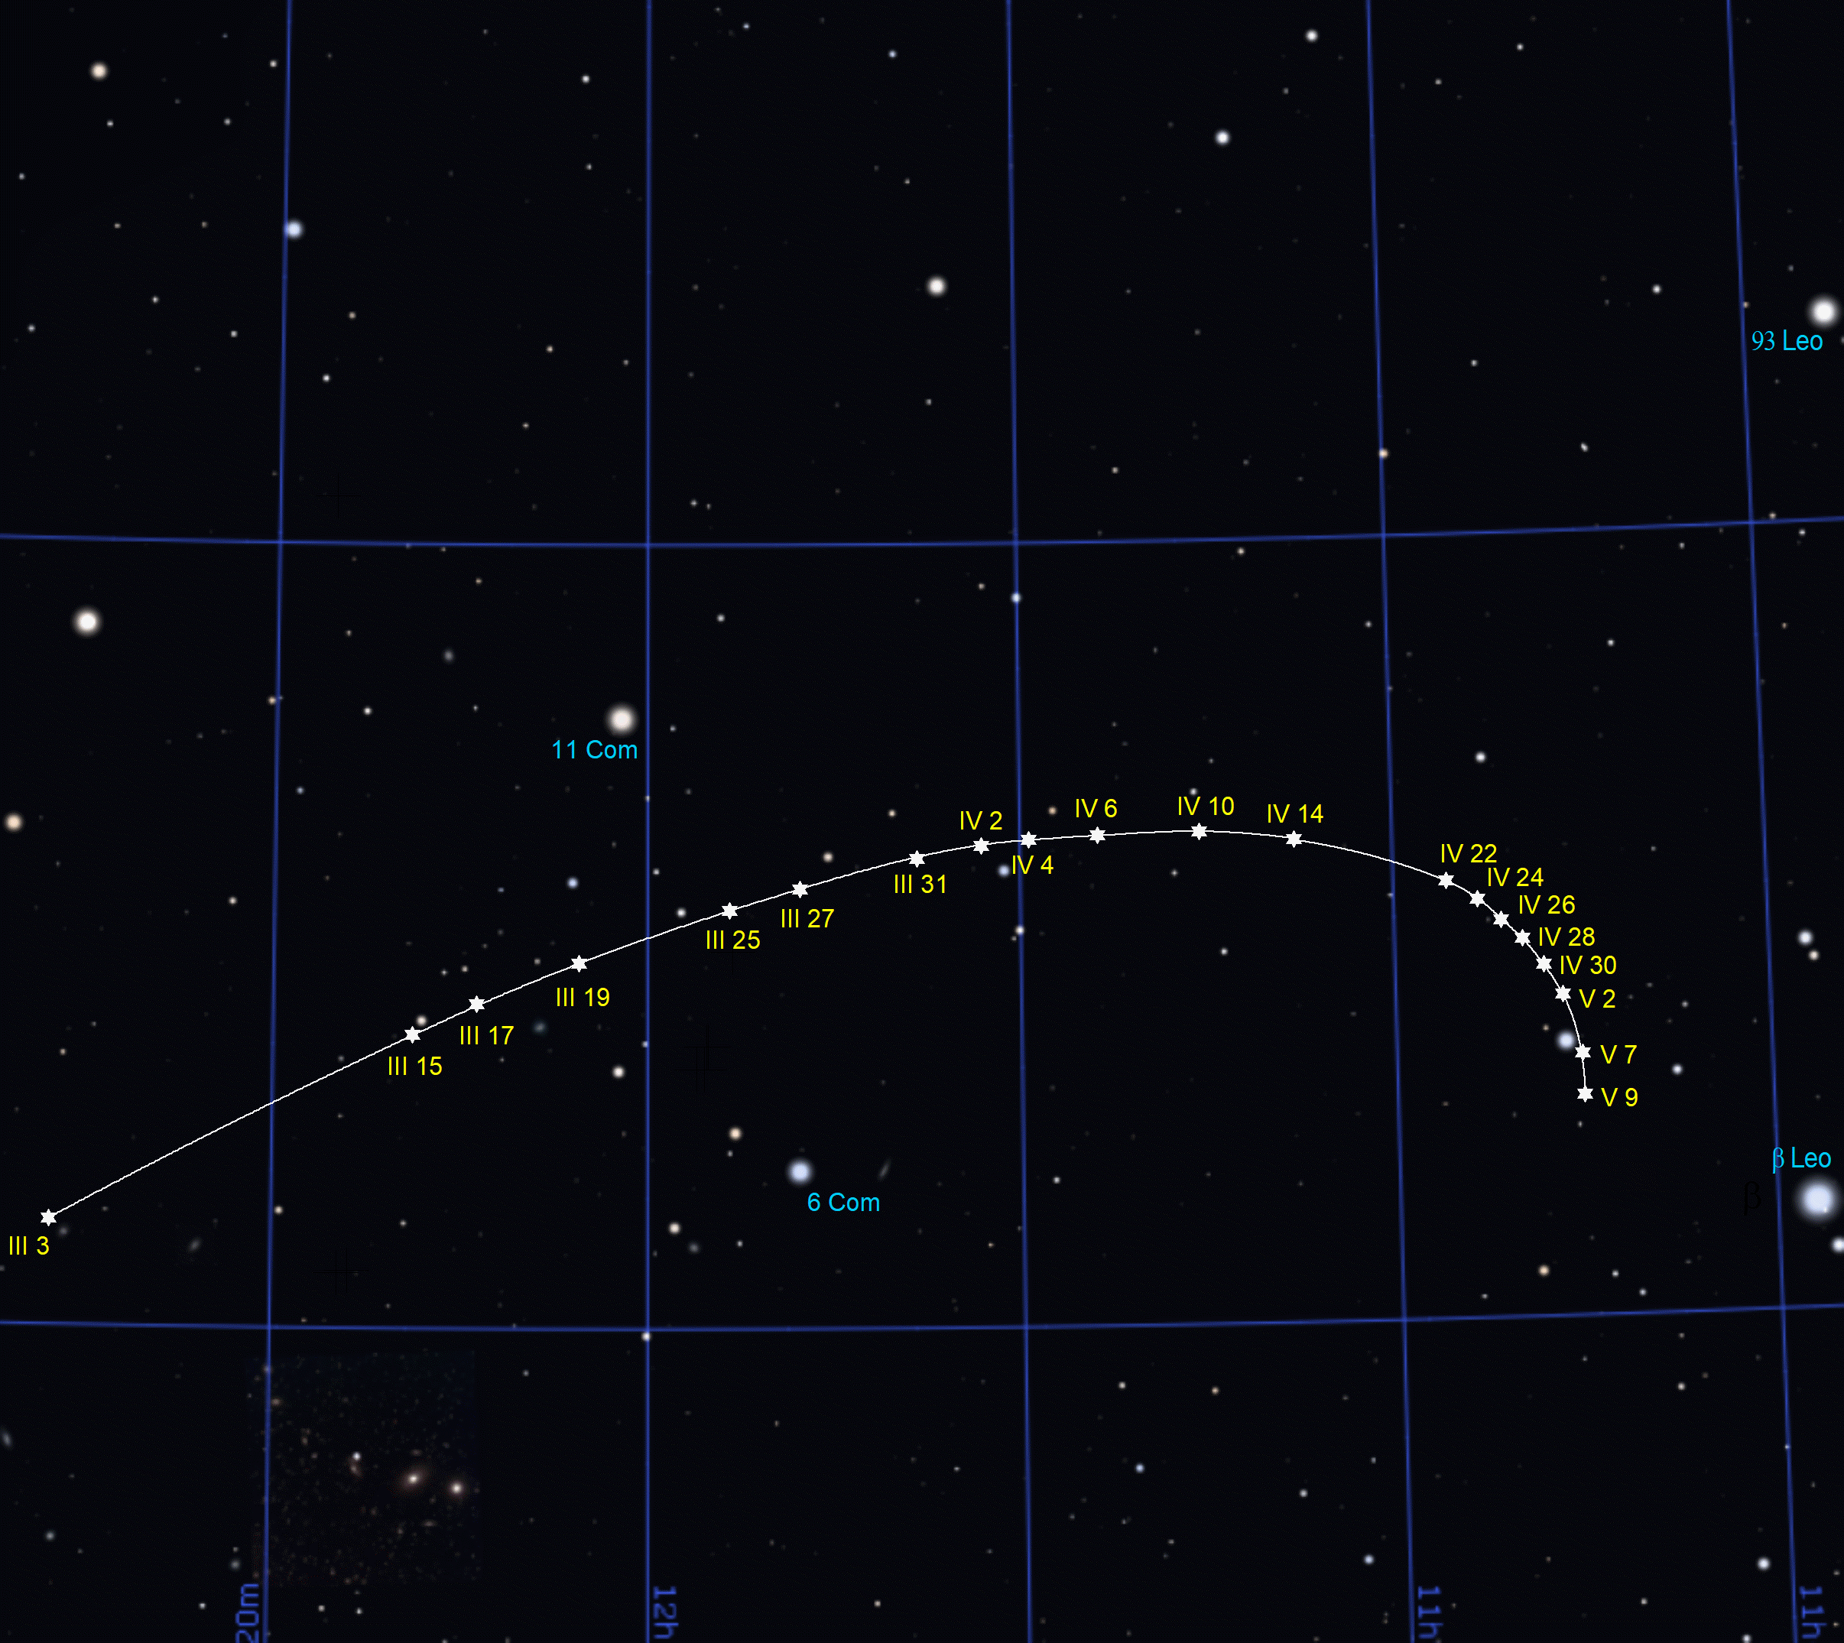

Slide 16
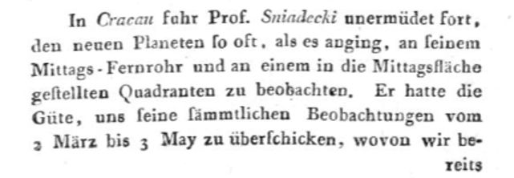
Von Zach described the Śniadecki’s activity as tireless.

Slide 17
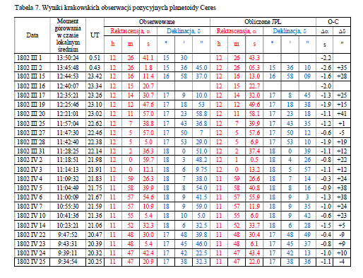
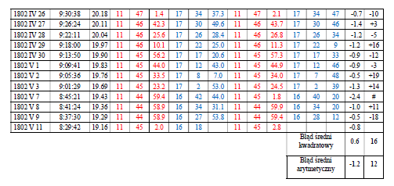
Positional observations
of Ceres
in 1802
A comparison with
the present JPL data

Slide 18
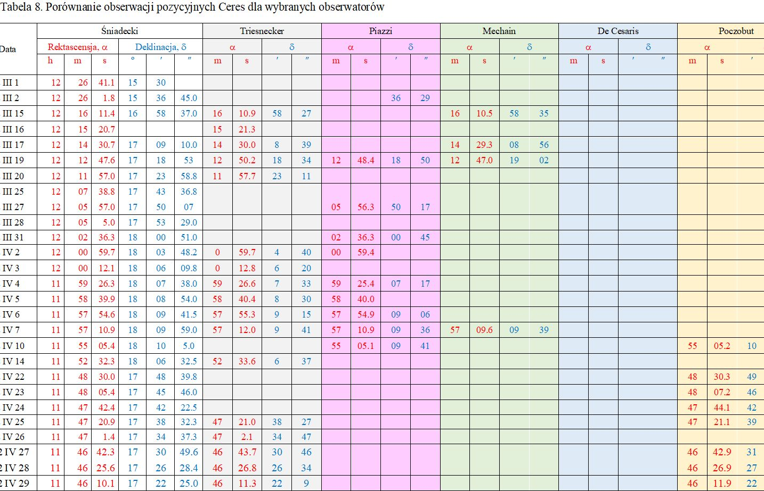
Parallel observations by other astronomers

Slide 19
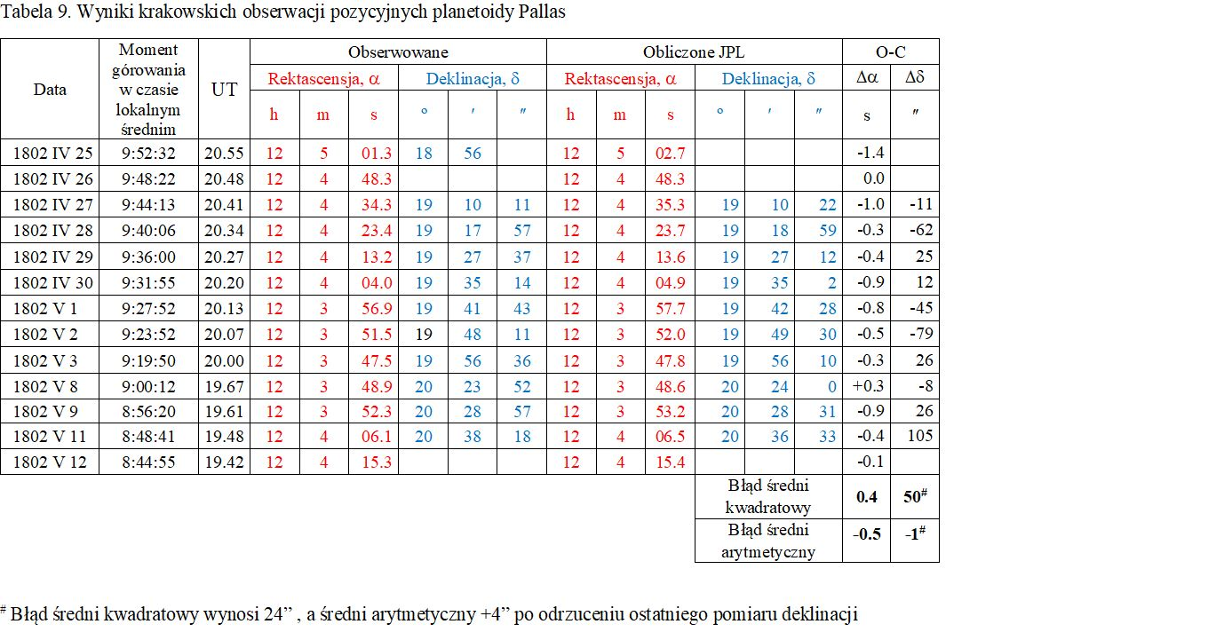
The positional observations of Pallas in 1802

Slide 20
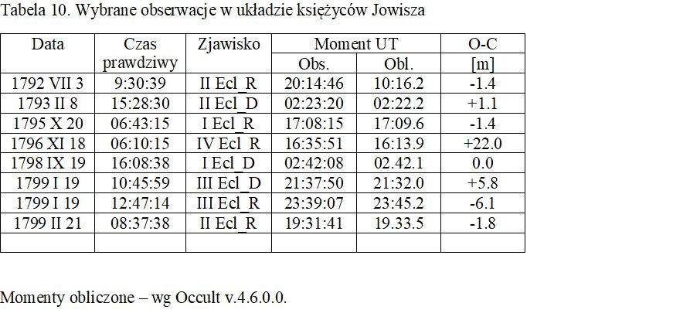
Selected observations of Gallilean satellites’ phenomena
First or last visibility of satellites recorded only

Slide 21
Positional observations of planets near their oppositions

Slide 22
Geographical co-ordinates of the observatory (around 1800):
J.Śniadecki
Accepted now
Latitude: 50º03’52” N identical
Longitude: 19º56’15” E 19º57’34” E
Latitude establihed using a combination of various techniques,
Longitude – using the timings of lunar occultations (!), and so much better than assumed before.

Slide 23
General conslusions
Jan Śniadecki achieved a very good accuracy of his observations, comparable to best results of professional observatories in Europe.
His effort was enormous, he observed during all clear nights and days, usually alone, having quite simple=standard equipment.
He worked not continuously because of several organizational and political impediments.
In 1803, encountering these unsolvable problems, he decided to leave Cracow and never reached a similar range of observations.

Slide 24
Thank you for your attention

