Slide 1
Origin of SOPiZ
and next sucesses and failures

Slide 2
Professional observers of lunar occultations
1944-1975 (VizieR occultation archive since 1623)
Kraków UAO – T.Banachiewicz, J.Kordylewska, B.Kołaczek,
A.Strzałkowski, L.Stankiewski, R.Szafraniec,
M.Kurpińska, Z.Klimek, M.Winiarski, J.Mietelski
A.Michalec, A.Kułak, Z.Dworak
Poznań UAO – J.Witkowski, H.Hurnik, F.Koebcke
Wrocław UAO – E.Rybka, A.Opolski
Warsaw UAO – M.Bielicki
Toruń UAO – C.Łubieńska
Usually very good results as O-C values.

Slide 3
1928 - Józef Witkowski on the basis of his publication entitled: „Occultation de l'étoile 6 G Librae par Jupiter et son satellite Ganymède” obtained in Kraków the title of habilitated doctor.
Numerous works on occultations, eclipses and astrometry performed by him and his co-workers.
In 1989 photolectric observations of lunar occultations started at the Wrocław University Observatory in Białków (A.Pigulski).

Slide 4
First two grazes after 1945 (accidentally) recorded.

Slide 5
Occasional observations of solar eclipses, transits, lunar occultations and positional observations by the PTMA members in 1966-1978:
Warszawa – Maciej Bielicki, Roman Fangor, Nikodem Wikliński, Arkadiusz Królikowski, Lucjan Newelski, Danuta Kozerska, Krzysztof Woźniak, Piotr Krysiak, Maciej Mikołajewski,
Marek Góźć, Magda Złotowska (in the framework of the observational section)
Łódź – Marek Zawilski, Andrzej Udalski, Błażej Feret
Opole – Edward Bryniarski, Stefan Czech
Poznań – Zbigniew Rzepka (popularyzcja – Józef Witkowski)
Mały Mędromierz – Mieczysław Szulc
Lublin – Stanisław Hałas
Ostrowiec Św. – Jerzy Ułanowicz
Gdańsk – Oliwa – Wojciech Sędzielowski, Leon Wohlfeil
July 1978, Warsaw – a discussion between R.Fangor and M.Zawilski. November 1978, Kraków – the acceptance of the creation of a national observation section (as a result of a discussion between M.Zawilski and M.Mazur, the president of PTMA).

Slide 6
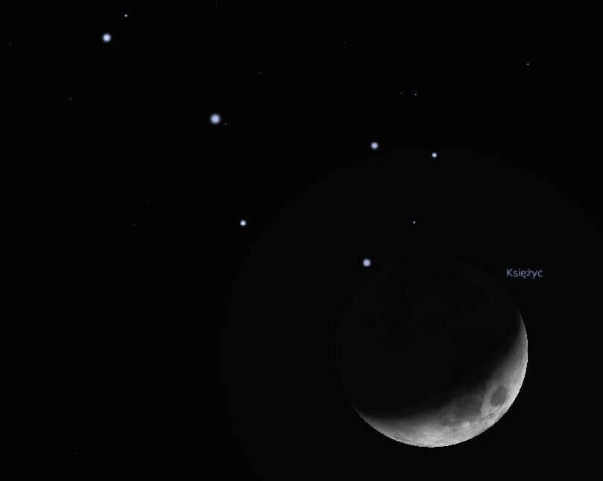
1972 III 19

Slide 7
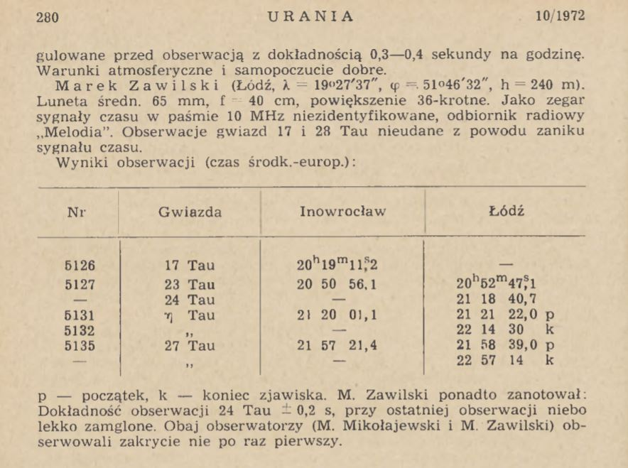
The Pleiades’ occultation
1972 III 19

Slide 8
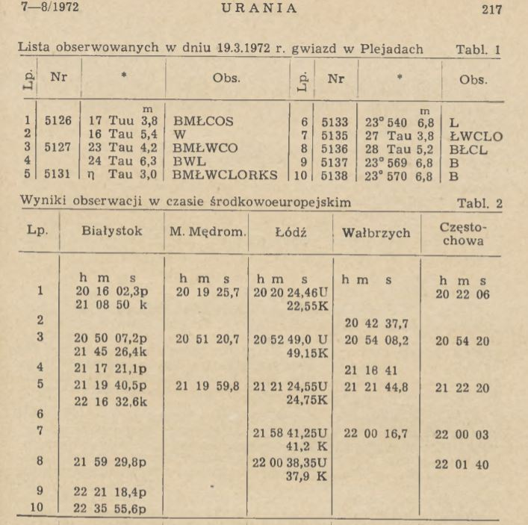
The Pleiades’
occultation
1972 III 19
A.Udalski

Slide 9
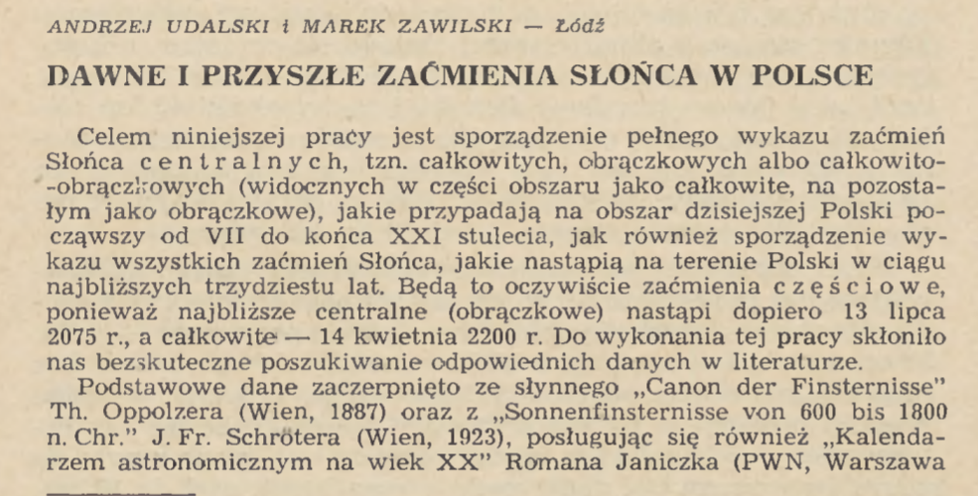
Urania, 1973, 9, 256.

Slide 10
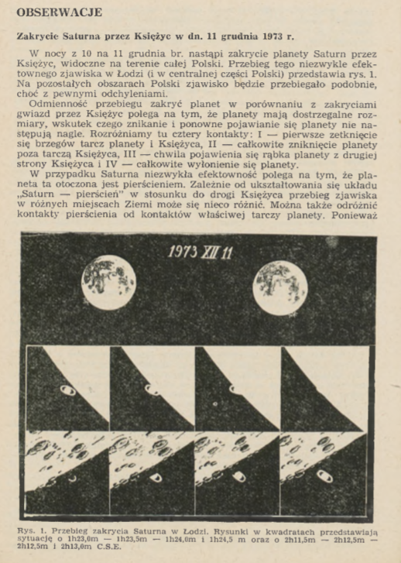
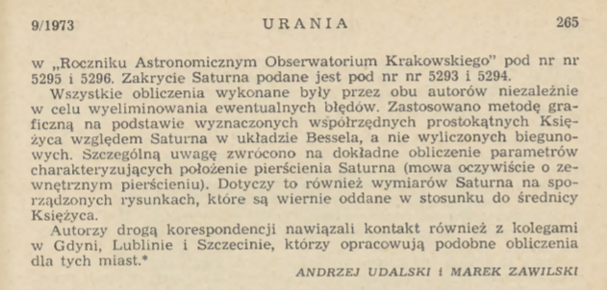
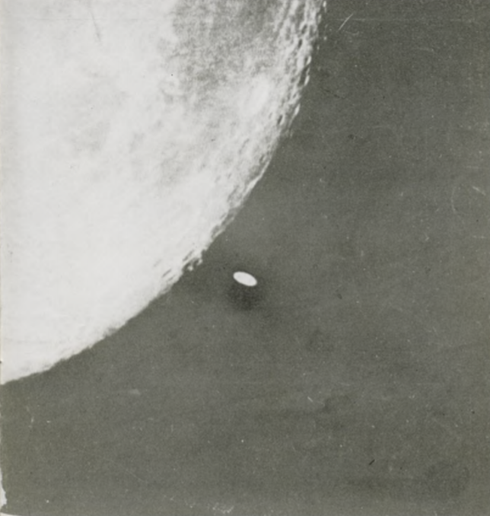
Phot. Roman Fangor

Slide 11
THE FOUNDING MEETING OF THE SECTION
FOR OBSERVATIONS OF POSITIONS AND OCCULTATIONS
(SOPIZ)
NICOLAUS COPERNICUS’ ASTRONOMICAL CENTRE (CAMK)
Warsaw Division of PTMA
APRIL 29, 1979
The present persons: Maciej Bielicki, Krzysztof Ziołkowski, Roman Fangor, Marek Zawilski,
Ryszard Palczewski, Dariusz Lis, Zygmunt Grela

Slide 12
The initial structure of the Section:
Doc. Maciej Bielicki - the scientific leader and co-ordinator
Marek Zawilski – eclipses and occultations
Roman Fangor – positional observations and the secretary
Headquarters’ address: Warsaw, CAMK, ul.Bartycka 18

Slide 13
MEMBERS OF THE SOPiZ JANUARY 10, 1980
No | Member | Locality
1 | Maciej Bielicki | Warsaw
2 | Roman Fangor | Warsaw
3 | Janusz Wiland | Warsaw
4 | Wojciech Jabłoński | Warsaw
5 | Arkadiusz Krajewski | Warsaw
6 | Tomasz Peszke | Warsaw
7 | Beata Paluszkiewicz | Warsaw
8 | Ryszard Szujecki | Warsaw
9 | Sławomir Dębowski | Warsaw
10 | Marek Zawilski | Łódź
11 | Alicja Zawilska | Łódź
12 | Błażej Feret | Łódź
13 | Mirosław Kubiak | Grudziądz
14 | Piotr Lamparski | Grudziądz
15 | Roch Pepliński | Grudziądz

Slide 14
No | Member | Locality
16 | Edward Bryniarski | Opole
17 | Stefan Czech | Opole
18 | Stanisław Brzostkiewicz | Dąbrowa Górnicza
19 | Edith Pilska | Frombork
20 | Andrzej Pilski | Frombork
21 | Narcyz Gawdzik | Frombork
22 | Janusz Kazimierowski | Kalisz
23 | Wojciech Nowak | Zielona Góra
24 | Mieczysław Chudoba | Zielona Góra
25 | Ryszard Palczewski | Szczecinek
26 | Krzysztof Graczyk | Szczecinek
27 | Zbigniew Rzepka | Poznań
28 | Zenon Skórzewski | Poznań
29 | Mieczysław Szulc | Mały Mędromierz/Tuchola
30 | Paweł Turkowski | Sanok

Slide 15
No | Member | Locality
31 | Dariusz Lis | Kielce
32 | Leszek Nowak | Nysa
33 | Zbigniew Szałkiewicz | Olsztyn
34 | Waldemar Ogonowski | Puławy
35 | Jarosław Białas | Szczecin
36 | Zbigniew Wychowski | Lubliniec
37 | Ireneusz Rzempowski | Lubliniec
38 | Mieczysław Paradowski | Lublin
39 | Adam Malinowski | Tychowy
40 | Sławomir Chorek | Bełchatów
41 | Janusz Bańkowski | Bełchatów
42
43
44
45

Slide 16
The new most active observers in the next years: active now
Sławomir Kruczkowski– Grudziądz
Mieczysław Borkowski, Marcin Górko, Piotr Perek, Paweł Matys, Mirosław Laskowski , Paweł Maksym, – Łódź
Zygmunt Winkler - Pabianice
Jerzy Lukaszewicz, Bożena Kardaś, Andrzej Gołębiewski, Robert Kurianowicz, Dariusz Miller, Lucjan Newelski,
Jerzy Bohusz, Piotr Badowski – Warsaw, Daniel Filipowicz – Otwock
Ryszard Drążkowski – Włocławek
Witold Maciejewski, Jerzy Olech, Andrzej Pigulski - Wrocław
Jerzy Speil – Książ/Wałbrzych
Leszek Benedyktowicz, Witold Piskorz, Andrzej Janus, Bogdan Zemanek – Kraków
Aleksander Trębacz, Janusz Ślusarczyk, Dominik Pasternak, Krzysztof Sadko, Łukasz Czuma – Niepołomice
Marcin Filipek – Jerzmanowice
Anna Wojtaś – Kielce
Wilhelm Dziura - Rudna Wielka
Mariusz Gamracki – Rzeszów
Robert Bodzoń - Jarosław
Stanisław Świerczyński - Dobczyce
Grzegorz Kiełtyka, Józef Lubas, Wacław Moskal, Łukasz Perec, Emilian Skrzynecki, Artur Kopeć, Mariusz Świętnicki, Lesław Materniak– Krosno
Wiesław Słotwiński – Krosno, Łańcut, Królik Polski
Artur Wrembel, Wojciech Broczkowski, Artur Wargin – Bydgoszcz
Wojciech Burzyński , Franciszek Chodorowski, Maciej Jarmoc, Gabriel Murawski – Białystok
Jacek Drążkowski – Lidzbark Warm.

Slide 17
Some important milestones
First succesful recordings of lunar occultations : 1972-1978 (215) sent to HMNAO, Greenwich.
Central transit of Mercury not observed because of bad weather – Nov 10, 1973
Two occultations of Saturn observed: Dec 11, 1973, Mar 3, 1794.
First expedition to the grazing occultation (of Saturn) - Feb 3, 1974 , Rozewie, A.Udalski.
Positional observations of asteroids 1976-1978 at Warsaw (R.Fangor).
Expedition to the annular solar eclipse (Peru) – 1980, M.Kubiak, S.Kruczkowski.
Lunar occultation of Venus and Regulus in the same morning observed (Warsaw) Oct 5,1980.
First attempt to observe an asteroidal occultation (negative) - Apr 2, 1981, Warsaw.
Next attempt: Sep 28, 1981, Łódź, Ostrów Wkp., Bełchatów – also negative.
Occultation of σ Sgr by Venus observed at Warsaw and Olsztyn - Nov 17, 1981.
Successful observations of total lunar eclipse on Jan 9, 1982 (during the extraordinary martial law) - Łódź, Krotoszyn, Warsaw, Bełchatów, surplus of terrestrial shadow radius 1.7-2.5%.
Participation in the occultation conference in Eilenburg (GDR) – August 1982 (M.Zawilski, J.Bańkowski); an electronic RUHLA stopwatch brought.
Unsuccessful attempts (10) to observe lunar grazes in 1979-1984 due to bad weather
A campaign to determine geographical co-ordinates od observation stations – 1983-1985 – M.Zawilski; a procedure of transformation of old geodetic data into ED 1950 system .

Slide 18
Some important milestones, cont.
Participation in the occultation conference in Valašske Meziřici (CSR) – October 1983
Two occultations of Jupiter observed (Łódź) - May 26, 1983 and Sep 12, 1983.
Nearly grazing occultation of Mercury observed by day (M.Szulc, Tuchola) - Jun 9, 1983.
Participation in ESOP III in Valašske Meziřici (CSR) – August 1984.
Partly successful observation of the graze of τ Aqr (near Włocławek) Oct 6, 1984.
An attempt of lunar eclipse observation using a photomultiplier (Grudziądz) – May , 1985.
ESOP V in Poland (Warsaw, Łódź) – August 1986.
Asymmetry of terrestrial shadow radius found during LE – May 4, 1985 and Oct 17, 1986.
Transit of Mercury observed at Łódź, Lublin, Księżyno and Krosno – Nov 13, 1986.
First group observation of a lunar graze (Łódź) – Mar 10, 1987.
First positive asteroidal occultation observed with unsure timing (Olsztyn, J.Tatyrża)-Apr 14, 1988
First positive and sure asteroidal occultation observed (Książ, J.Speil) – Aug 9, 1988.
The Venus occultation observed (Lublin, Krosno, Księżyno) – Oct 7, 1988.
Maciej Bielicki died – Nov. 1988.
A software for reading-out the timing signals from the magnetic tape (J.Wiland) – 1989.
Transfer of the SOPiZ headquarters to the Łódź Division of PTMA.

Slide 19
Some important milestones, cont.
Occultation of 28 Sgr by Titan observed (Warsaw, Kraków, Niepołomice, Krosno, Białystok, Rudna Wlk, Dąbrowa) – July 3-4, 1989; the central flash noticed.
DCF-77 time signals receiver (Funk-Uhrmodell) in use - 1989.
First use of a CCD camera for occultations (Łódź, M.Borkowski) – 1989.
First successful large expedition (by plane from Kraków) to the lunar graze (Jasień/Gdańsk) – Aug 13, 1990; a cable transmission of timings applied.
Successful recording of a double star (ε Ari) graze (Lipno, R.Fangor) – Jan 24, 1991; one component occulted only.
Occultation of Mars observed (Krosno, Jarosław) – Mar 22, 1991.
Occultations of stars in M35 cluster using the CCD camera recorded (Łódź, M.Borkowski) – May 16, 1991.
Testing the DCF-77 module in the aspect of time-delays (L.Benedyktowicz), 1991.
Photoelectric observations of the Jovian satellites phenomena (Białków, A.Pigulski), 1991.
Expedition to the big solar eclipse (Mexico, the Kraków-Niepołomice team) – July 11, 1991
First lunar graze observed abroad (Minturno, Italy, M.Zawilski) – Aug 24, 1992.

Slide 20
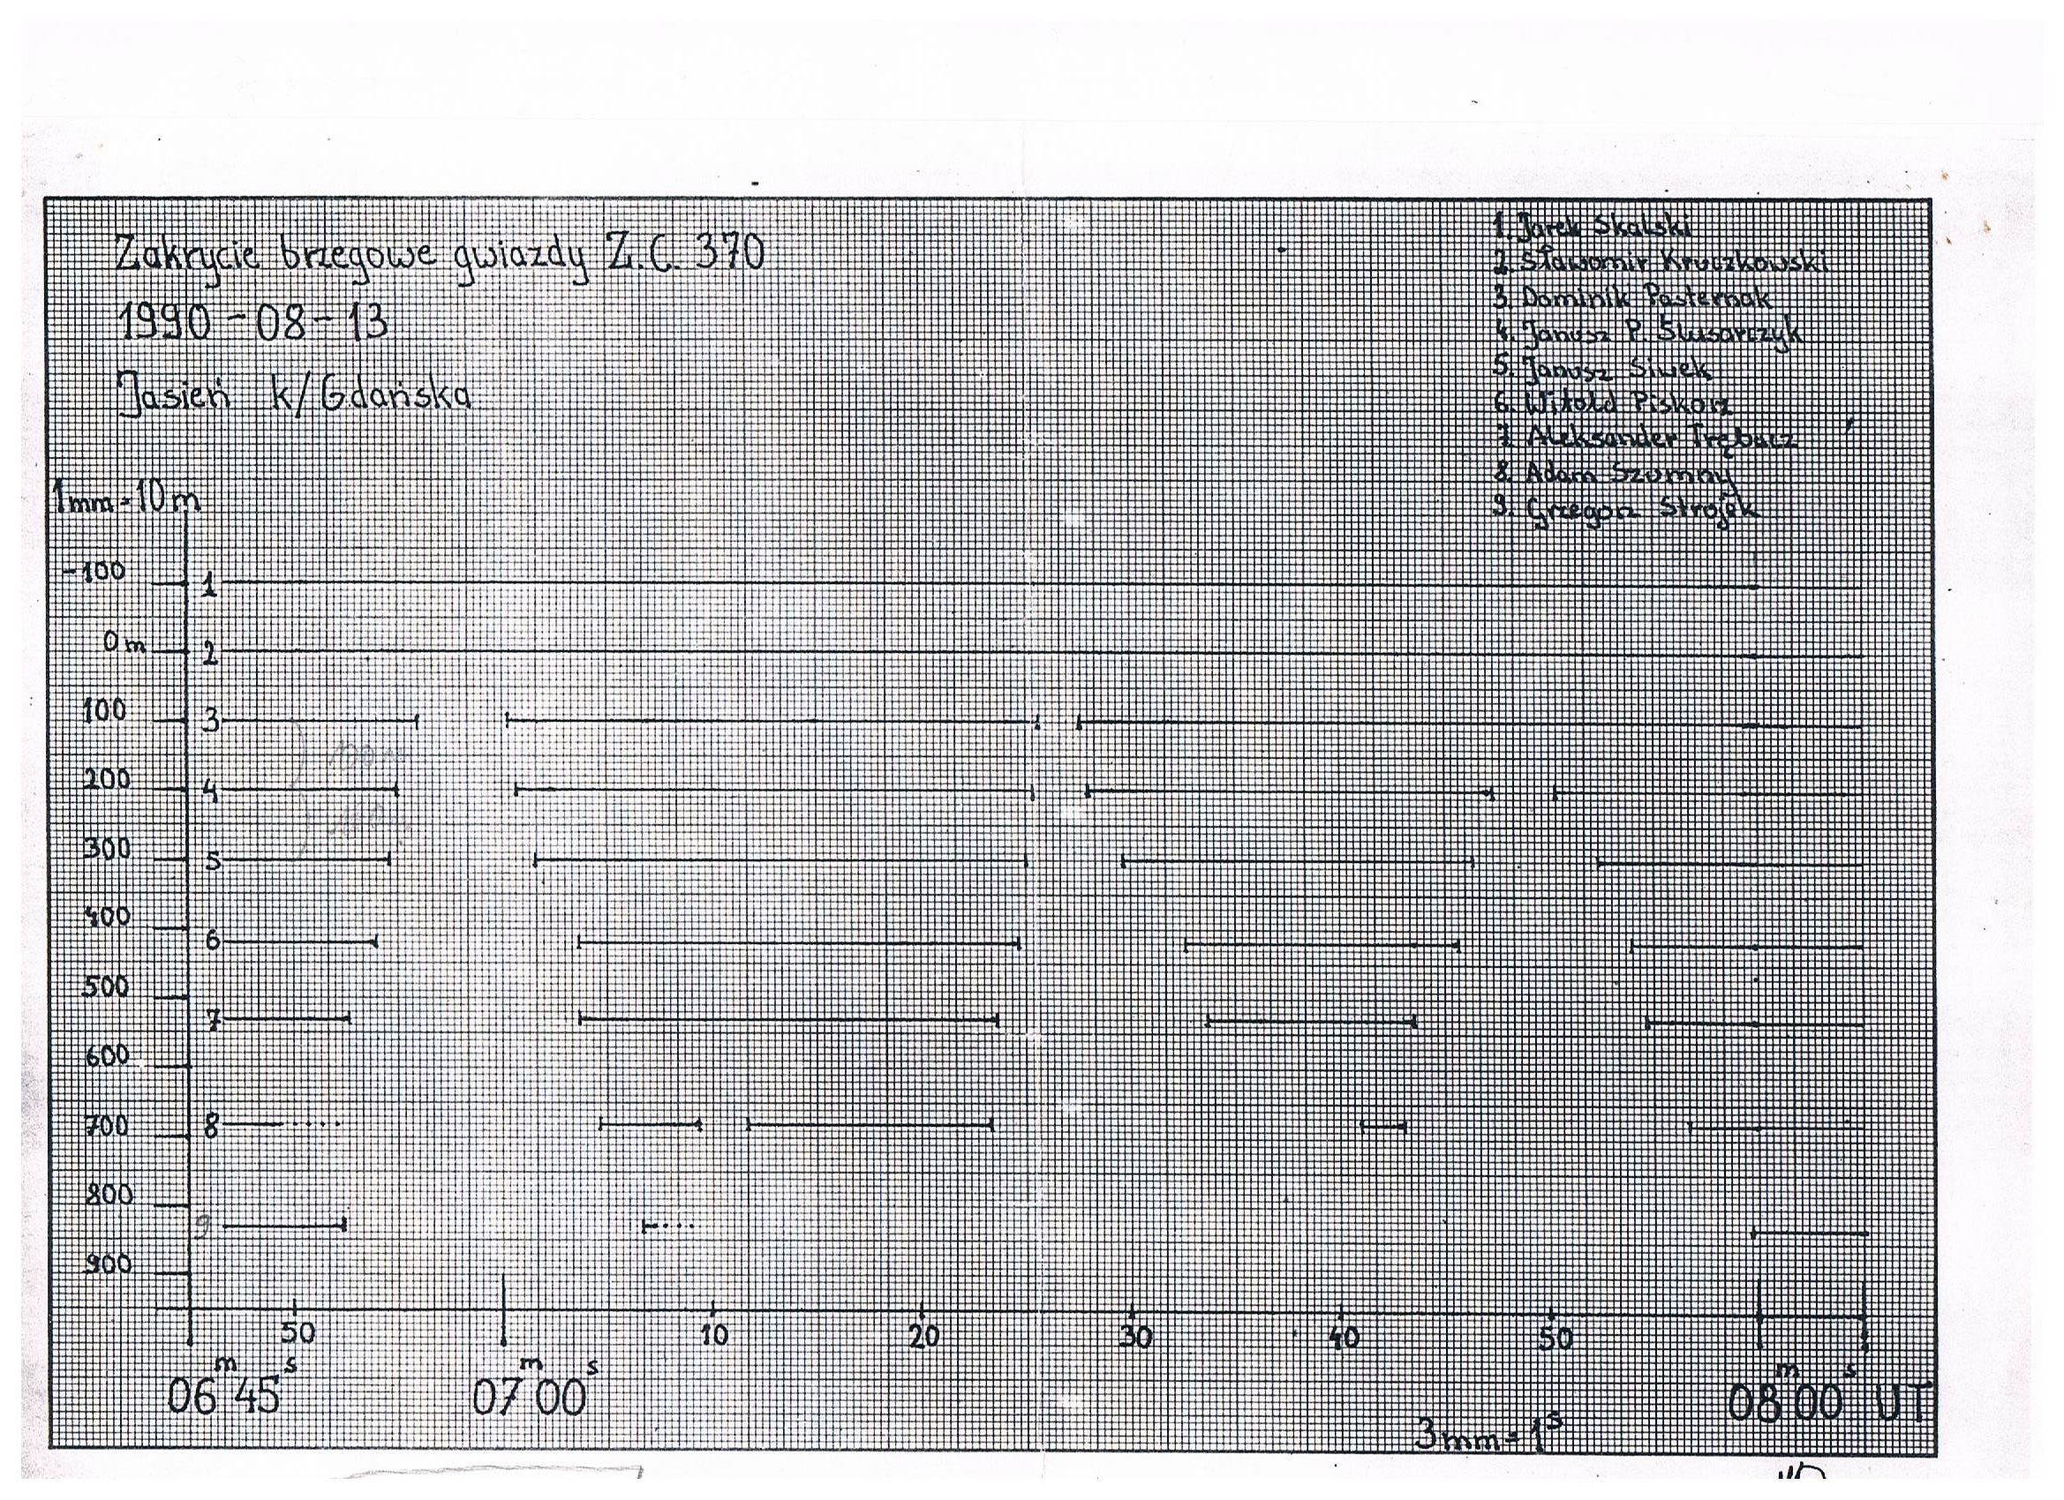
Graze of R 370, Jasień, Aug 13, 1990

Slide 21
Some important milestones, cont.
First observation of a lunar graze (of α Cancri) at two locations by two independent teams (Bolimów and Lubaczów) – Apr 29, 1993.
Program OCCULT v.1.0 implemented on IBM/PC (Łódź) – Nov, 1993.
Asteroidal occultation in the New Year’s Day observed (Niepołomice, A.Trębacz, W.Piskorz) – Jan 1, 1994; it was a trans-continental observation, seen in the USA, too.
Program EVANS v.1.0 implemented on IBM/PC (Łódź) – 1994.
ESOP XIII in Kraków – August 1994.
First positive group observation of the asteroidal occultation - PPM 227 166 by (30) Urania (southern Poland) – May 15, 1995.
LOW (Lunar Occultation Workbench) software implemented - 1996.
Time Inserter GaPaJaWil - 1997
Most north graze observed–Krokowa, Aug 28, 1997
Video-recording of the total lunar eclipse sent to Australia where it was elaborated by B.W.Soulsby– Łódź and Warsaw, Sept 16, 1997
First Slovak-Polish graze (of Aldebaran) failed because of clouds – Nov 15,1997
First successful Slovak-Polish graze (of Aldebaran) – Tachty, Feb 5, 1998

Slide 22
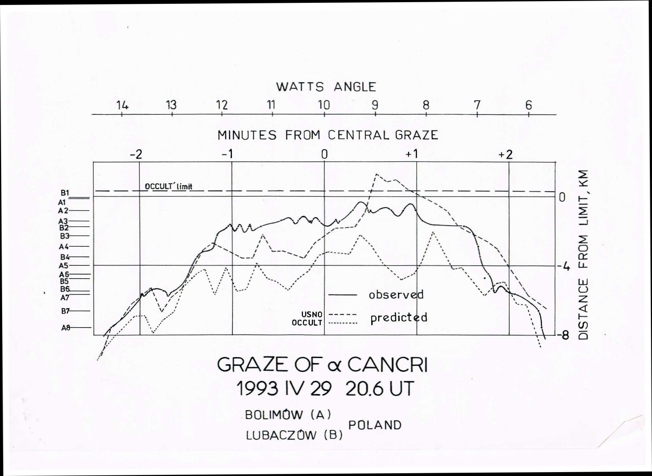

Slide 23
Some important milestones, cont.
The best observed graze (of Aldebaran) observed at 21 stations– west of Łódź, Polish-Czech-Slovak team (plus 2 stations at Poznań), 126 contacts in total, Apr 28, 1998.
Three grazes without predictions observed – 1997 Mar 16 at Łódź (at 16 km from the limit), 1998 V 1 at Jarosław (7 km) and Jun 19, 1998 at Bydgoszcz (9 km).
Observation of the asteroidal occultation without the EAON prediction – Sanok, W.Słotwiński, May 24, 1998.
Negative asteroidal occultation for the group observation inside the path in Poland (6 stations) and Slovakia – Sep 22, 1998.
The graze od Regulus almost failed (due to clouds) near Wałbrzych – Apr 24, 1999.
The expedition to the total solar eclipse in Hungary – Aug 11,1999.
The participation in the graze occultation expedition in the Netherlands (M.Borkowski, M.Zawilski) , 63 contacts in total – Oct 16, 1999.
ESOP XIII in Łódź – Aug 2000.
Two grazes observed during the same night : ZC 1030 (Wojaszówka, 12 stations) and ZC 1055 (Kalwaria, 9 stations) – Sept 29/30, 2002.
Transit of Mercury successfully observed – May 7, 2003.

Slide 24
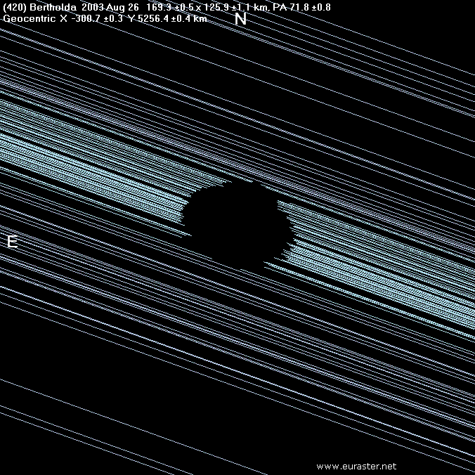

Slide 25
Some important milestones, cont.
Successful group recording of the asteroidal occultation (Bertholda) - S-W Poland, 4 stations (+8 other negative) – Aug 26, 2003
Next successful group recording of the asteroidal occultation (Alphonsina) near Koszalin – Dec 22, 2003.
ERC_READ for Windows – 2003 (J.Wiland).
Transit of Venus everywhere observed – Jun 8, 2004.
The expeditions to the total solar eclipse in Turkey and Egypt – Mar 29, 2006.
The occultations of Saturn successfully observed – Mar 2 and May 22, 2007.
Occult Watcher implemented – 2007.
Venus occultation observed in southern Poland – Dec 1 ,2008.
ESOP XIX in Niepołomice – Aug 2009.
Watec camera used – 2010.
Transit of Venus observed in its final phase – Jun 6, 2012.
Paweł Maksym died – Feb 13, 2013.
Roman Fangor died – Nov 19, 2013.
Jerzy Speil died – Feb 19, 2015.

Slide 26
Some important milestones, cont.
IOTA time inserter used – 2014.
The graze of Aldebaran recorded and live stream organized– N-E Poland – Apr 21, 2015.
Transit of Mercury successfully observed – May 9, 2016.
Methodology of exoplanetary transits observations elaborated – G.Murawski – 2016.
Arduino time inserter implemented – P.Smolarz -2017.
The Himalia occultation recorded at 5 stations (E.Bredner, A.Marciniak, R.Hirsch, M.Zawilski, A.Nowak) with unclear results – May 20, 2018
Asteroidal occultation (Hedwig) of a double star recorded – M.Jarmoc at Białystok –
Jul 26, 2018
The Catalog of Historical Observations of Solar Eclipses (almost) completed – M.Zawilski – 2018
The graze of a star fainter than 11 mag recorded (M.Jarmoc, W.Burzyński), Apr 11, 2019

Slide 27
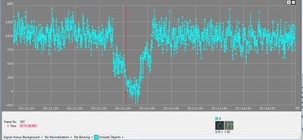
Asteroidal occultation (Hedwig) of a double star recorded – M.Jamroc at Białystok –
Jul 26, 2018

Slide 28
SOME STATISTICS
Lunar occultations 1979-2004: 11 083 contacts
including 545 contacts during grazing occultations
Graze expeditons 23
Leaders: Mieczysław Szulc, Wiesław Słotwiński ……
Jerzy Speil, Janusz Ślusarczyk, Leszek Benedyktowicz, Roman Fangor, Janusz Wiland…..
Grzegorz Kiełtyka, Mieczysław Borkowski, Artur Wrembel, Marek Zawilski, Jerzy Olech, Wilhelm Dziura….

Slide 29
Some archive pictures will be shown later

Slide 30
FUTURE ACTIVITY
Different phenomena
Different instruments
Different methods
Various ideas
New observers needful
?????

Slide 31
After the formal and unformal management of our work for 30 years…..
… I’d like to delegate my tasks as the Section co-ordinator to Wojciech Burzyński.
Good luck for him and for all observers!

