Slide 1
"History of the ESOP and cooperation between SOPIZ and IOTA / ES"
Konrad Guhl (president@iota-es.de)
www.iota-es.de

Slide 2
What is IOTA, IOTA/ES and ESOP?

Slide 3
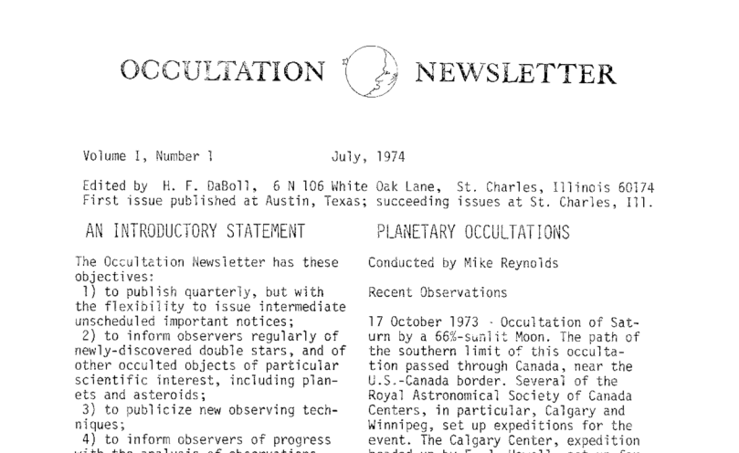
What is IOTA ?
1983 official born by amateur and professionals founded, main driver David Dunham
But ON starts 1974
In 1960 a young business man H. J. Bode ...

Slide 4
IOTA today:
IOTA for America and Japan
IOTA/ES
IOTA/ME
LIADA(La Liga Iberoamericana de Astronomía)
RASNZ (Royal astronomical society of new Zeeland)
National groups like SOPIZ or SOTAS…

Slide 5
Highlights of occultation astronomy
1953 Pressure and temperature of Jupiter atmosphere
1977 Discovery of the Uranian ring system by the Kuiper
Airborne Observatory
1988 Discovery of Pluto atmosphere
1989 Observation of the central flash of Titan, details of Titan's
atmosphere
2002 Expanding of Pluto atmosphere discovered
2005 Precise diameter of Pluto satellite Charon
2010 Precise diameter of Eris by occultation
2014 Detection of a ring around Chariklo

Slide 6
What is IOTA/ES ?
HJB worked as president AAH
David Dunham founded 1983 official IOTA
HJB and his friends held ESOP 1 and 2 in Hannover
Contact list → Maliczek → ESOP III in CSSR
Gentlements agreement
Poland partner for ESOP V in 1986 in Warszawa

Slide 7
IOTA/ES today
88 member in 18 European countries (Poland 4 member today)
Organize ESOP, Produce and publish JOA since 2011
Host M2 telescope
Partner in ERP program “Lucky Star”

Slide 8
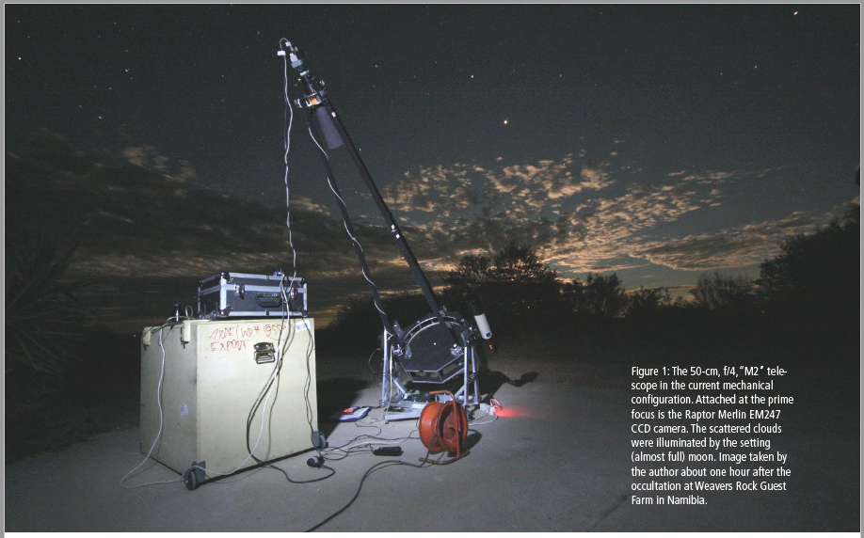
„M2“ a transportable telescope 500mm f=2m

Slide 9
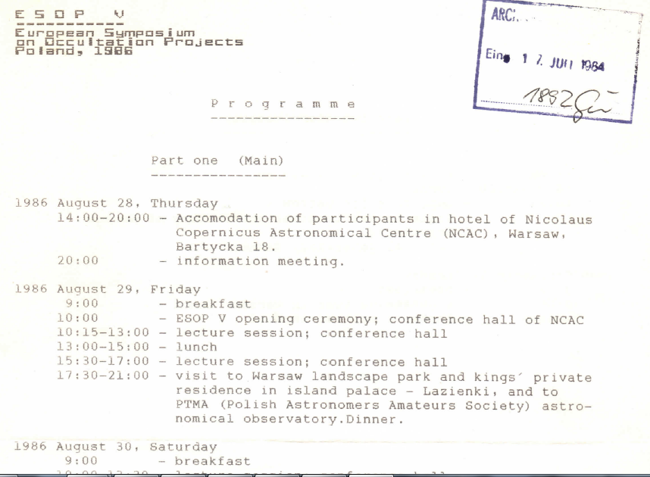
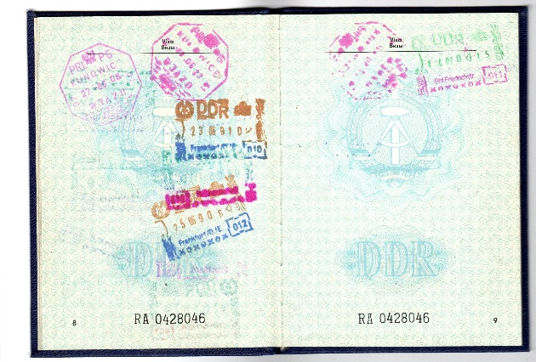
Warszawa 1986:

Slide 10
In ESOP history:
12 times Germany,
5 times Czech Republik
4 times POLAND (1986, 1994, 2000, 2009) + 2020 = 5
3 times UK and Italy
Twice B, NL, SP,
one DK, F, SU, SK
2019 No XXXVIII in Paris
http://lesia.obspm.fr/lucky-star/esop38/

Slide 11
A job to do ?
http://www.iota-es.eu/ESOP/index.htm

Slide 12
Thank you….
Join us – IOTA/ES

