Slide 1
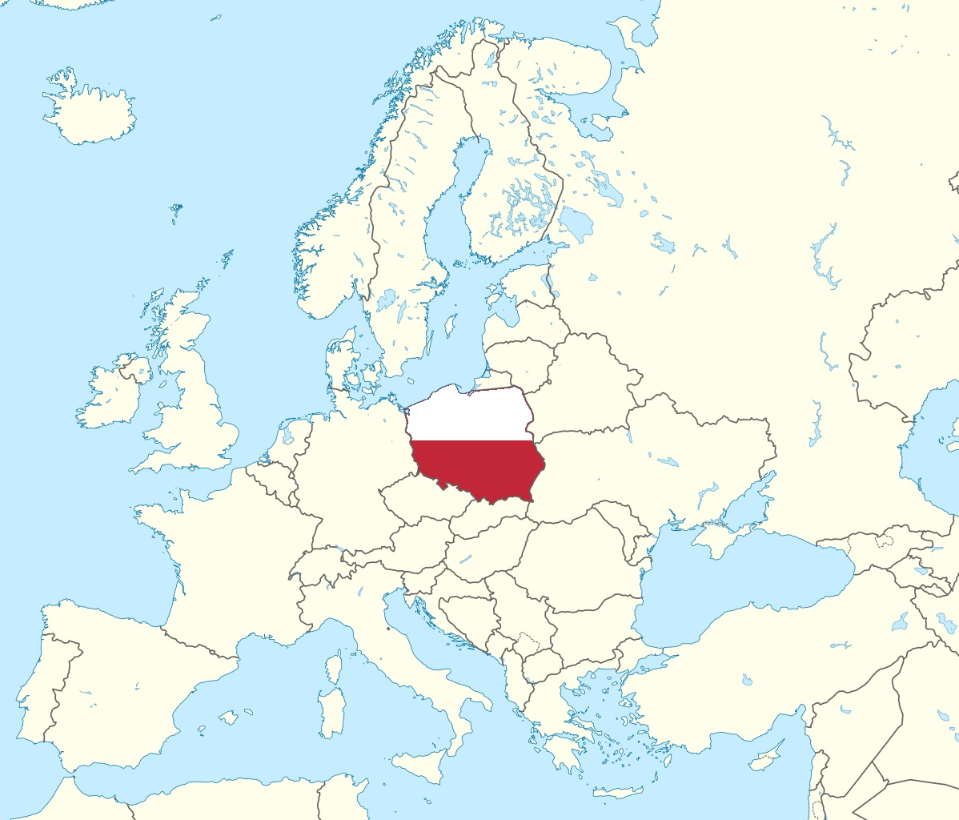
The history of occultation observations in Poland
MSc Eng. Wojciech Burzynski
The Occultation Section of the Polish Amateur Astronomers Society, IOTA/ES

Slide 2
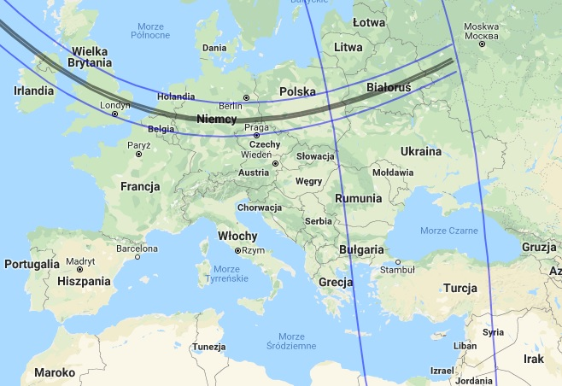
The first occultation event probably noticed...
The total solar eclipse on Oct 29th, 878 AD, was propably noticed by Slavic pagan tribes - 88 years before the beginning of Polish statehood (the Baptism of Poland in 966 AD)

Slide 3
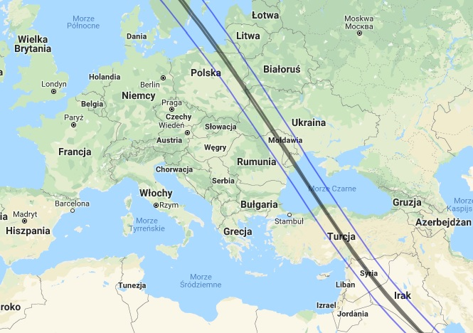
The first written report in historical sources...
...is about the total solar eclipse on Sep 4th, 1187 AD.
Described as „a great eclipse with stars visible in the sky” in „Annales seu cronicae incliti Regni Poloniae” written by Jan Dlugosz in 15th century.

Slide 4
In over a thousand years of Polish history, total solar eclipses (excluding ring ones) took place 17 times In brackets selected larger cities and towns where totality was seen
20 III 1140 (Slupsk, Wladysławowo, Hel)
4 IX 1187 (Gdansk, Olsztyn, Warszawa, Bialystok, Lublin, Lwow)
26 VI 1321 (Wloclawek, Leszno)
16 VI 1406 (Szczecin, Kołobrzeg, Swinoujscie)
7 VI 1415 (Wroclaw, Katowice, Krakow, Łodz, Kielce, Warszawa, Lublin, Bialystok)
26 VI 1424 (Szczecin, Poznan, Torun, Czestochowa, Łodz, Warszawa, Lublin, Lwow)
16 III 1485 (Zakopane, Stryj, Tarnopol)
24 I 1544 (Olsztyn, Plock, Sieradz)
12 VIII 1654 (Slupsk, Gdansk, Olsztyn, Siedlce, Biala Podlaska)
23 IX 1699 (Swinoujscie, Pila, Radom, Zamosc, Tarnopol)
12 V 1706 (Gdansk, Poznan, Torun, Wroclaw)
13 V 1733 (Wladyslawowo, Hel, Braniewo)
19 XI 1816 (Slupsk, Bydgoszcz, Wlocławek, Łodz, Warszawa, Rzeszow)
8 VII 1842 (Zakopane, Rzeszow, Przemysl, Lwow)
28 VII 1851 (Gdansk, Olsztyn, Warszawa, Bialystok, Lublin, Tarnopol)
19 VIII 1887 (Gorzow Wielkopolski, Poznan, Bydgoszcz, Torun, Olsztyn, Suwalki, Wilno)
30 VI 1954 (Suwalki, Sejny)

Slide 5
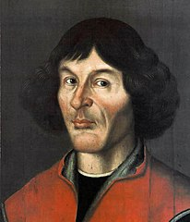
Nicolaus Copernicus (1473-1543), Frombork - N Poland astronomer, mathematician, lawyer, economist, medicine doctor
BRIGHT STAR OCCULTATIONS BY THE MOON:
- Aldebaran: 1497 (Bologna, Italy)
PARTIAL LUNAR ECLIPSE: 1500 (Roma, Italy)
OCCULTATION OF VENUS BY THE MOON: 1529
On 12th March 1529 Copernicus made his second and first in Poland observation of a lunar occultation. According to his work “De Revolutionibus...” he noticed the disappearance of the planet at one hour after sunset and a reappearance after the next hour, both events were assessed as central ones.
PARTIAL SOLAR ECLIPSES: 1530, 1536, 1539, 1540, 1541

Slide 6
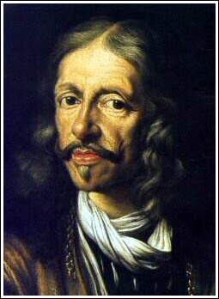
Jan Hevelius (1611-1687), Gdansk - N Poland Royal Astronomer, mathematician, brewer
BRIGHT STAR OCCULTATIONS BY THE MOON:
- Aldebaran: 1644,1645, 1664, 1681
- Regulus: 1683
- Spica: 1660
TRANSIT OF MERCURY : 1661
OCCULTATION OF SATURN BY THE MOON: 1630
PARTIAL SOLAR ECLIPSES: 1624, 1639, 1650, 1661
TOTAL SOLAR ECLIPSE: 1654 – clouded sky

Slide 7
XVIII century
Few other solar eclipse observations were made in the 18th century.
On 6 June 1761, Jakub Niegowiecki, the astronomer of the Jagiellonian University of Cracow, observed the transit of Venus obtaining quite good results. At the same time the transit was observed at Warsaw by Stefan Łuskina.
Only at the end of 18th century some astronomers began their regular observations of occultational phenomena. This was connected with the foundation of observatories in Vilnius, Gdańsk and Poznan.
In Vilnius Odlanicki-Poczobutt was then observing lunar occultations in order to find the geographical longitude of the observatory.
First recording of an annular solar eclipse was made on 5 September 1793 by Jowin Bystrzycki who observed from the Royal Castle observatory in Warsaw. He described the annularity as perfectly symmetric and recorded 2nd and 3rd contact.
The occultation of Venus by the Moon on 24 November 1799 was the first such observation after Copernicus (Jan Sniadecki, Cracow Univ. Obs.) He also observed several total lunar occultations of stars at Cracow.

Slide 8
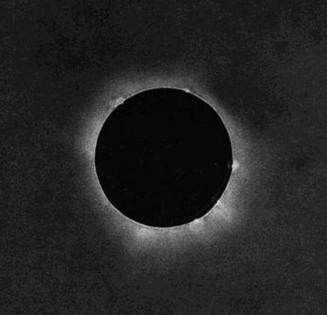
XIX century
The founding of the new University Observatory in Warsaw in 1825 made it possible to observe among others lunar occultations regularly (F. Arminski)
The first photo of a total solar eclipse was taken on July 28, 1851, by Johann Julius Friedrich Berkowski (Polish roots because of surname?), who was said to be the most skilled daguerreotypist in the Prussian city of Königsberg (formerly Krolewiec, Poland - now Kaliningrad, Russia).
At the same time, Karol Bayer - Polish photographer from Warsaw did the same, but his daguerreotypes have not survived until the present day.
The astronomer Adam Prazmowski made careful measurements of the polarization of the crown and protuberance light and detected that only the crown sends polarized light.

Slide 9
The beginning of XX century
In 1901 Tadeusz Banachiewicz began regular observations of lunar occultations from Warsaw Unviv. Obs. However, he was, among others, the pioneer in observations of planetary occultations. In 1903 he predicted the occultation of a star in Aquarius by Jupiter and successfully observed the event. Next he predicted other similar phenomena.
In 1927 he designed so called “chronokinematograf” (photo below), a device for recording solar eclipses. The idea was creating the light signals according to radio time signals. The spots were next recording on the film together with the image of the sun. The device had been used during the solar eclipses in 1927 in Lappland, in 1932 in the USA and in 1936 in Greece, Siberia and Japan.

Slide 10
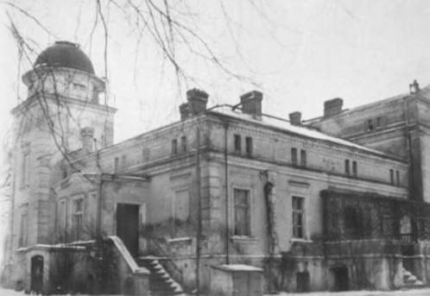
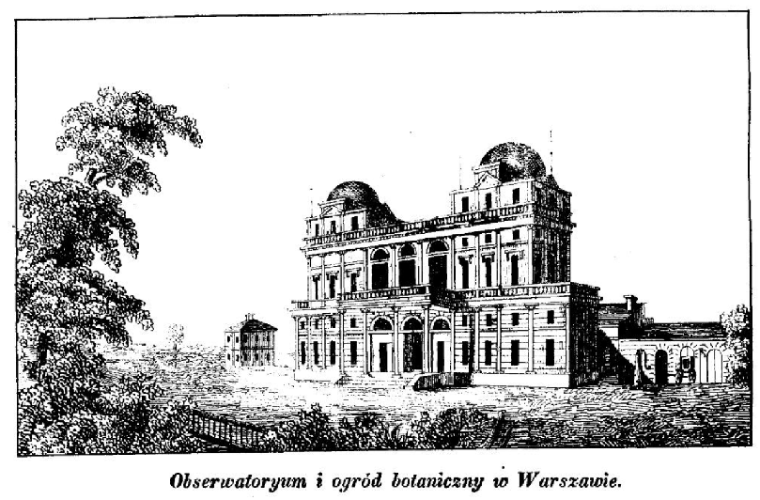
Interwar period (1918 – 1939)
BRIGHT STAR OCCULTATIONS BY THE MOON
were observed by University Observatories in the biggest Polish cities:
Crakow, Warsaw (right image), Wroclaw, Poznan (left image)
Aldebaran: 1923 x2, 1924 .... Regulus: 1924, 1932 .... Spica: 1931
Polish Amateur Astronomers Society was founded in 1919

Slide 11
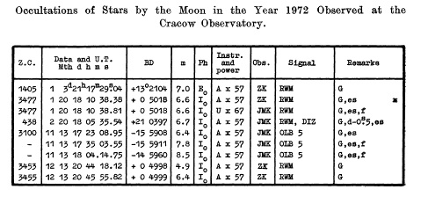
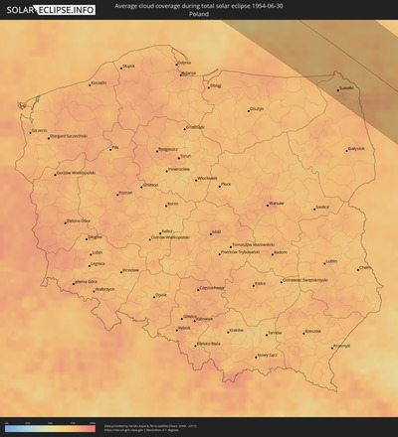
After the Second World War
In June 1954, the last seen total solar eclipse in Poland took place – many expeditions of Polish professional astronomers to path of totality (Sejny, NE Poland)
From late 1960s, few amateurs were trying to record lunar occultations and eclipses on their own, using various techniques and without any coordination
The photoelectric observations of occultations started in 1970s in the
new Cracow Observatory (Fort Skala).
In 1976 a local Warsaw Section of Positional Observations was established - observations for asteroids (1) Ceres, (9) Metis, (16) Psyche and (1580) Betulia, Halley Comet and Bernard Star were made.

Slide 12
The Occultation Section of the Polish Amateur Astronomers Society
The Occultation Section of the Polish Amateur Astronomers Society (pol. SOPiZ PTMA) was founded in 29th April 1979.
IOTA was born in May 1975, IOTA/ES in June 1976.
„Golden Ages” between 1991 and 2001 when over 40 members were been able to observe over 600 total lunar occultations per year – it was 6-9 % of global observations. Grazing expeditions in 90’s have had over dozen people.
„Dark Ages” from 2005 to 2015 – internal discussions on the further form of the Section and the ILOC announcement to stop collecting total lunar occultation observations since March 2009 caused strong weakening of observers activity.
Unfortunately between 2012 and 2015 our most active and charismatic members have passed away. The biggest problem now is the lack of new members and the aging of those present.

Slide 13
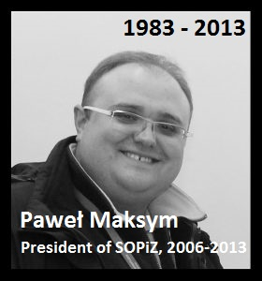
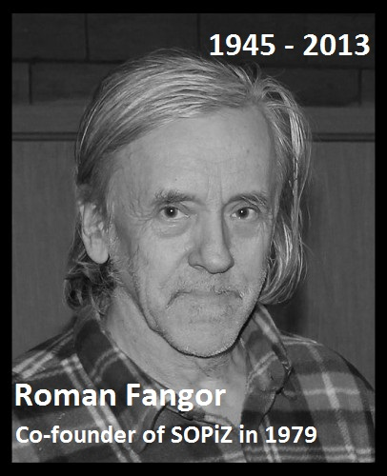
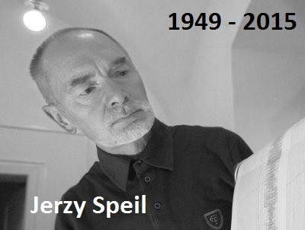
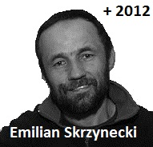
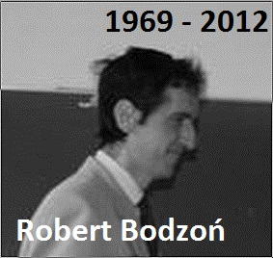
The Occultation Section of the PAAS (pol. SOPiZ) They have passed away between 2012 and 2015

Slide 14
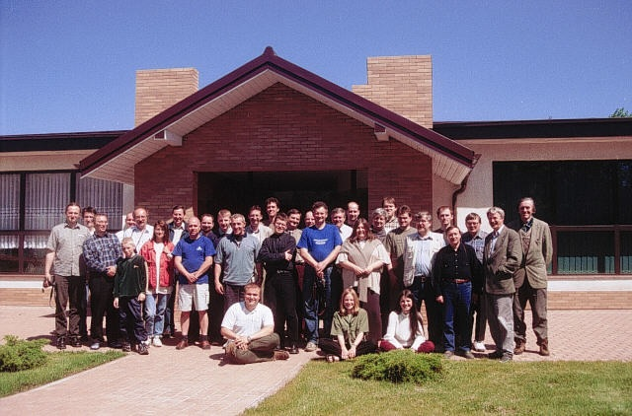
The Occultation Section the PAAS
Annual two-day members conferences between 1980 and 2009, resumed in 2017
XXI Conference of the Section in Jastrzebia Gora (Baltic Sea coast, Jun 2002)

Slide 15
The Occultation Section of the PAAS - developmental milestones
1980 – The Electronic Time Recorder (pol. „ERC”) made by R. Fangor
1982 – first use of electronic stopwatch for occultation work
1985 – first use of photomultiplier for occultation work
1986 – first occultation software for ZX Spectrum computers have been written by
M.Zawiski, R. Fangor, J. Wiland, et al.
1989 – „ERC READ DATA” – the software for reading audio casette tapes
has been written by J. Wiland
1990 – first use of sensitive CCD TV camera for occultation work
1990 – first use of the DCF module for occultation work – L. Benedyktowicz
1993 – use of blinking LED in the CCD’s field of view
1993 – The Microprocessor Time Recorder (pol. „MRC”) made by J. Wiland
1997 – first video time inserter based on the DCF signal made by J. Wiland
1997 – first use of the GPS handheld device (station coordinates meas.)
2013 – first video time inserter based on the GPS signal made by T. Wezyk
2015 – the VTI based on the Arduino board (open source project) by P. Smolarz

Slide 16
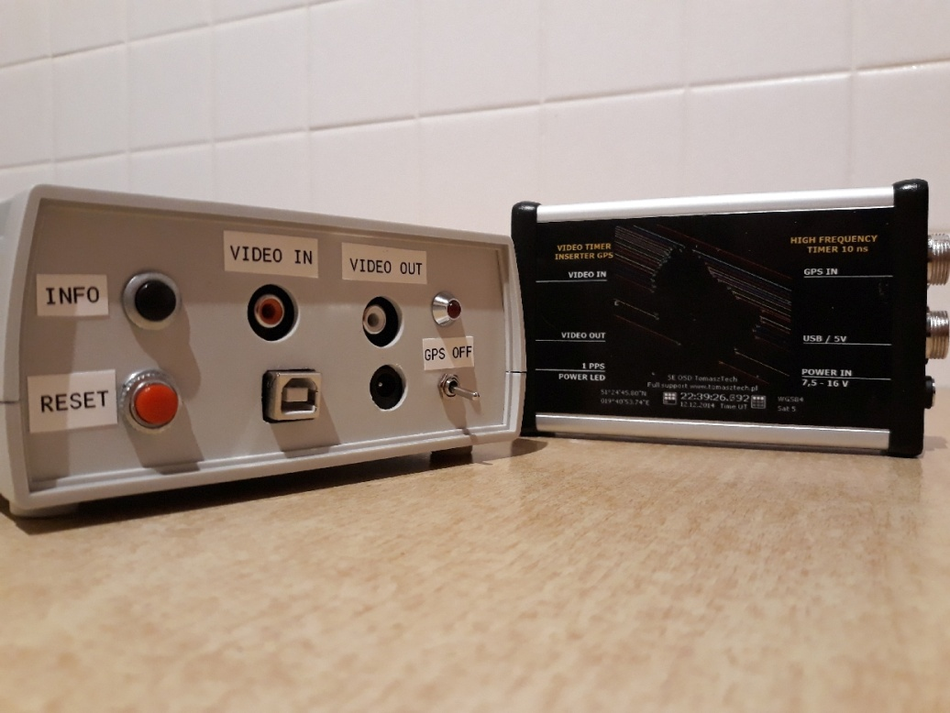
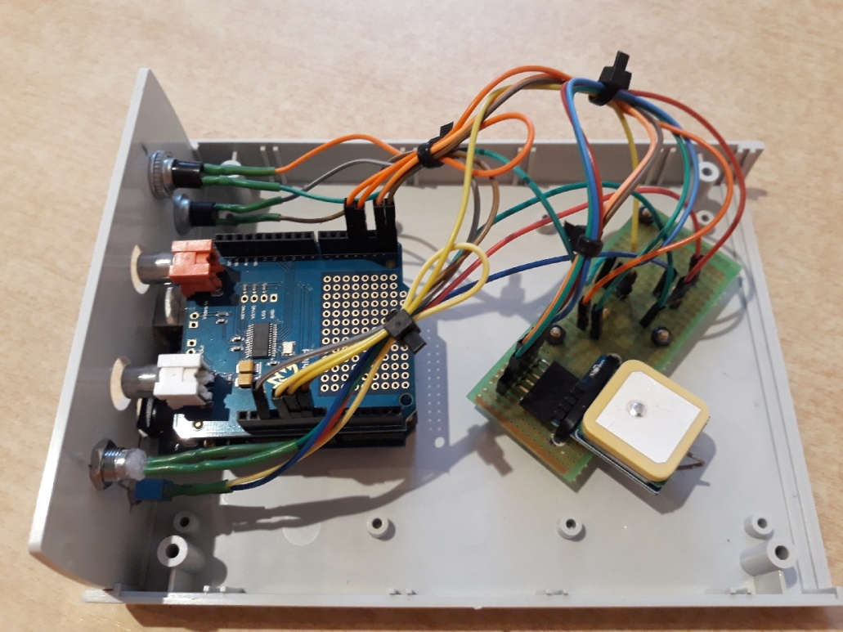
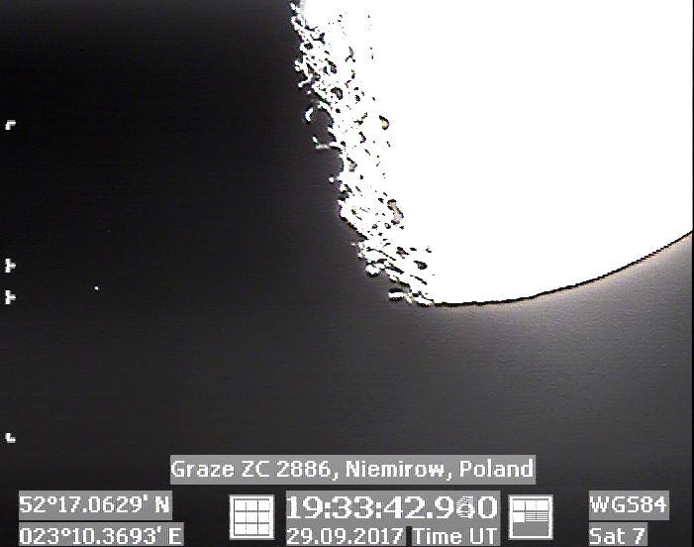
The Occultation Section of the PAAS - hardware making (DIY)

Slide 17
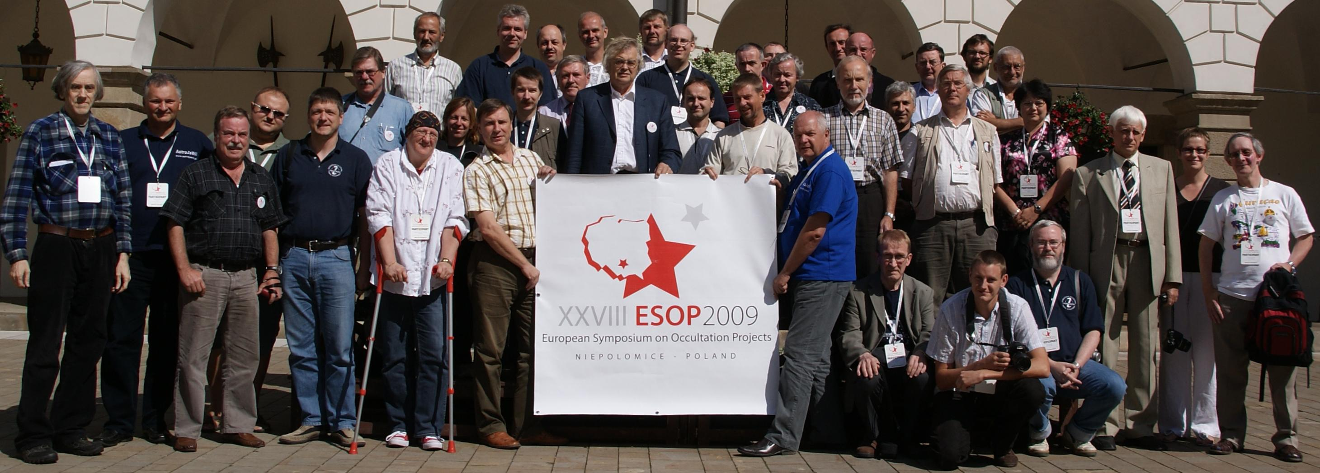
The Occultation Section of the PAAS
Since 1984 members of PAAS Occultation Section have participated in European Symposium on Occultation Projects (ESOP). Four ESOPs were organized in Poland:
1986: Warsaw / Lodz 1994: Krakow
2000: Lodz 2009: Niepolomice near Krakow (photo below)

Slide 18
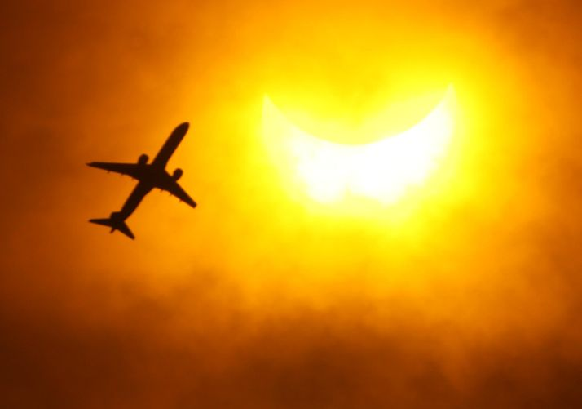
The Occultation Section of the PAAS
Total and annular solar eclipse expeditions to:
- 1980 : Peru - Tambo de Mora
- 1990 : Finland - Joensuu, Russia - Bielomorsk: 200 km S from the Arctic Circle
- 1991 : Mexico - Mexico City
- 1999 : Hungary - Siofok (Lake Balaton)
- 2005 : Spain - Toledo
- 2006 : Turkey - Side
and Egypt - El Salloum (Lybian border)
- 2008 : Russia - Novosibirsk
- 2009 : China - Shanghai
- 2017 : USA - Riverton (Wyoming)
Partial phase of the TSE in 2009 taken from high-speed train near Shanghai – W. Burzynski

Slide 19
The Occultation Section of the PAAS
ASTEROIDAL OCCULTATION
In 1988 first positive asteroidal occultations have been recorded:
14 IV 1988 - SAO 120975 – the 7.3 mag star and (772) Tanete at Olsztyn Observatory,
N Poland, by Jan Tatyrza (however without timing)
09 VIII 1988 - SAO 56117, 7.5 mag star and (626) Notburga
at Ksiaz Castle, SW Poland, by Jerzy Speil
(also missing near Lublin, E Poland, was
obseerved by Mieczysław Paradowski)
01 I 1994 - PPM 96118, 8.2 mag star and (144) Vibilia - the second successful
asteroidal occultation by Witold Piskorz at Niepolomice Observatory,
S Poland (1st positive on the world in 1994!)

Slide 20
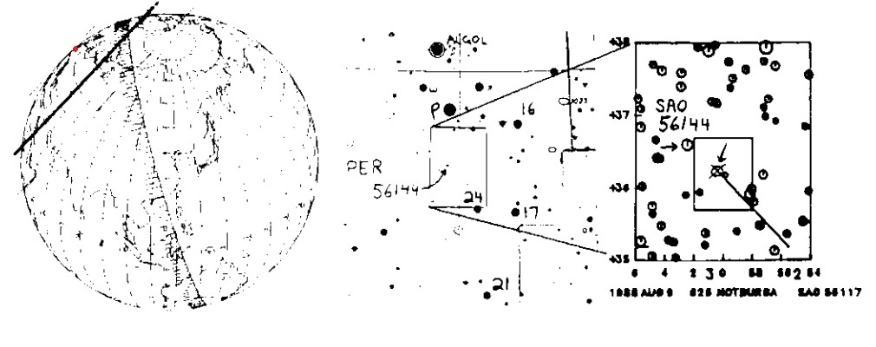
Occultation SAO 56117 by (626) Notburga
Source : Occultation Newsletter, IOTA - VOL. IV, No 8, Jun 1988

Slide 21
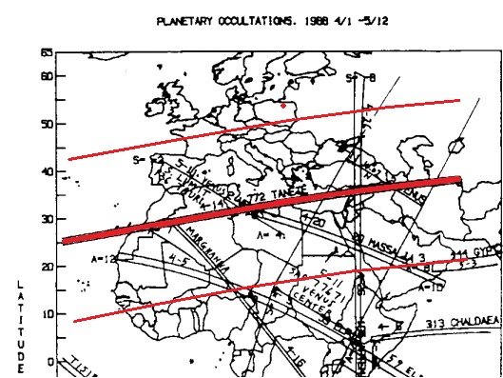
Occultation of SAO 120975 by (772) Tanete in 1988... ...
Source : Occultation Newsletter, IOTA - VOL. IV, No 7, Feb 1988

Slide 22
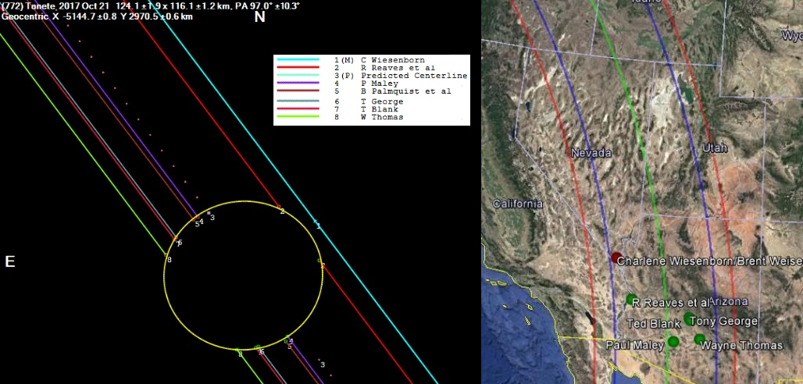
... compared to (772) Tanete occultation in 2017
Source : http://www.asteroidoccultation.com, USA 2017 Asteroidal Occultation Results

Slide 23
The Occultation Section of the PAAS
COLLECTIVE ASTEROIDAL OCCULTATION WITH POSITIVE RESULTS :
15 V 1995 - (30) Urania - the first collective observation ever,
- 5 observers, 5 POSITIVE !
26 III 1998 - (578) Heppelia – 2 observers
17 IX 2002 - (345) Tercidina – 2 observers had travelled to Slovakia
26 VIII 2003 - (420) Bertholda – 5 observations POSITIVE
and 12 MISS (135 observers in total !!)
22 XII 2003 - (925) Alphonsina – 4 observers
07 VI 2011 - (173) Ino – 2 observers
30 IX 2017 - (217) Eudora – 1 of 2 POSITIVE

Slide 24
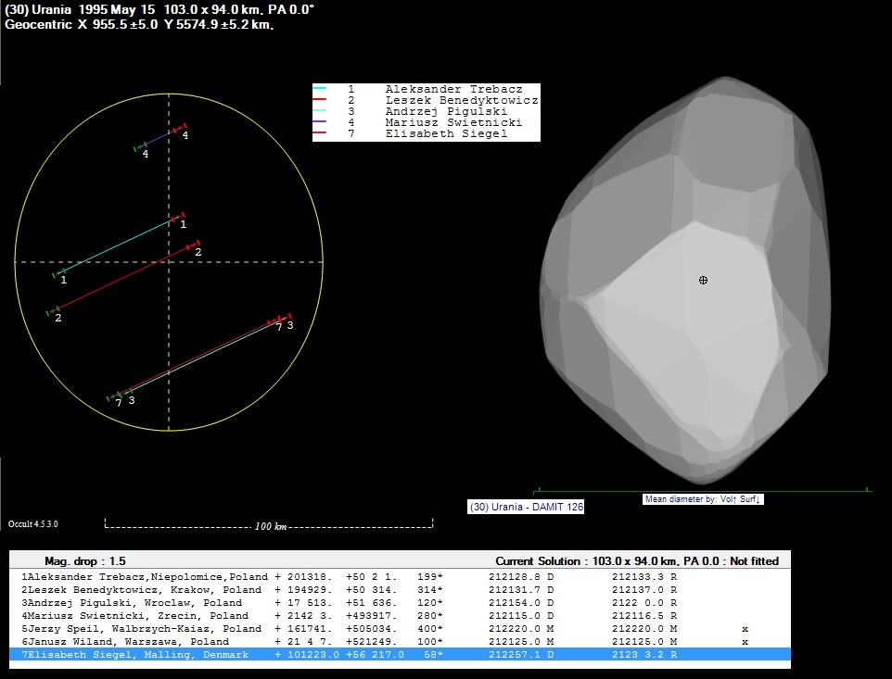
(30) Urania occultation – 5 positive obs.

Slide 25
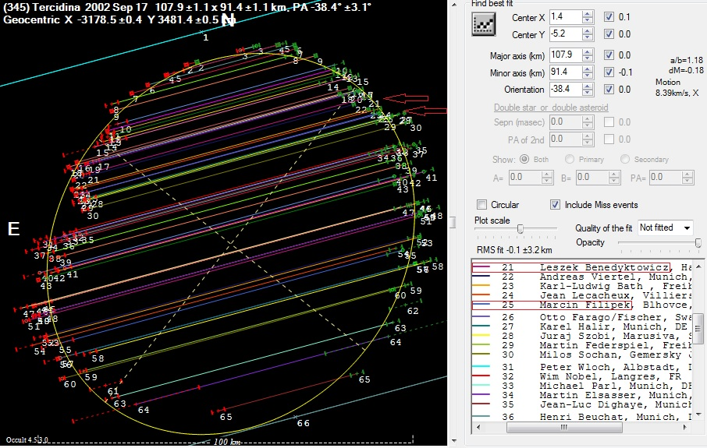
Tercidina occultation – expedition to Slovakia

Slide 26
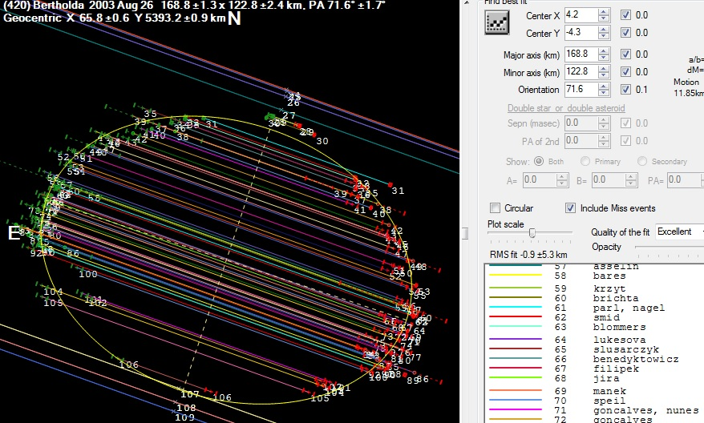
Bertholda occultation - 17 of 135 were from Poland The 3rd place in number of observers recording asteroidal occultation ever... ... and the winner is the occultation of (472) Roma in 2010 with 231 observers from Europe.

Slide 27
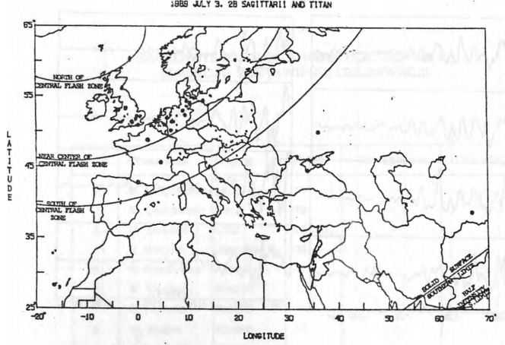
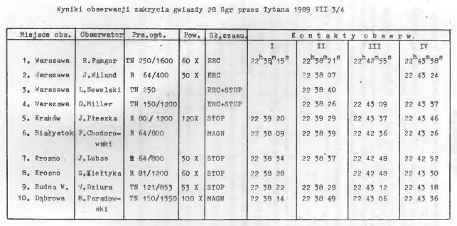
The Occultation Section of the PAAS
PLANETARY OCCULTATION:
On July 4, 1989 observations of the occultation of 28 Sgr by Titan were made in central and south-eastern Poland by 10 observers in total. Central flash was recorded in Warsaw.

Slide 28
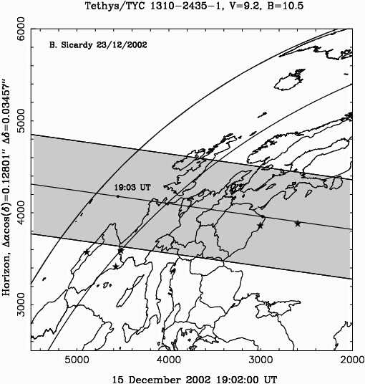
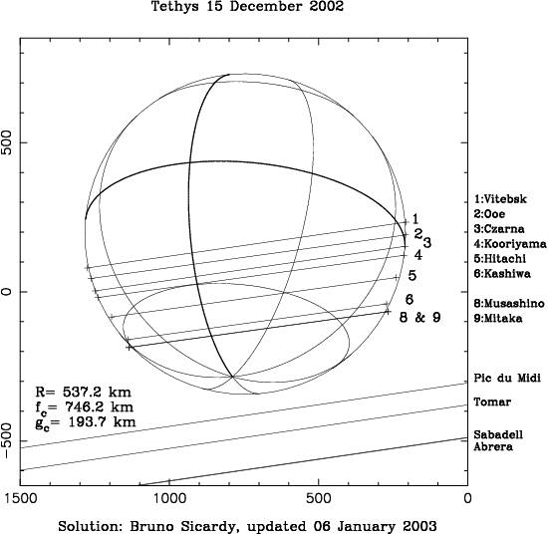
The Occultation Section of the PAAS
PLANETARY OCCULTATION:
OCCULTATION OF PPM 94676 BY TETHYS ON DEC 15th, 2002 by W. Burzynski (3)

Slide 29
The Occultation Section of the PAAS
GRAZING LUNAR OCCULTATION:
25 VIII1981 First grazing occultation result from single station observer (M. Szulc)
SAO 78221 (8.6 mag), CA = 7.7, MF: -23%
1 event (RD), OC = -1.76”
8-cm telescope, 7 km S from the graze limit line

Slide 30
The Occultation Section of the PAAS
GRAZING LUNAR OCCULTATION:
19 IV 1983 2nd grazing occultation result from single station observer (R. Fangor)
SAO 79519 (8.1 mag), CA = -2.0, MF = +43%
2 events: 1 min 2 sec between DB and RB (both bright site!), OC = 1.13”/1.81”
35-cm telescope, 1 km from the graze limit line

Slide 31
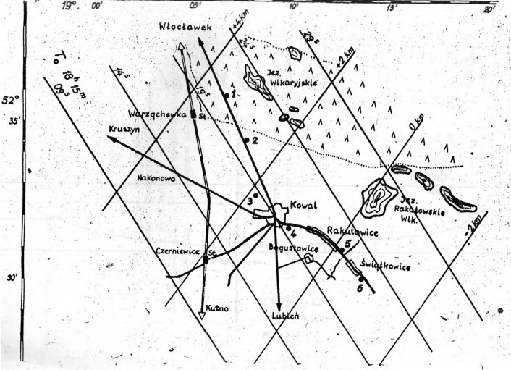
The Occultation Section of the PAAS
GRAZING LUNAR OCCULTATION:
06 X 1984 First collective grazing occultation expedition with positive results
ZC 3349 (tau Aqu), 4.0 mag
CA = 2.8 N, MF = +91% !
4 observers near Kowal,
central Poland
13 events recorded

Slide 32
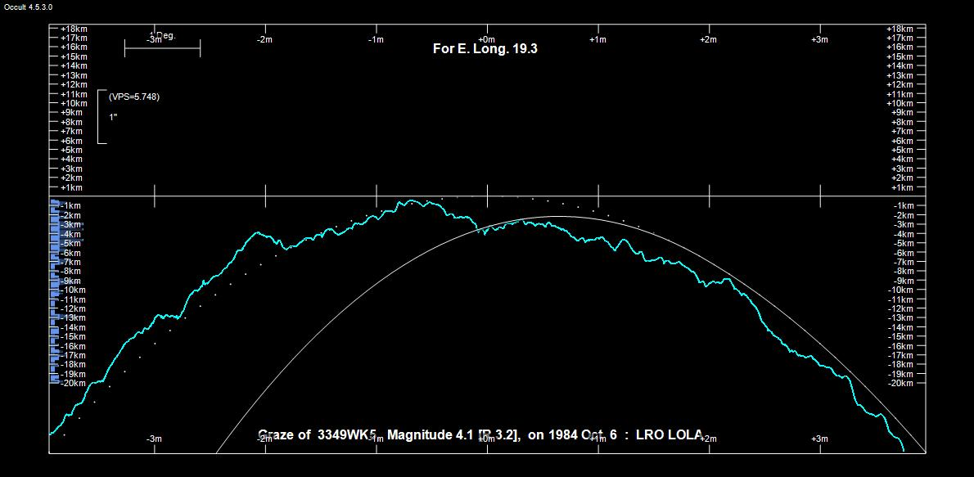
06 X 1984 First collective grazing occultation expedition with positive results

Slide 33
The Occultation Section of the PAAS
12 VIII 1990 Second collective grazing occultation expedition with positive results
- 10 stations near Gdansk-Jasien, N Poland
- 10 observers had travelled over 560 km from S Poland ! (Niepolomice Obs. team) - 42 events recorded

Slide 34
The Occultation Section of the PAAS
28.04.1998 The greatest grazing occultation expedition in Poland ever (Aldebaran)
- 29 stations near Lodz, central Poland - 42 observers (9 were from Czech Republic and Slovakia) - 142 events recorded ! - mean residual of events: - 0.019" ± 0.098"

Slide 35
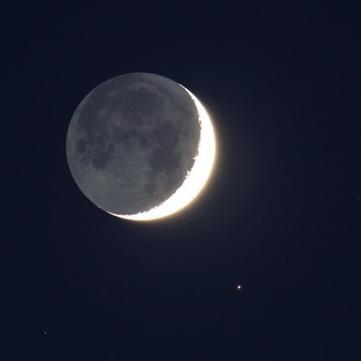
The latest activity – Aldebaran grazing occultation on 21st April 2015
Nowinka, NE Poland
8 observers
64 events
mean residual of events: - 0.006" ± 0.045"

Slide 36
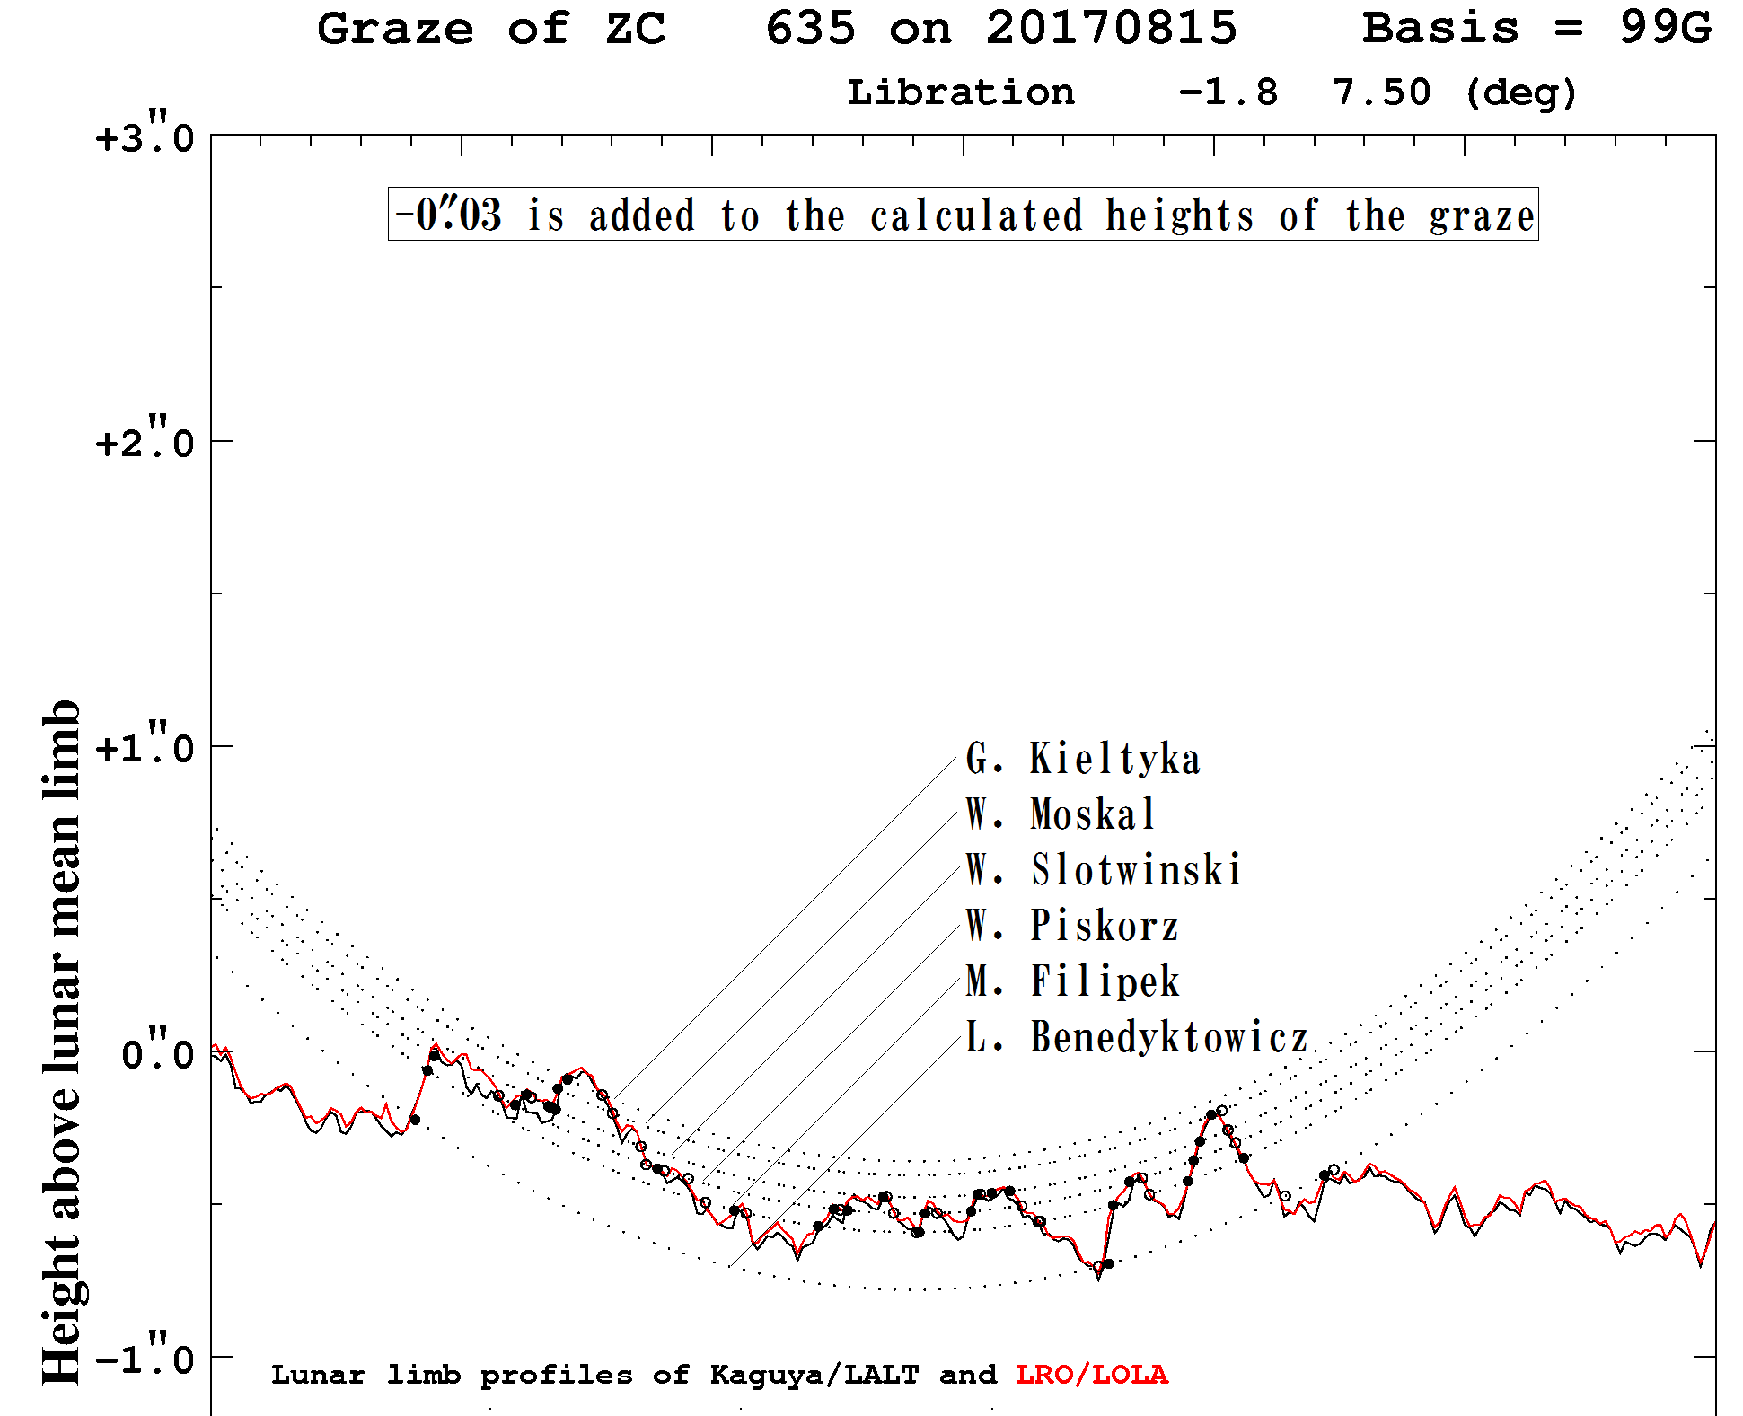
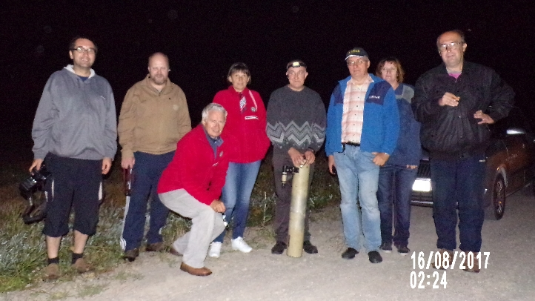
The latest activity – lunar grazing occultation on 15th Aug 2017
In 2017, 3 of 18 reported global grazing occultation were observed in Poland
6 observers
58 events
mean residual
of events:
0.007" ± 0.039"

Slide 37
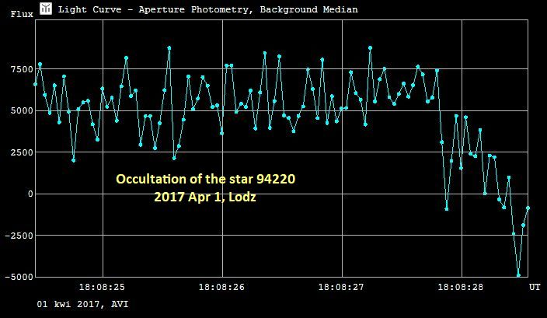
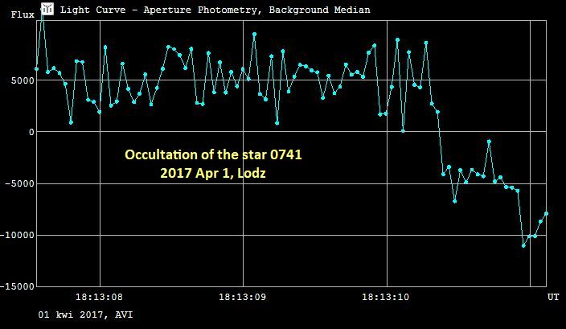
The latest activity – double star occultations
Observations of double star occultations by dr Marek Zawilski on 1st Apr 2017
separation 0.08 - 0.1” both

Slide 38
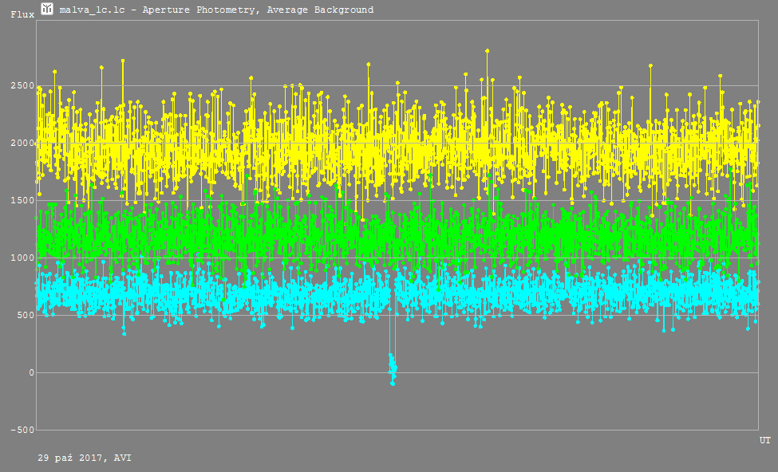
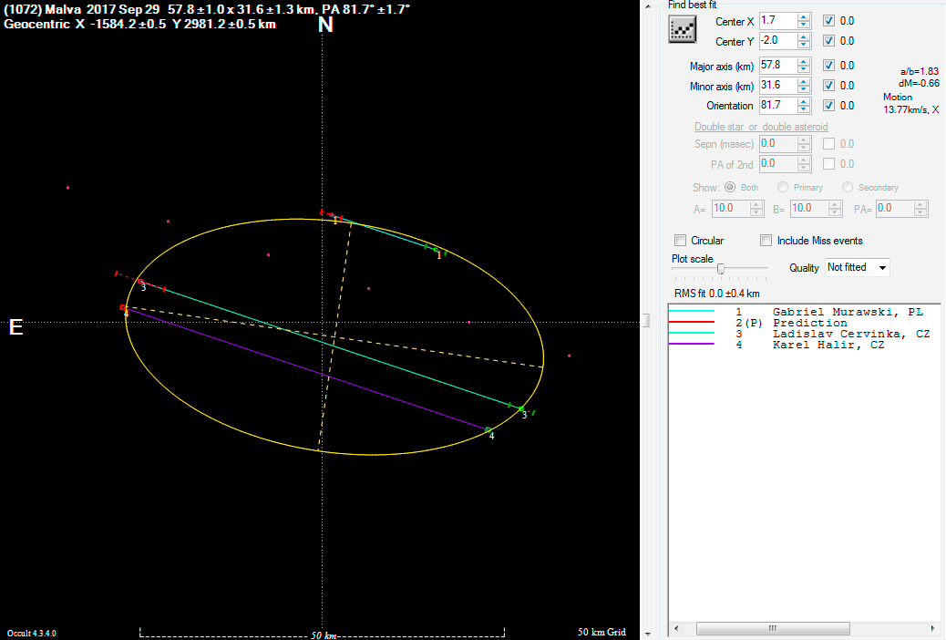
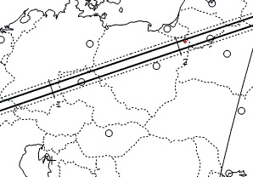
The latest activity – asteroidal occultation
In 2017, 3 of 13 asteroidal occultation observed in Poland were POSITIVE
Occultation of TYC 1870-01460-1 by (1072) Malva on 29th Sep 2017
observed by Gabriel Murawski
dur. 1.04 secs.

Slide 39
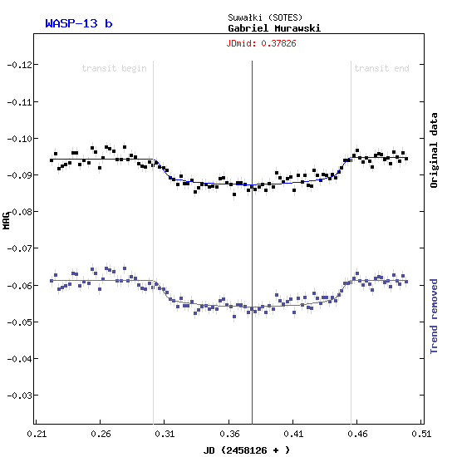
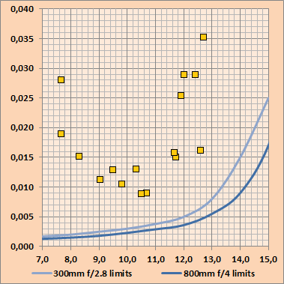
The latest activity – exoplanetary transits
Gabriel Murawski – the most active exoplanetary transit observer in Poland now
He also has dicvovered nearly 50 new variables during exoplanetary transits observations in 2017!

Slide 40
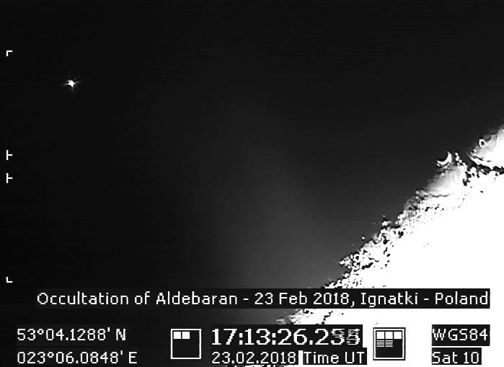
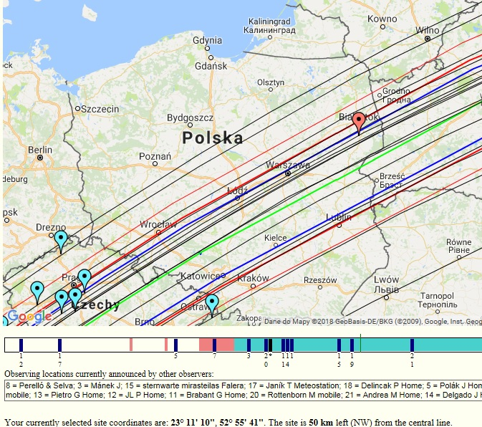
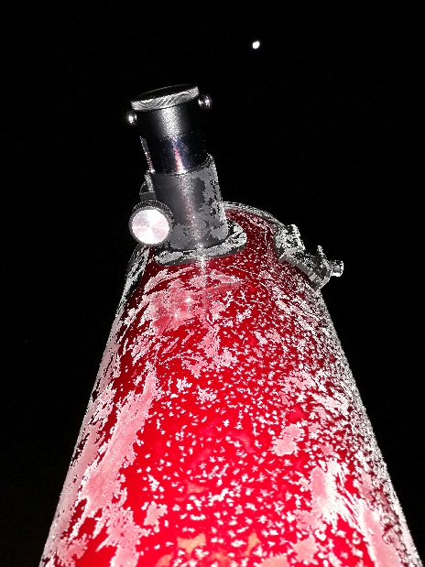
The really ☺ latest activity – 23rd Feb 2018

Slide 41
What in 2019 ?
100th anniversary of the
Polish Amateur Astronomers Society
5th October 2019, Kraków
40th anniversary of the PAAS Occultation Section
April-May 2019, Warsaw

Slide 42
Thank you for your attention Polish Amateur Astronomers Society: www.ptma.pl Occultation Section of PAAS: www.sopiz.ptma.pl

